Slide 1
Is Finer Better? A Master’s Investigation into Coarse Grading
Andrew K. Rose
NUS-Business

Slide 2
Why Do We Assess Students?
Key purpose: identify what students have learned
Determine if they have mastered the material in an absolute sense
Evaluate their understanding relative to their current and past peers
Creates incentives for students to learn the material
Also, inadvertently, distortions

Slide 3
Is a granular grading system more informative than coarser?
What I do
Compare typical fine grading (A+, A, A-, B+, …) to coarse
Recent data >1200 NUS-Business master’s students
Little information lost when three coarse used rather than ten fine passing grades
Also
NUS-Business switched from fine to coarse grading in 2021
Survey evidence from before and after change, students and staff
Student academic conduct changed little, as perceived by students and faculty

Slide 4
Primary Purposes of Grading
Encourage appropriate behavior (appropriate incentives)
Encourage adventurousness
Encourage teamwork, facilitate experiential learning,
Encourage extra-curricular engagement, leadership
Club/organization activities, networking are important, valued by recruiters and students
Be transparent, equitable and just
Faculty should adhere to policy
Contain stress to reasonable levels in faculty and students
Encouraging focus on learning, not just assessment!

Slide 5
Quick Literature Survey
Theory: coarse grading can elicit either more or less student effort than more granularity
Dubey and Geanakoplos (2010): suppose marks a function of ability, effort, randomness, and relative ranking matters
1 gets (70,80) if shirks, (80,90) with effort
2 gets (40,50) if shirks, (50-60) with effort
Grades of <50=C; >85=A; (50,85)=B elicits effort
Empirics center around impact of grade thresholds
Grant and Green (2012): no evidence of threshold effects (more student effort when pre-exam score just below threshold, no bunching just above thresholds)
Similar results: Main and Ost (2013); Oettinger (2002)

Slide 6
History: all grading schemes now coarse
Coarseness introduced explicitly to diminish motivation
A-F system began 1884 at Harvard
“The Faculty last year did away with the minute percentage system of marking, and substituted a classification of the students in each course of study in five groups … It is hoped that this grouping system will afford sufficient criteria for the judicious award of scholarships, honorable mention, and the grade of the bachelor’s degree, while it diminishes the competition for marks and the importance attached by students to College rank in comparison with the remoter objects of faithful work …”
Yale established 3-cell (pass, high pass, honors) in 1967 to reduce grade obsession
“it is believed by those members of the faculty who voted in favor of the plan that it will offer some relief from what one educator described as ‘the excessive preoccupation with number of letter grades’ … “

Slide 7
Grading Data
All (≈7000) 2019-20 masters-level NUS-Business grades, (≈1200) students, (≈200) modules (drop S/U (overseas), audited classes)
Data and Rough Hypothetical Synthetic Grades
Status Quo | Old Grades | A+ | A | A- | B+ | B | B- | C+ | C | D+ | D | F
 | Grade Points | 5 | 5 | 4.5 | 4 | 3.5 | 3 | 2.5 | 2 | 1.5 | 1 | 0
 | % | 6.9 | 18.4 | 22.8 | 23.7 | 17.0 | 7.5 | 3.0 | 0.6 | 0.0 | 0.2 | 0
Rough Synth | New Grades | Distinction |  | Merit |  |  | Pass |  |  |  |  | F
 | Grade Points | 5 |  | 4 |  |  | 3 |  |  |  |  | 0
 | % | 25.3 |  | 63.6 |  |  | 11.3 |  |  |  |  | 0

Slide 8
Harvard Business School
Category I “Given to the top 15%-20% in [required] or the top 15%-25% in [elective] courses.”
Category II “Given to the next 70%-75% in [required] or the next 65%-75% in [elective] courses … the actual number is subject to the number of Category I grades assigned.”
Category III “Given to the lowest-performing 10% of students.”
Adopted by NUS-Business for AY 2021-22

Slide 9
Why a Three-Cell System?
Encourage and reward excellence (distinction)
Deter and discourage poor performance (pass)
Encourage most other students to fixate on learning and the student experience (merit)
Also
Make life easier for faculty (fewer dividing lines that are more transparent, quantitative)

Slide 10
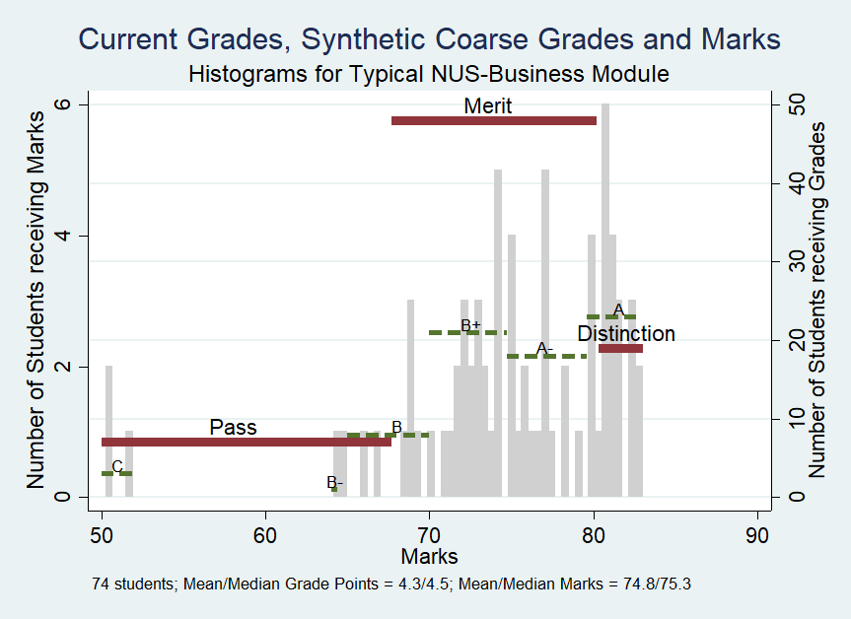
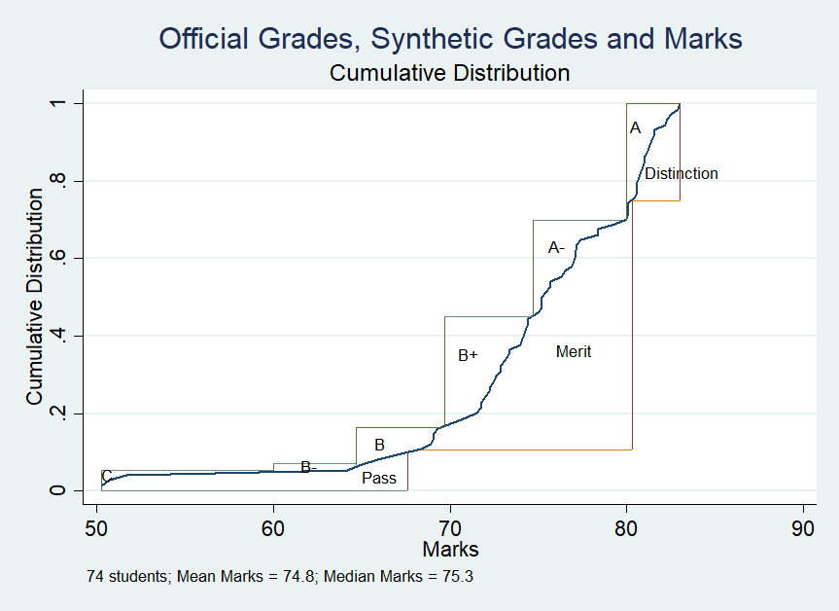
Illustrative Data: an Actual Module

Slide 11
Old and New Grade Point Distributions
 | Actual |  |  |  | If grades assigned under three-cell
Percentile | All | EMBA | MBA | MSc | All | EMBA | MBA | MSc
5% | 3 | 3 | 2.5 | 3 | 3 | 3 | 3 | 3
10% | 3 | 3 | 3 | 3.5 | 3 | 3 | 3 | 4
25% | 3.5 | 3.5 | 3.5 | 3.5 | 4 | 4 | 4 | 4
50% (median) | 4 | 4 | 4 | 4.5 | 4 | 4 | 4 | 4
75% | 5 | 4.5 | 4.5 | 5 | 5 | 4 | 4 | 5
90% | 5 | 5 | 5 | 5 | 5 | 5 | 5 | 5
95% | 5 | 5 | 5 | 5 | 5 | 5 | 5 | 5
Mean | 4.14 | 4.15 | 4.10 | 4.19 | 4.14 | 4.15 | 4.11 | 4.16
Std. Dev. | .72 | .69 | .76 | .69 | .59 | .57 | .61 | .58
Observations | 6,950 | 2,352 | 2,498 | 2,100 | 6,950 | 2,352 | 2,498 | 2,100

Slide 12
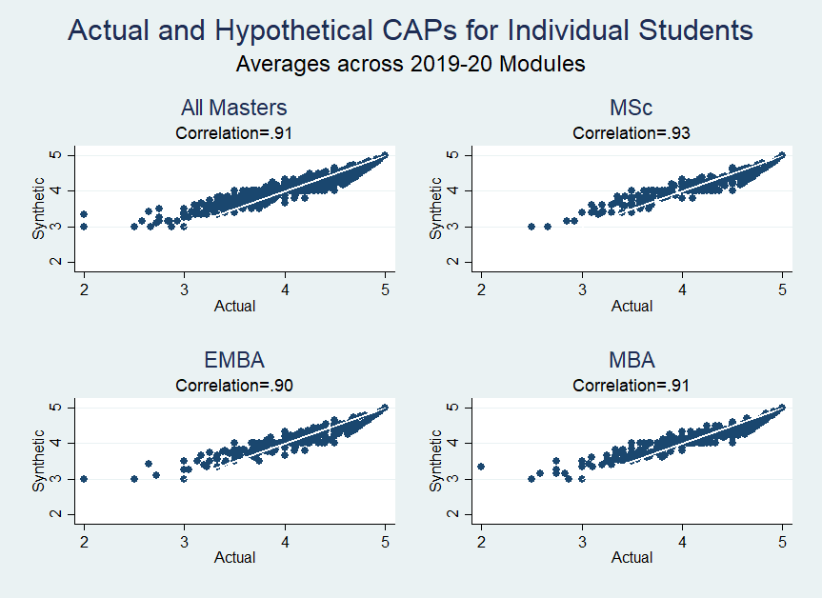
Old and New Student CAPs: Very Similar

Slide 13
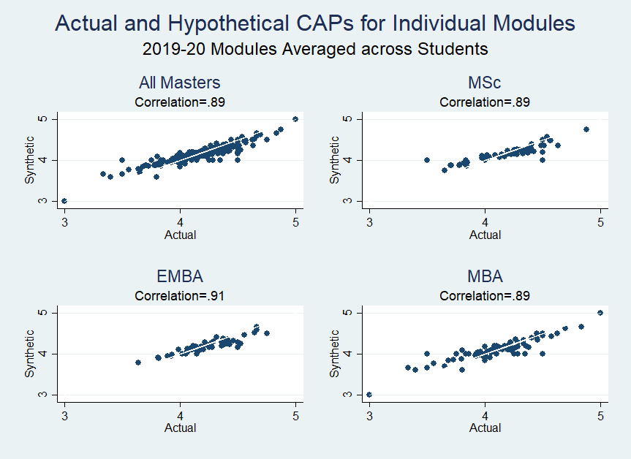
Old and New Module Averages: Very Similar

Slide 14
Statistical Analogues to Scatterplots
 | (1130) Student Averages |  | (215) Module Averages
Percentile | Actual | Hypothetical | Actual | Hypothetical
5% | 3.3 | 3.5 | 3.5 | 3.8
10% | 3.5 | 3.7 | 3.8 | 3.9
25% | 3.8 | 4 | 4 | 4
50% | 4.2 | 4.1 | 4.2 | 4.1
75% | 4.5 | 4.4 | 4.4 | 4.3
90% | 4.8 | 4.7 | 4.5 | 4.4
95% | 4.9 | 4.8 | 4.6 | 4.5
Mean | 4.15 | 4.13 | 4.15 | 4.14
Std. Dev. | .51 | .39 | .32 | .25
Std. Dev. | .51 | .39 | .32 | .25

Slide 15
Survey Results from Change in Grading Policy
NUS-Business switched fine to coarse grading, 2021
All masters-level students invited to quick survey
Semesters before (2021S2) and after (2021S1) policy change
>400 responses; no obvious selection bias
All academic and program staff also surveyed
Five-point Likert Scale

Slide 16
Survey Questions
"Grades are the key motivator for students to engage in academic work"
"I focus on my grades rather than on learning and the wider university experience"
"I spend time disputing grades/marks (e.g., arguing for A- rather than B+)“
Only after change in policy
I am less motivated to engage in academic work by the new (coarse) grading system than I was previously.

Slide 17
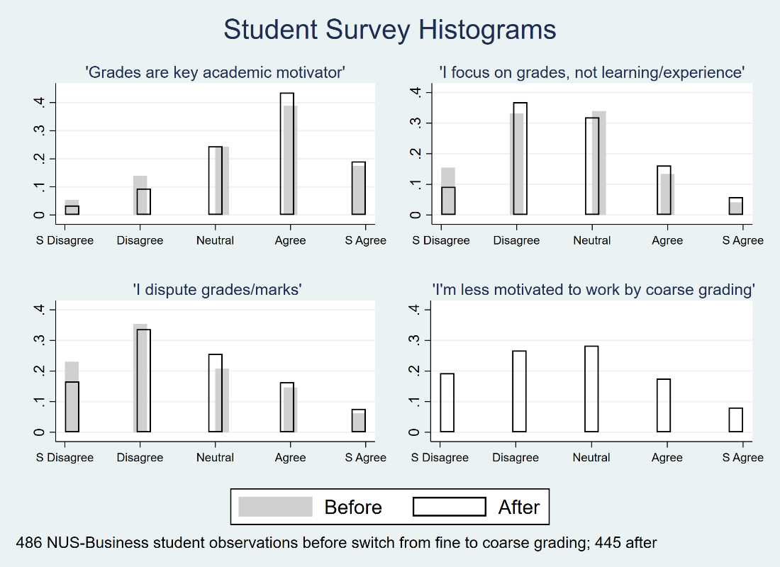
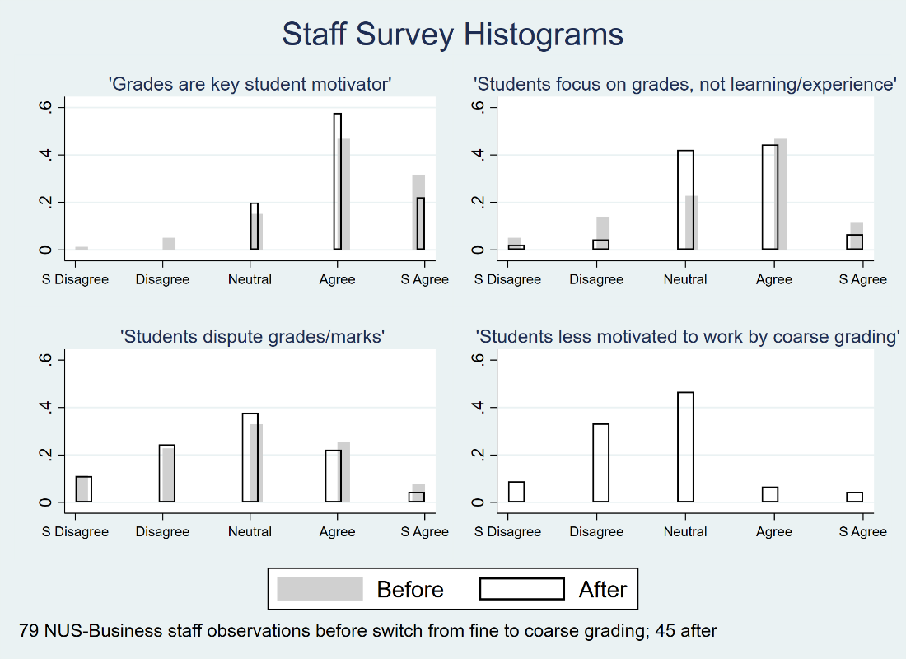
Survey Histograms: Few Differences

Slide 18
Responses before/after: very similar P-values for tests of equality (χ² , 4 df)
 |  | Obs. | Q1 | Q2 | Q3
Students | All | 931 | .10 | .03 | .07
 | MSc | 628 | .91 | .59 | .69
 | Singaporeans | 332 | .52 | .32 | .51
Staff | All | 124 | .31 | .12 | .94
 | Academic | 96 | .46 | .54 | .74

Slide 19
Different Student Responses before/after
"I focus on grades, not learning …“
Fewer disagree after change, more strongly disagree
"I dispute grades/marks"
After, more students neutral, fewer strongly disagree

Slide 20
Mostly: Little Change from Before and After
Students and staff agree grades a key academic motivator
Most students do not think they dispute grades/marks much,
Staff think that students do
Most students are focused on learning and the wider experience
Staff think students focus on grades
Only quarter of students say less motivated to academic work by coarse grading
Tenth of staff consider students to be less motivated by coarse grading.
Strong majority both staff and students thought coarse grading did not reduce student motivation, or no opinion
Consistent with hypothesis fine and coarse grading schemes convey similar information
So change has little effect on academic conduct

Slide 21
Conclusion
Little evidence that information should have or has been lost when NUS-Business moved from ten-cell to three cell grading for masters
Hoping for endogenous benefits in future:
Less stress, adherence to stated policy
Encourage adventurousness, less grade-obsession
More teamwork, experiential learning, leadership in extra-curricular/club activities
But at this point so far, few visible costs

Slide 22
Appendices/Extras

Slide 23
Other Desirable Features of Grading Systems
Green and Emerson (2007)
Transparency
Ease of implementation
Ease of aggregation across courses
Reliability across graders
Stability over time
Horizontal consistency (similar achievement receives a similar grade)
Vertical differentiation (different achievement receives different grade)

Slide 24
Transition Issues
Policy changes should be well motivated explained and
Be easy to explain to and popular with (most) potential students and employers,
Be plausible and defensible (a good pedigree helps),
Not reduce academic effort substantively,
Not adversely affect (m)any students whose tuition is paid by their employers, and
Not adversely the employment prospects of (m)any students.

Slide 25
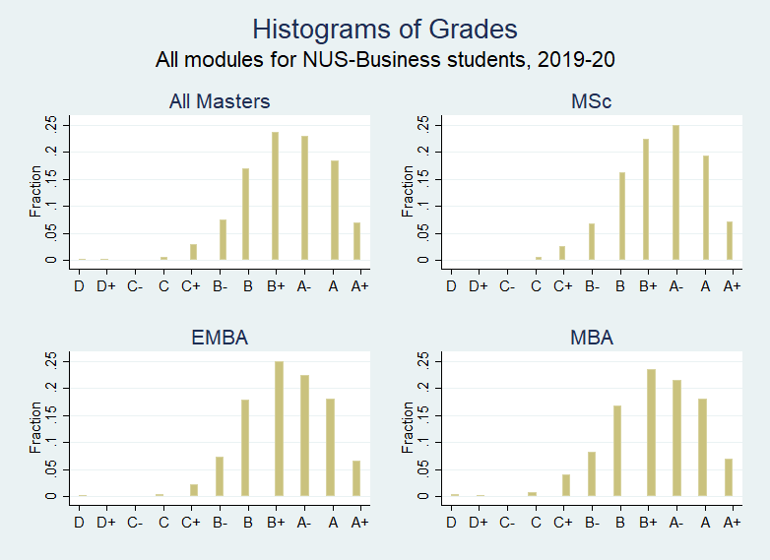
Distributions of (Old) Grades from Data
Data from all modules taken 2019-20 by master’s students at NUS-Business.
All Masters Courses |  |  | Cumulative
Grade | Freq | % | All | MSc | EMBA | MBA
D | 12 | 0.17 | 0.17 | 0.00 | 0.17 | 0.32
D+ | 1 | 0.01 | 0.19 | 0.00 | 0.17 | 0.36
C- | 0 | 0.00 | 0.19 | 0.00 | 0.17 | 0.36
C | 43 | 0.62 | 0.81 | 0.62 | 0.60 | 1.16
C+ | 206 | 2.96 | 3.77 | 3.24 | 2.76 | 5.17
B- | 519 | 7.47 | 11.24 | 9.95 | 10.03 | 13.46
B | 1,180 | 16.98 | 28.22 | 26.14 | 27.89 | 30.28
B+ | 1,645 | 23.67 | 51.88 | 48.57 | 52.85 | 53.74
A- | 1,589 | 22.86 | 74.75 | 73.67 | 75.30 | 75.13
A | 1,278 | 18.39 | 93.14 | 92.95 | 93.37 | 93.07
A+ | 477 | 6.86 | 100.00 | 100.00 | 100.00 | 100.00

Slide 26
Why Three Coarse (Passing) Cells?
Ockham’s razor
HBS Precedent
More dramatic
Bureaucracies tend to complicate, not simplify

Slide 27
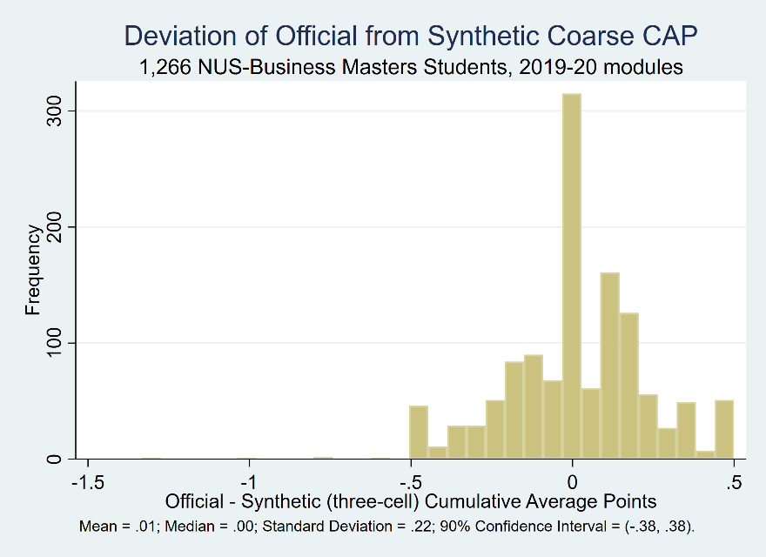
Deviation of Old from New CAPs: Small

Slide 28
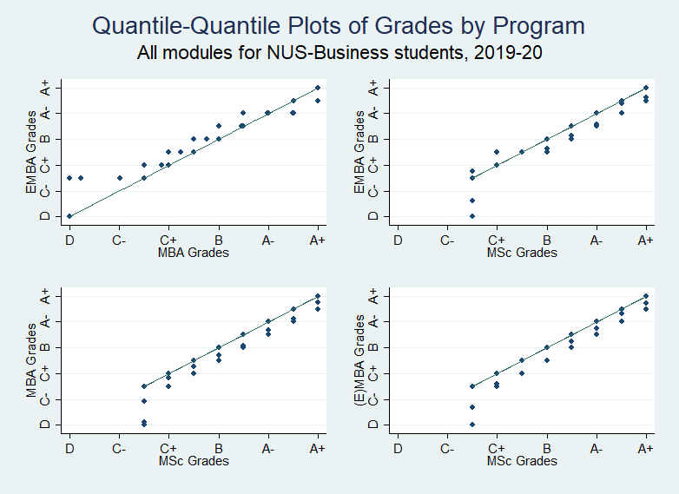
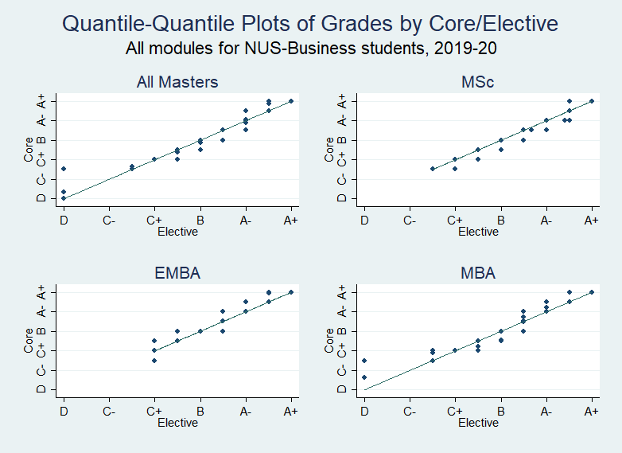
Variation across Program- or Course-Type
Program
Module

