Slide 1
Trump and Trade
Andrew K Rose
Wee Cho Yaw Visiting Fellow, NUS
Berkeley-Haas, ABFER, CEPR and NBER

Slide 2
Today’s Agenda
What Do Economists Think of Protectionism and Why?
Costs of Trump’s Protectionism
What Effect is Trump Himself Having on American Exports?
New Research linking “Soft Power” to Trade

Slide 3
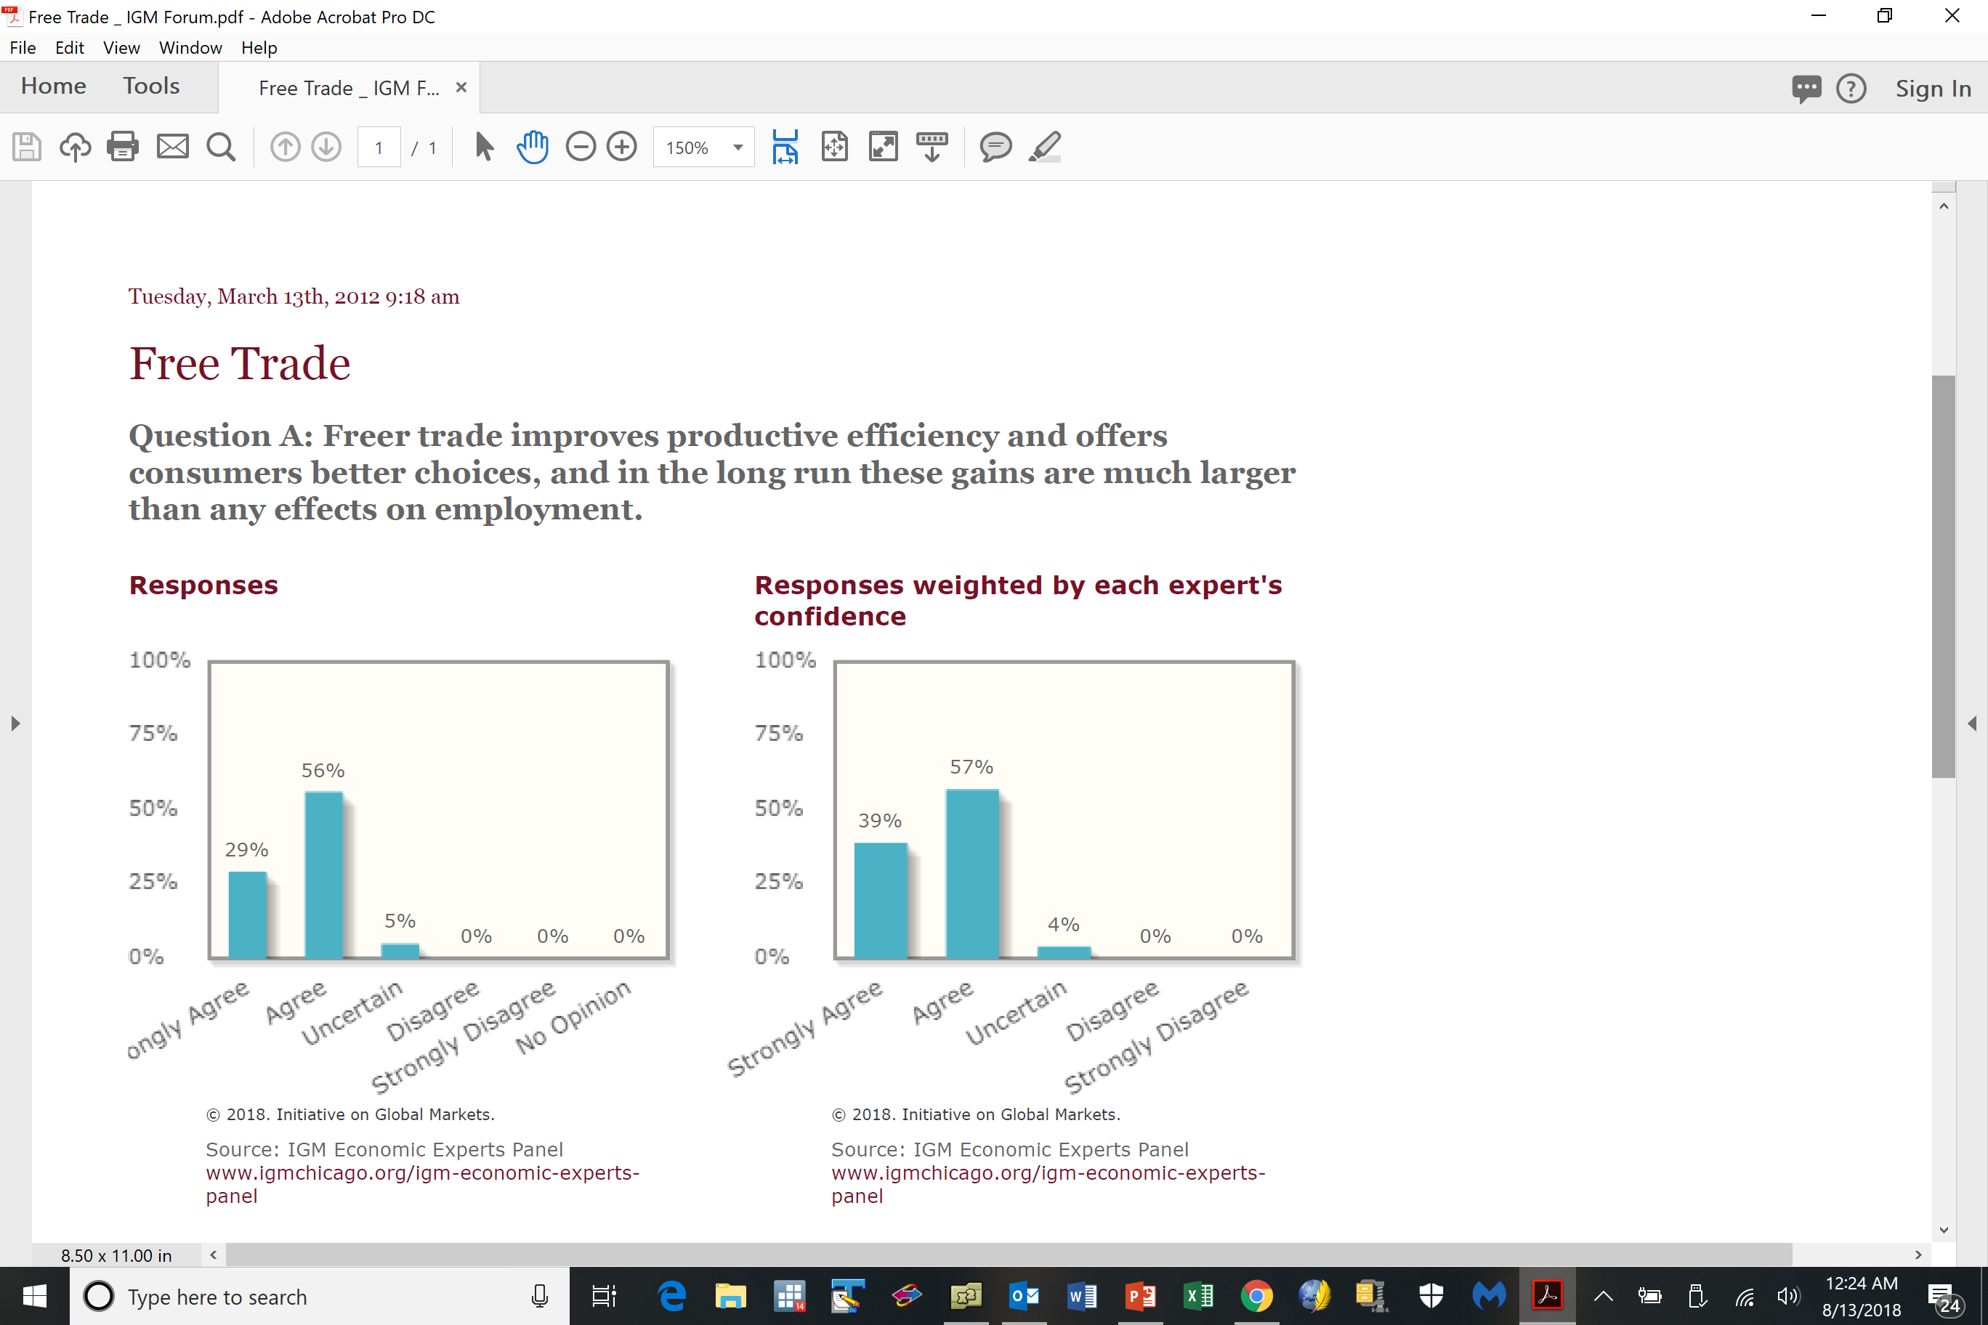
Free Trade Best: Essentially all Economists

Slide 4
Why do Essentially all Economists Agree?
(Noting how rare such agreement is)
If unrestricted markets are typically good, then protectionism is bad for the same reason
Absent a distortion/externality/market failure, one should let markets rule
Trade is a positive sum game, the way domestic transactions are
Who takes advantage of whom in a mutually agreed transaction (absent constraints, information asymmetries, etc.)?
Of course …
Free trade doesn’t help everyone in theory or practice; some factors of production can lose

Slide 5
There are sometimes market failures
But tariffs are almost never a targeted solution
One can find almost always find other policy tools with fewer side effects
Ex: if job losses painful, should assist transition across space/industry/occupation
Hence existence of social safety net; facilitates adjustment (counter to Trump policies)
Other trade barriers (quotas, NTBs, VERs) are worse than tariffs
Tariffs (as all taxes) create microeconomic distortions, inefficiency
Consumers lose (pay more) more than producers gain (higher prices)
“Harberger Triangles” are small … but add up over long periods of time
Trade is often “deflected” or “redirected”
What is a “German” car? BMWs produced in America?

Slide 6
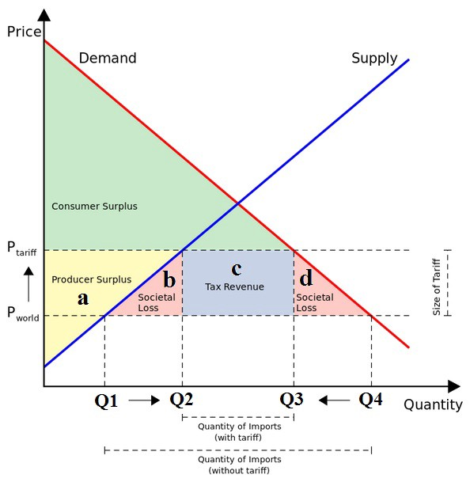
Traditional Analysis of Tariff (Harberger Triangles)

Slide 7
Economists and Free Trade, continued
Imports are often intermediate inputs, so raise costs
Especially true in Asia … and with commodities … like steel, aluminum
Tariffs redistribute “the wrong way”
From many consumers (some poor) to a few producers (usually rich)
Corrupt customs officials and smugglers benefit
Tariffs create wasteful vested interests, so hard to eliminate
Agriculture in rich countries
Tariffs invite retaliation
Especially with legacy of national humiliation – Chinese “Unequal Treaties” after Opium Wars
Tariffs have minor macroeconomic effects, especially with floating exchange rates (which tend to offset)
Without changing savings or investment, protectionism can’t change current account

Slide 8
Economists and Free Trade, more
No special concern about trade deficit
A country is not a company (Krugman); trade balance is not bottom line akin to business
Adam Smith: both sides gain even if trade is balanced
Trade deficit results from consumption > production, not “bad trade deals”
In any case, US is different:
US$ has three special roles as a currency of choice for: a) trade invoicing, b) official reserves, and c) debt issuance.
Issuing “safe assets” delivers “exorbitant privilege”

Slide 9
More on Capital Flows and Exchange Rates
American fiscal expansion pushing up US interest rates
Similarly, monetary tightening is also raising US rates
Both serve to attract capital inflows, appreciate US$
Appreciation of dollar, worsening of US current account seems likely
Will affect all countries in American sphere of financial influence – especially developing and emerging markets in Latin America, Caribbean, Asia-Pacific
Because of special role of US$ and resulting currency mismatch, US$ appreciation and access to US markets often leads to problems in developing countries (Turkey!)
Trump concern with current account deficit (≡ Savings – Investment) means that savings should rise not fall to lower current account deficit

Slide 10
Back to Economists and Free Trade
To avoid protectionism, need sustainable institutional commitment to liberal trade
Rules (on protectionism, dispute settlement, etc.) better than discretion
Uncertainty critical to encourage costly investment (but Trump likes uncertainty …)
Institutions are better than individuals
But the WTO, regional trade agreements (like NAFTA), and the rules-based trade institutions are being undermined by Team Trump
Belief that US can win more concessions unilaterally
Little supporting evidence thus far

Slide 11
Regional Trade Liberalization
Multilateral WTO-lead rounds currently dead (Doha)
Hence Regional Trade Agreements proliferating
Even better for Team Trump to push America’s weight around
Traditionally US more liberal than partners; lower American barriers less
And if old deals were so bad, why aren’t newer better deals easy to sign?
One “success” thus far: KORUS
Renegotiation trivial
Reduced Korean steel exports, maintain US tariffs on small trucks [that Korea doesn’t export] and raise Korean car import limits [that Koreans don’t buy].
Likely because of North Korean nuclear disarmament drive

Slide 12
Special Trumpian Points
Focusing on trade in goods, ignoring services is just dumb
What’s special about something you can drop on your foot?
Thinking of a G&S surplus as “good” is just dumb
Especially to potential defaulters … like Trump …
Think of a trade balance after a typical currency crisis … or Japan … or my trade balance with my son … or my son’s with UChicago …
Focus on bilateral trade balance is just dumb
Think of my trade balance with my barber
One can understand protectionism during bad times like the early 1980s (even if don’t agree). But protectionism during good times is especially perplexing
Liking strong US$ and trade surplus is contradictory and dumb

Slide 13
Trump Induces Trade Policy Uncertainty
Who gains?

Slide 14
But Trump really REALLY cares about Trade
Reducing US bilateral trade deficits is the one national “issue” Trump has consistently cared about
“Other countries are taking advantage of us”
“The United States has trade deficits with many, many countries, and we cannot allow that to continue”
“Trade wars are good and easy to win”
US is being “ripped off so badly” and “losing billions”

Slide 15
The Big Mystery
Why has my president found such a large audience?
Why no political cost from raising taxes?
Why protect inputs, focus on bilateral deficits, …?
Why has the profession failed?

Slide 16
Because … the Trade War is Here
Ironic that USA, creator of rules-based system, now undermining it
Violating old agreements raises geopolitical tension
Ex: Iran nuclear deal and Korean denuclearization
Also, ironic to have any focus on trade for US
Trade matters for employment, wages … but not that much
“China shock” well documented but finite and unusual
Consensus that automation matters much more over long periods of time
Trade just isn’t that important for US
Ordinarily, international is a backwater for American economists

Slide 17
Trade War, continued
Has it started already?
No official declaration; tariffs often raised/lowered
Trump’s steel/aluminum tariffs (Spring 2018), <5% US imports
Has not exempted allies (Canada, EU, Mexico)
WTO ignored, national security rationalization (section 232) a new (low) first
Little stock market reaction as of now
Canada, EU, Mexico, China have retaliated to steel/aluminum tariffs
Trump threatening further retaliation … and more on European autos
Trump paying farmers for lost sales
China’s response calibrated, restrained thus far … but … spiraling escalation?

Slide 18
US-China Trade War
China runs bilateral surplus, hence more to lose
(Similar to saying one country can lose more from nuclear exchange)
Hence Chinese responses targeted (pork, bourbon, soybeans, narrow body airframes, …)
Can do much more (iPhone assembly: a national security threat?) Sales of US firms in China
China has higher Export/GDP
Hence interested in preserving WTO, rules-based trading system
Also Chinese use of WTO helps other countries, provides soft power for China to pursue other initiatives (Taiwan, South China sea, etc.)
China can affect exchange rate (as they have historically)
China owns > $1 trillion of US treasuries
Unconventional weapon (harms China)

Slide 19
US-China Trade War, continued
Consensus that China does violate letter and spirit of intellectual property agreements in WTO. (Not everything Trump does is wrong!)
Industrial espionage, forced licensing and joint ventures
But ineffectual US response; more effective to create WTO-based coalition
Timing unfortunate; steel/aluminum were first, but are minor and divisive
Ironic that TPP intended to harness China, but Trump left
All in all VERY frustrating for economists!

Slide 20
New Research: Soft Power and Trade
Does Trump’s Leadership Style affect trade in and of itself?
Hard power is the ability to coerce
Grows out of country’s military and economic might
“Soft Power” (Nye) arises from attractiveness of country’s culture, political ideals and policies
“… the ability to attract, [since] attraction often leads to acquiescence … soft power uses a different type of currency (not force, not money) to engender cooperation – an attraction to shared values ...”
Does Trump’s effect on US soft power affect trade?

Slide 21
How is Soft Power Measured?
Gallup asks (≈1000) participants in (>150) countries:
“Do you approve or disapprove of the job performance of the leadership of China/Germany/Russia/UK/USA”
A standard measure of soft power
Alternatives exist (deliver similar results)
BBC asks people in (>40) countries about (17) other countries:
“Please tell me if you think each of the following are having a mainly positive or negative influence in the world?”
Pew:
“Please tell me if you have a very favorable, somewhat favorable, somewhat unfavorable or very unfavorable opinion of _____?”

Slide 22
Trump has Certainly Harmed US Soft Power

Slide 23
Still, a Range of Views Across Countries

Slide 24
Importers of US Goods Preferred Obama

Slide 25
But Does Soft Power Actually Affect Exports?
Need to control for other export determinants via “Gravity Model”
One country (e.g., US) trades more with countries which are:
Larger in economic mass (GDP)
Closer
Geographically: distance, common land border
Culturally: share language, colonial heritage
Politically: regional trade agreement
Gravity: a (rare) example of an economic model that works well in both theory and practice
Fits well; large and similar (across study) effects of income, distance
Heritage of Tinbergen (and Newton)

Slide 26
Methodology
I estimate:
ln(X_{ijt}) = γSOFTPOWER_{ijt} + β₁ln(D_{ij}) + β₂Lang_{ij} + β₃Cont_{ij} + β₄RTA_{ijt} + β₅Colony_{ij}
+ {λ_{it}} + {ψ_{jt}} + ε_{ijt}
Bilateral data, 55 Exporter-Year/1426 Importer-Year FE; 2006-17, for 5 exporters, 157 importers, 6,331 observations, LS estimation

Slide 27
Soft Power Has a Big Effect!
Log(Approval) | .66** (.12)
Log(Disapproval) |  | -.35** (.10)
Net Fraction Approval |  |  | .91** (.20)
Log Distance | -.77** (.09) | -.89** (.09) | -.83** (.09)
Common Language | .39* (.17) | .38* (.18) | .35* (.18)
Common Border | .76** (.29) | .82** (.30) | .79** (.30)
Regional Trade Agreement | .52** (.19) | .60** (.20) | .54** (.19)
Colonial Relationship | .81** (.20) | .88** (.20) | .83** (.02)
Observations | 6,331 | 6,331 | 6,331
R² | .87 | .87 | .87

Slide 28
How Big is the Trump Effect on Exports?
A 1 percentage point improvement in leadership approval raises exports by ≈.1%
Average net approval by foreigners of the American leadership fell from +16.6% in 2016 (Obama’s final year in office) to -7.4% in 2017 (the first year of the Trump presidency)
Swing of 24 percentage points in average net approval lowers American exports by (.24*.91*$1.45tn≈) .22% or $3.3 billion
Probably more because both Canada and Mexico (largest US importers) had >50% declines in net American leadership approval
Long run effects bigger than short run effects

Slide 29
Summary
Trump has had a large negative effect on global and American trade
Wrong-minded fixation on a) bilateral b) deficits in c) goods
Ignores economic and political benefits of trade, costs of protectionism, causes of aggregate deficit
Inducing retaliation and dollar appreciation
Undermining rules-based international order in trade (and security)
Ironically reducing American soft-power lowers US exports
Fundamental Problem: protectionism seems to be a “solution” in search of a problem
Incoherence stems from inability to answer: What is the American objective?
Worse to come likely!

Slide 30
Supplementary

Slide 31
Histograms of Gallup Net Approval

Slide 32
China and Russia

Slide 33
Different Measures of Soft Power
 | Good | Bad | Net | Observations
Lag of Approval, Gallup | .70** (.12) | -.38** (.10) | 1.02** (.20) | 5,812
Current+1st+2nd Lags, (χ² (1)), Gallup | .78** (27.8) | -.41** (11.5) | 1.08** (20.8) | 4,166
Log (Positive Influence), BBC | .48** (.13) | -.30** (.10) | .77** (.22) | 3,369
Log (Favorable Opinion),Pew | .55** (.17) | -.31* (.12) | .62** (.22) | 1,946

