Slide 1
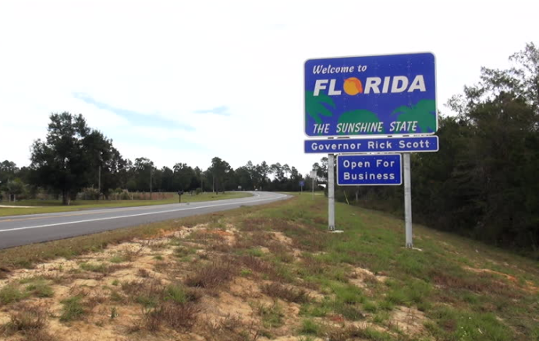
Political Borders and Bank Lending in Post-Crisis America
Matthieu Chavaz (Bank of England), Andrew K. Rose (Berkeley-Haas)
- This work only reflect the authors’ views only -

Slide 2
Motivation (I)
Are corporates benefiting from public intervention subject to political influences?
A large literature shows that political considerations influence the choice of beneficiary firms
Subventions / Public procurements / Outright bailouts
These programs can be critical, particularly in crisis times.
And they generate substantial media and political controversies.
Less evidence of how the political forces that create the programs consequently affect the economic behavior of recipients of the same programs

Slide 3
Motivation (II)
Large literature on political economy of finance and banking
Predicts two-way relationship between politicians and corporates
Politicians may encourage investment that benefit their constituents, or themselves (Shleifer & Vishny, 1994)
Responsive firms may gain access to public safety net and influence key votes (Faccio et al. 2006; Mian et al. 2010)
Gaps literature to date:
Influence on state-owned banks in environments with weak institutions (Sapienza, 2004; Dinc, 2005; Carvalho, 2014).
No US evidence, despite important notion in historical narratives (Rajan, 2009; Calomiris and Haber 2014)
Often focuses on benefits to the bank (e.g. bailout), less to the politician (bank behavior after bailout); politician behaviour (vote) also unknown

Slide 4
This paper
Objective: show how a substantive public intervention in an important market changes the investment decisions of beneficiary firms across political districts, and, in particular, how this response likely reflects political influences
Intervention=Injection of $209 billion capital into 709 banks under the 2008 Troubled Asset Relief Program (TARP)
Market=US mortgage and small business lending market
Political influences:
Congressional representatives helped applicant banks headquartered in their constituencies to gain access to the program.
Did beneficiaries, in return, increase lending in these politicians’ constituency?
Politicians tend to help firms located in their constituency more generally
So firms should have an incentive to be responsive to local politicians, particularly in a context of policy uncertainty (regulatory overhaul)

Slide 5
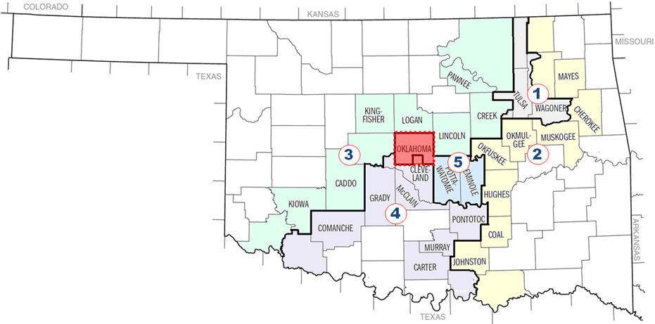
This paper
“Bailed out” US banks lend 22-60% more in (otherwise similar) neighborhoods just inside their home-Congress representative’s district.
(home-district=district in which a bank is headquartered)

Slide 6
This paper (II)
The effect is larger if the representative:
Voted for the bailout in Congress
Received more political contributions from banks
Is still in office after the Nov 2008 elections
Is member of a key committee
“Relies” more on the bank (mortgage market share)
Takeaway: political considerations influence lending decisions of banks benefiting from an important public intervention
Despite no formal interference possibilities
More so if benefits are reciprocal

Slide 7
Why Should We Care?
Effect of government intervention on credit allocation
Bailouts can create/exacerbate fragmented credit allocation.
Especially if bank activities extend across political borders.
And even in a politically/economically highly integrated area
Resolution authority in federal unions.
US: state vs. federal interests key for historically fragmented regulatory and branching system (White, 1982).
Deemed resolved by removal of barriers to intra- and interstate banking (1994 Riegle-Neal Act).
Tensions can resurface in the case of federal programs.
Support EU-wide bank resolution scheme, but cautionary note on the possibility of national distortions.
Heated debate: were “bailouts” about Wall Street or Main Street?
Perhaps both
But in a federal political structure, some Main Streets may be “more equal than others”.

Slide 8
A More Methodological Note: Difficult to Identify Political Border Effects
Three Generic Empirical Problems
Differentiating political from other borders isn’t easy
Usually regulatory/monetary/fiscal/social/cultural borders coincide with political borders
Thus can’t use international borders; same economical and political borders
Ditto intra-national borders (US states, Canadian provinces, …)
Hard to differentiate any political border effect from local demand
A perennial identification issue
Need exogenous shock that exposes some firms (not all!) to political influence in some (but not all!) areas in which they are economically active

Slide 9
We Handle All Three Problems!
American banks: intrinsically interesting industry
Especially around 2008-09 global financial crisis
Critical: a vehicle to address all three challenges
Can identify purely political border effect, accounting for local demand, with plausibly exogenous shocks
Compare areas in different political constituencies with similar economic, social, and cultural characteristics
Exploit dis-aggregated data sets to control for potential contaminating factors, including local demand
Use Troubled Asset Relief Program (TARP), hence variation by bank, hence geography
Consider both mortgage and small-business loans
Again, both intrinsically interesting, especially around Global Financial Crisis

Slide 10
Literature: Political Economy of Banking
Dominant theme: politicians extract “rents” from captive firms
Credit allocation in EM/countries with state-owned banks
Sapienza (2004 JFE): Italian state-owned banks grant cheaper loans to firms connected to the ruling party in economically depressed areas
Dinc (2005 JFE): state-owned banks grant more credit during election years.
Cole (2009 AEJ), Carvalho (JF): political-driven lending cycles in India and Brazil, respectively.
Bail-outs
Brown and Dinc (2005, QJE): Bank bankruptcy less likely during electoral years in EM.
Behm et al. (2014): bail-outs are less likely before an election in Germany.
Our Contribution:
Advanced economy
No formal link between bankers and politicians

Slide 11
Identification strategy
Discontinuities associated with congressional district borders
Most banks lend in multiple districts
Compare (same) banks in economically similar area…
… belonging to different constituencies
Comprehensive and detailed mortgage lending data (HMDA, 2006-2010)
Separate supply and demand
Match with politicians vote
TARP as shock to political connections between banks and politicians
Choice to participate; but ways to get around that (combination of IV, PSM, DIDID and fixed effects)

Slide 12
Literature: Political Economy of US Banking history
A major determinant for the evolution of the US banking system
Politicians support regulation that gave local banks monopolies White (1982 JEH), Kane (1996 JMCB); Kroszner and Strahan (1999 QJE).
Comes at the cost of
Access to credit by the broader public
Lower geographical diversification
Limited evidence for bailouts
Bank failures are 45% less likely in the year before US gubernatorial election: Liu and Ngo (2014 JFE)
Our Contribution:
Two-way relationship: politics influences bank lending
Political support for bailouts not only motivated by the special interest of banks, but also to serve broader constituent interests (access to credit).

Slide 13
Literature: Post-crisis Financial Fragmentation
Domestic politicians pursue financial protectionism via bailed-out banks (Rose and Wieladek, 2014; Kleymenova et al., 2015)
Home bias (Gianetti and Laeven, 2014).
Our Contribution:
Results possibly biased due to possible confounding factors (changes in credit demand or financial regulation).
Political interference may distort capital allocation at the international level, but also within a single country.
Easier to identify empirically/plausibly.

Slide 14
Literature: TARP
Mixed effect on credit supply
Black and Hazelwood (2013 JFS), Duchin and Sosyura (2014 JFE): recipients increase the riskiness of loans.
Our Contribution: impact on the geographic allocation of credit.
Importance of political connections:
Initial support of TARP in Congress: Mian et al. (2012 AER)
Application review process: Duchin & Sosyura (2012 JFE)
Foreclosures affected: Agarwal et al (2016)
Our Contribution: political connections affect local lending behaviour.
Motivation for political support
Mian et al. (2010): anti-foreclosure program vote determined by local defaults.
But TARP vote was unrelated to mortgage defaults.
Our Contribution: both may matter for TARP
Cost of TARP
Veronesi and Zingales (2010 JFE): transfer to shareholders from taxpayers associated with the initial bailout of the nine systemic US banks.
Our Contribution: politically-induced misallocation of credit as another cost.

Slide 15
Hypothesis Development, 1
Prior 1: Politicians could influence banks
(Duchin & Sosyura, 2012, 2014), Li (2013): Politicians intercede for banks on their vicinity
Creates a bond/pressure point
Treasury could constrain executive compensation or TARP repayment plans.
Bazazitova and Shivdasani (2013 RFS): reason for healthy recipients exiting TARP early.
CPP contracts foresaw an “exceptional” unilateral right for Congress to modify legal terms
TARP recipients are under intense regulatory scrutiny, partly by local regulators.
more lax than federal regulators (Agarwal et al. 2014 QJE).
Possible mechanisms:
“Moral suasion”
“Self-suasion”: voluntary “reward” local congressional representative to prevent any formal or informal interference.

Slide 16
Hypothesis Development, 2
Prior 2: Politicians have an incentive to exploit this pressure point to influence bank lending
Political economy foundations:
Public interest view: correct market failure (e.g. Bolton and Rosenthal, 2002 JPE)
Private interest view: Stigler, 1971, Peltzman, 1985
Channels:
Loans to small business have a direct effect on local productivity and employment (Chodorow-Reich, 2014 QJE).
Mortgage lending can indirectly boost local economic activity by increasing housing prices (Favara and Imbs, 2015 AER),
Relieve Collateral constraints (Chaney et al., 2014 AER)
Wealth effect.
Refinancing helps preventing foreclosures and negative externalities (Mian et al. 2011 NBER wp).
Cater to specific constituent interests (e.g. community activists pressure).

Slide 17
Background: American Banks and Congressional Districts
American Banking spatial fragmentation: an unusual, long-lived phenomena
Product of old barriers to intra- and inter-state banking
These caused by political economy frictions (Kroszner and Strahan, 1999)
So most banks have local footprints
Key: banking markets do not coincide with congressional districts
District maps not drawn for economic reasons; intrinsically political
Most districts must have similar number of people
Hence considerable heterogeneity in district size
Cook County IL includes eleven congressional districts
Congressional districts reallocated to state each decade
Congressional borders redrawn regularly
Most banks lend in multiple districts empirically
Most banks small (regional); county is default spatial measure in literature

Slide 18
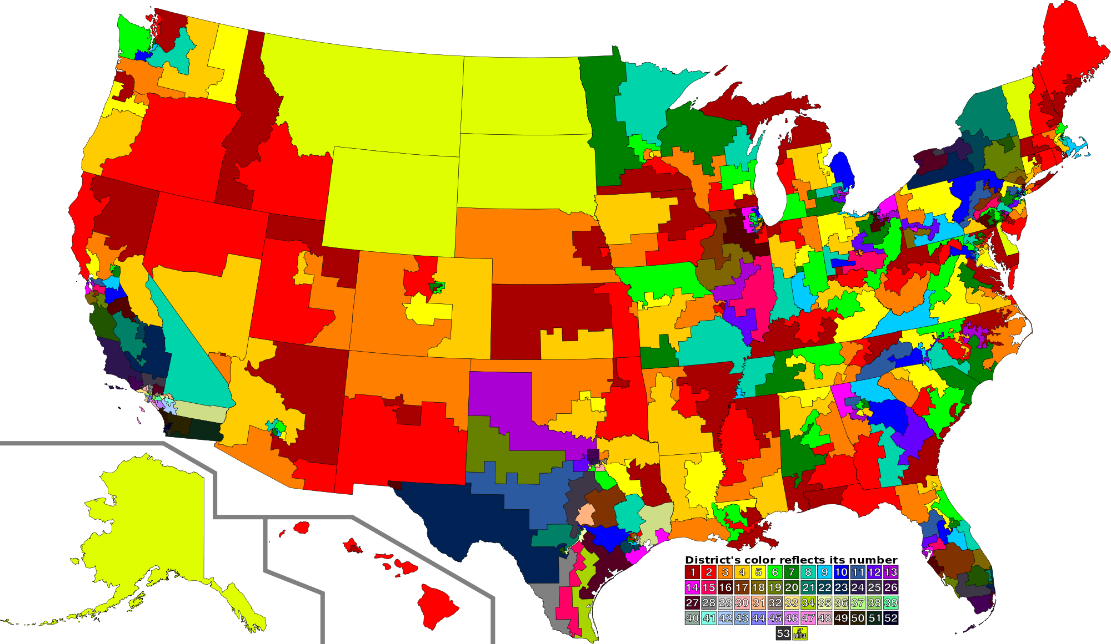
US Congressional Districts

Slide 19
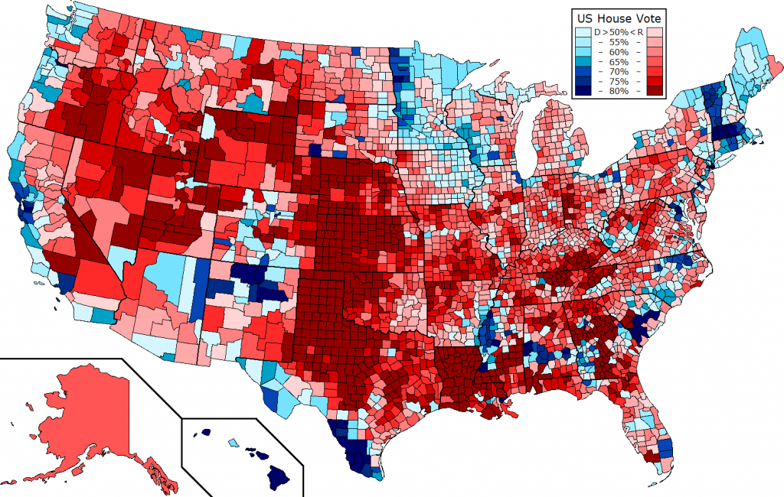
US counties

Slide 20
Empirical Strategy
Q: Do political borders matter for credit allocations of banks which received TARP?
Do TARP banks lend more in counties inside constituency of political representative where the bank is headquartered – the “home district” – as opposed to outside?
Difference-in-difference-in-difference strategy. Examine credit growth of:
TARP recipients (as opposed to non-recipients)
After TARP (as opposed to before)
Inside bank’s home district (as opposed to immediately outside)
Employ OLS and IV

Slide 21
Why TARP?
Offers banks unprecedented injection of public capital
But gives Congress representatives important levers
Tight vote in Congress (Mian et al. 2010)
Influence applications (Duchin and Sosyura, 2012)
Influence terms of repayment (Bayazitova and Shivdasani, 2011)
Do politicians use that “leverage” to influence participants lending?

Slide 22
Background: The TARP
Flagship program of Paulson’s 2008 Emergency Economic Stabilisation Act (EESA)
Originally a 700 $bn program (later reduced to 450 $bn)
14 different initiatives and programs
Lion’s share: Capital Purchase Program (CPP)
709 recipients
$204.6bn pledged
80+ investments still outstanding
Voluntary participation
All domestic banks/BHCs eligible
Terms: Purchase of preferred share by the Treasury
5% dividend (9% after five years)

Slide 23
The TARP program
Application submission
Application review
Capital injection
Local regulator
Federal regulator
US Treasury

Slide 24
Timeline
20.09.2008 | Paulson’s three page EESA proposal
29.09.2008 | EESA voted down by the House
1.10.2008 | Senates votes EESA
3.10.1008 | House votes for EESA
14.10.2008 | Treasury releases first 250 $bn CPP tranche; 125 $bn taken up by the nine big banks
4.11.2008 | 111th Congress election
14.11.2008 | Application deadline for CPP expires.
4.12.2008 | Ford, GM and Chrysler ask Senate for 34bn $CPP tranche
15.1.2009 | Senate release second 350 $bn tranche
21.1.2009 | House passes the TARP Reform and Accountability Act
18.2.2009 | Geithner announces (i) Home affordability plan, (ii) PPIP and (iii) stress tests.
9.6.2009 | Treasury approves 10 major banks to repay 68 $bn of CPP
12.2009 | Geithner asks for extension of TARP to 10.2010; To be used for foreclosure relief, SME lending (CPP into small banks) and securitisation (TALF).
2.2.2010 | Treasury announces 1 $bn TARP tranche for CDFIs .
27.09.2010 | Congress creates 30 $bn Small Business Lending Fund to incentivise TARP recipients to lend to SMEs, but used by 137 banks to repay TARP.

Slide 25
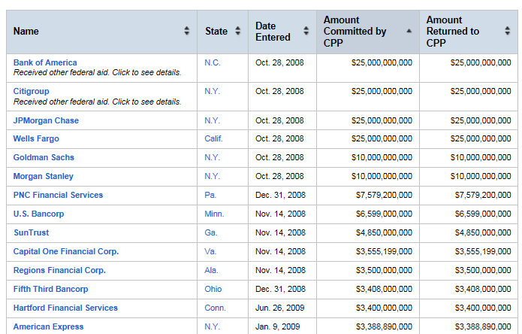
Data: TARP Participation
Source: US Treasury
Time and amount of injection
Time and amount of repayment
No data on application

Slide 26
Why TARP?
STATEMENT OF JOSEPH ZUCCHERO, OWNER, MR. BEEF DELI Chicago IL
At the 2009 Congress hearing: “Is TARP working for main street?”
“Good afternoon, Chairman Gutierrez, Ranking Member Hensarling, and members of the committee. (…) I thank the committee for inviting us to participate in this crucial hearing. I sincerely believe it is essential during this tumultuous time that the voices of small business owners are heard and those struggles are reported”.
Many small businesses are being starved of needed lines of credit or having their lines of credit not renewed upon maturity. (…) I have two relatively small loans that matured in October and November of last year. (…) Midwest Bank, which received $85 million in TARP funds, will not renew or extend mature loans any further. This places my business and my properties in jeopardy.

Slide 27
Why TARP?
Banks rushed to repay because of the associated restrictions on pay levels and the political atmosphere, (…) as soon as we announced it (…) people were saying, ‘Make them lend. Why aren’t they lending more?’ … And so I think what happened was then some banks were reticent to take the capital.

Slide 28
Why TARP?
Confronted by an Ohio congresswoman about foreclosures in her district, TARP recipient J.P. Morgan communicated that “the company lent more than $16 billion to more than 3.5 million Ohio consumers last year and provided $3.8 billion in loans to more than 70,000 companies in the state.

Slide 29
Why the home district?
Politicians are more prone to help banks located in their constituency; connections must be particularly valuable to both parties (Faccio and Parsley, 2009; Cooper et al., 2010; Cohen et al. 2013; Kim et al. 2013; Kostovertsky 2015).
Anecdotal evidence :
Should give the politician a lever to influence the bank, and the bank an incentive to respond to influences (or the threat thereof).,

Slide 30
Data: HMDA
Comprehensive coverage (mandatory reporting)
>48.3 mn loans originated by >8,000 banks in 2006-10
Borrower location information up to census tract
Keep only loans to census tracts contiguous to intrastate district borders
Add fixed effects
Borrower risk/characteristics
Loan size, income, LTI, ethnicity, gender, census tract characteristics
We only discarded applications to top-19 banks (forced to participate in TARP) … though results insensitive to inclusion

Slide 31
Empirical model
ΔLoan_{i,c,t} = β_{T}TARP_{i,t} + β_{TH}TARP_{i,t}∙Home_{i,c} + δX_{i,t} + ζZ_{i,c,t} + {η_{c,t}} + {θ_{i,c}} + ε_{i,c,t}
c=county (for single-district counties) or district (for multiple district ones)
X=bank controls; Z=borrower controls
Main challenge: TARP correlated with post-TARP Home demand.
{η_{c,t}} county-year fixed effects; {θ_{i,c}} bank-district fixed effects
Zoom onto “frontier” counties/census tracts
IV: pre-TARP political connections (Duchin and Sosyura, 2014)
Propensity Score and characteristic-by-characteristic matching
Application-level regression

Slide 32
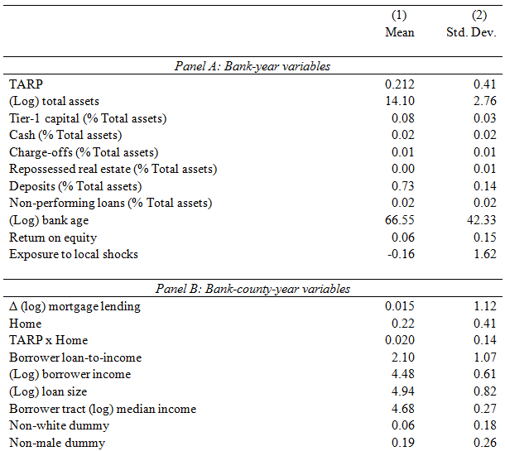
Controls

Slide 33
Zoom onto “frontier” counties/census tracts
Figure: Congressional districts and counties in the State of Oklahoma

Slide 34
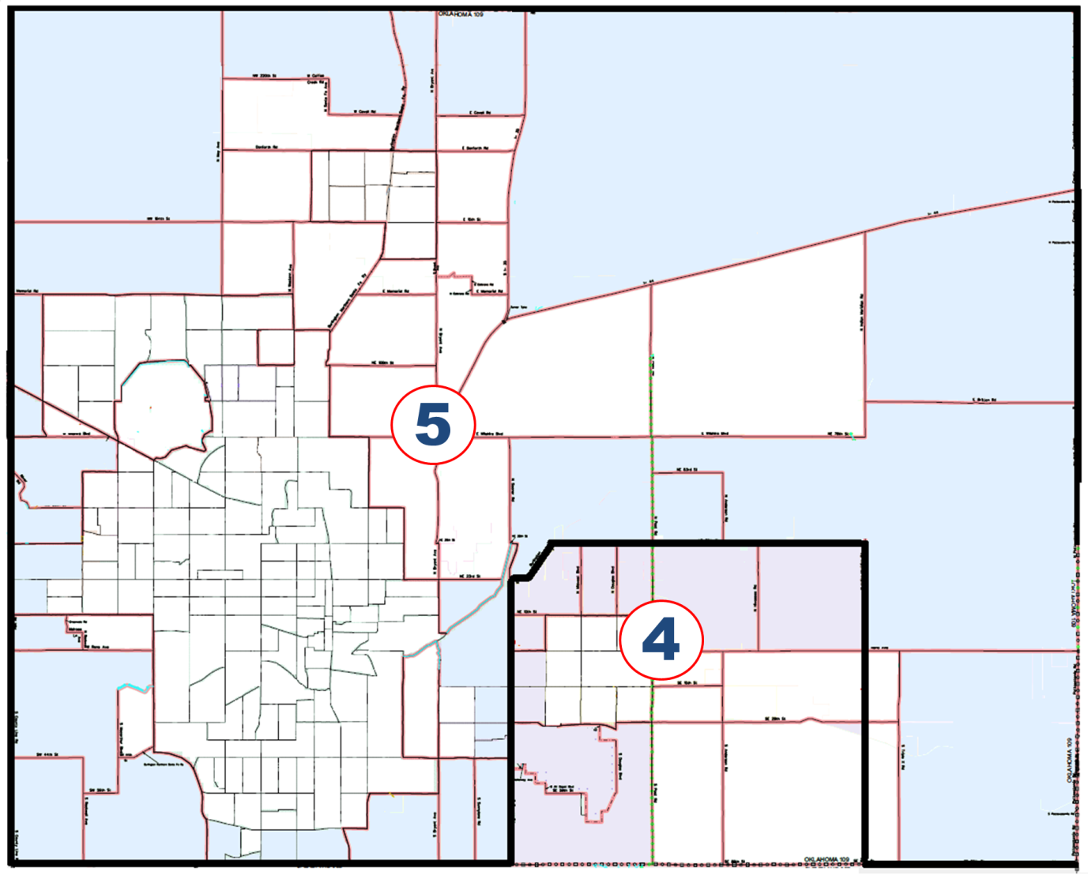
Zoom onto “frontier” counties/census tracts
Figure: Congressional districts and census tracts in the Oklahoma City county

Slide 35
Empirical Strategy, more
Bank chooses to apply for TARP, hence selection bias
Also TARP acceptance decision a choice)
Handle with instrumental variables, following Duchin and Sosyura (2012), Li (2013): pre-crisis political/regulatory connections increased chances of TARP application/approval/participation
2007Q4 cross-sectional probit for bank i‘s TARP participation:
TARP_{i} = λPolitical_{i} + ψX_{i} + ξ_{i}
Political_{i} a measure of political connections for bank i:
Fed director dummy if executive director of bank i served on the Fed BoG/regional board
Subcommittee dummy for bank i if its home district representative served on the Financial Institutions Sub-Committee of the 111th Congress
X control variables from equation (1), using 2007Q4 values
Retrieve fitted values, interact with dummy (1 post-2007, 0 ow)

Slide 36
Instrumental Variable Summary
Estimate cross-sectional probit for bank i‘s TARP participation
Construct an instrument; 0 before 2008, fitted value after:
$${\hat{TARP}}_{i,t}=\left(b∗Connections\right) if year>2008$$
$${\hat{TARP}}_{i,t}=0 otherwise.$$

Slide 37
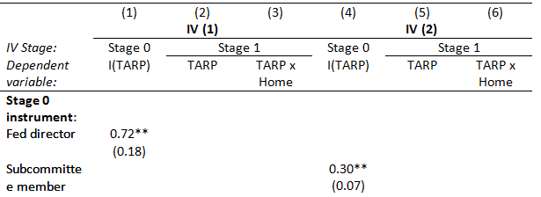
Instrumental Variable (Duchin & Sosyura 2014 JFE)
Estimate cross-sectional probit for bank i‘s TARP participation
Construct an instrument; 0 before 2008, fitted value after:
$${\hat{TARP}}_{i,t}=\left(b∗Connections\right) if year>2008$$

Slide 38
Generating the Instrumental Variables
IV Stage: | Stage 0 | Stage 1 |  | Stage 0 | Stage 1
Regressand | I(TARP) | TARP | TARP x Home | I(TARP) | TARP | TARP x Home
Fed director | 0.72**
 | (0.18)
Subcom member |  |  |  | 0.30**
 |  |  |  | (0.07)
$\hat{TARP}$ (1) |  | 0.76** | -0.013
 |  | (0.17) | (0.08)
Home x $\hat{TARP}$ (1) |  | -0.066 | 1.08**
 |  | (0.03) | (0.07)
$\hat{TARP}$ (2) |  |  |  |  | 0.74** | -0.01
 |  |  |  |  | (0.19) | (-1.84)
Home x $\hat{TARP}$ (2) |  |  |  |  | -0.09** | 1.08**
 |  |  |  |  | (0.03) | (0.08)
Observations | 6251 | 92,790 | 92,790 | 6251 | 92,790 | 92,790
Adjusted R2 |  | 0.81 | 0.44 |  | 0.799 | 0.432
F-test for both (p-value) |  | .00 | .00 |  | .00 | .00

Slide 39
Data: HMDA
Bank lending data: Home Mortgage Disclosure Act (HMDA)
240 mn applications (2003-2012)
>48.3 mn loans originated by >8,000 banks in 2006-10
Borrower location information
Comprehensive coverage
Borrower risk/characteristics
Mortgage massaging:
Discard lending by non-banks (credit unions, thrifts …), no balance sheets
Discard applications with incomplete information, overseas applicants
Discard banks without call reports
Typically drop 9-big banks (forced to participate in TARP)
Remove Fannie/Freddie and subsidised loans
Follow literature in aggregating to county-year
Key: Retain only loans to census tracts contiguous to intrastate congressional district border

Slide 40
More Data
Bank controls: Call Reports
Location of headquarters (bank/BHC)
Maintained Assumption: banks are connected to the congressional representative of the district in which it is headquartered (bank “home” district for “home representative”)
Congressional district maps: US census bureau
Congressional voting records and commission membership: House of Congress

Slide 41
Empirical Strategy, Summary
Prediction: Recipients lend more in their representative’s district (a) than elsewhere, (b) post-TARP, and (c) than non-recipients.
Difference-in-difference-in-difference approach, IV
Compare
TARP recipients vs. non-recipients
Before vs. after TARP
Lending in their representative’s district (“home”) vs. outside
Holding credit demand etc. constant
ΔLoan_{i,c,t} = β_{T}TARP_{i,t} + β_{TH}TARP_{i,t}∙HOME_{i,c} + δX_{i,t} + ζZ_{i,c,t} + {η_{c,t}} + {θ_{i,c}} + ε_{i,c,t}

Slide 42
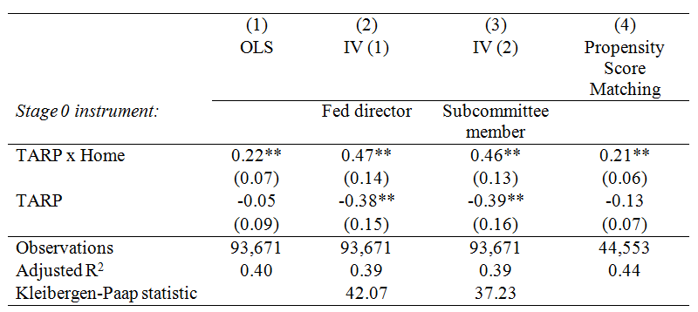
Main result: the “home-district effect”

Slide 43
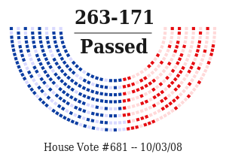
Recipients lend more in their Home Rep’s District!
Suggests an (unwritten and incomplete) “social contract”: “Funding for lending”
Moral suasion
Self-suasion
“Contract” should be more enforceable for representatives who supported TARP

Slide 44
Robustness
Drop gerrymandered districts
Drop GSE and FHA loans
County x Year x TARP fixed effects
Only rural/urban counties
Keep loans in all census tracts
Characteristic-by-characteristic matching
Placebo exercises:
No Home-district effect before TARP (2003-2007)
No Home-county effect

Slide 45
Sensitivity Analysis 1: Tarp x Home (β_{TH})
 | (1) | (2) | (3) | No. Obs.
 | OLS | IV (1) | IV (2)
Instrument: |  | Subcom. member | Fed director
Default | 0.16* | 0.37** | 0.39** | 92,790
 | (0.06) | (0.08) | (0.08)
Drop GSE-purchased loans | 0.09 | 0.24** | 0.25** | 82,902
 | (0.06) | (0.07) | (0.08)
Drop FHA/VA guaranteed loans | 0.16* | 0.36** | 0.38** | 90,358
 | (0.07) | (0.08) | (0.08)
TARP is 0 once b exits | 0.1 | 0.44** | 0.46** | 92,790
 | (0.07) | (0.1) | (0.1)
Control for TARP Exit | 0.14* | 0.34** | 0.36** | 92,790
 | (0.01) | (0.082 | (0.08)
Control for Crisis x Home | 0.084 | 0.22 | 0.23 | 92,790
 | (0.06) | (0.13) | (0.13)
No Bank Controls | 0.13 | 0.35** | 0.37** | 94,171
 | (0.07) | (0.08) | (0.08)

Slide 46
Sensitivity Analysis 2: Tarp x Home (β_{TH})
 | (1) | (2) | (3) | No. Obs.
 | OLS | IV (1) | IV (2)
Instrument: |  | Subcom. member | Fed director
1% Winsorizing | 0.15** | 0.31** | 0.33** | 92,790
 | (0.05) | (0.07) | (0.07)
Drop >2 Std | 0.12** | 0.30** | 0.33** | 87,934
 | (0.04) | (0.05) | (0.05)
Drop >3 Std | 0.13** | 0.33** | 0.34** | 91,617
 | (0.04) | (0.06) | (0.06)
2006-2009 | 0.12 | 0.47** | 0.50** | 80,581
 | (0.08) | (0.12) | (0.12)
2005-2012 | 0.13* | 0.33** | 0.36** | 122k
 | (0.05) | (0.06) | (0.06)
Keep loans in all census tracts | 0.22** | 0.55** | 0.58** | 208k
 | (0.08) | (0.09) | (0.09)

Slide 47
Sensitivity Analysis 3: Tarp x Home (β_{TH})
 | (1) | (2) | (3) | No. Obs.
 | OLS | IV (1) | IV (2)
Instrument: |  | Subcom. member | Fed director
Keep all banks | 0.15** | 0.34** | 0.36** | 116k
 | (0.05) | (0.08) | (0.08)
Drop top-19 banks (SCAP participants) | 0.14** | 0.39** | 0.40** | 74,074
 | (0.05) | (0.07) | (0.06)
County clustering | 0.16** | 0.37** | 0.39** | 92,790
 | (.03) | (.07) | (0.01)
No clustering | 0.16** | 0.37** | 0.39** | 92,790
 | (0.02) | (0.05) | (0.05)

Slide 48
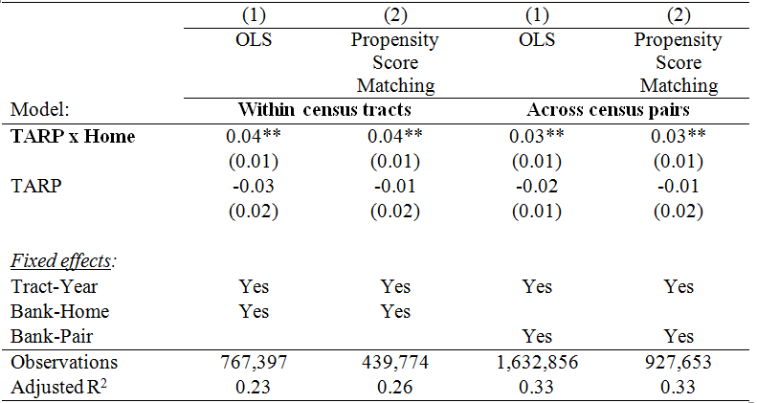
Application-level regression
Accepted_{a,i,c,t} = β_{T}TARP_{i,t} + β_{TH}TARP_{i,t}∙Home_{i,c} + δX_{i,t} + ζZ_{i,c,t} + {η_{c,t}} + {θ_{i,c}} + ε_{i,c,t}

Slide 49
Mortgages: Summary
TARP recipients do not provide higher mortgage growth on average
But do make substantially more loans to borrowers inside their home-representative’s congressional district
“Home District” effect: purely political
16 (!) robustness checks
Results do not depend delicately on minor features of methodology

Slide 50
External Validity Check: Small Business Lending
No reason “home district” effect only true of mortgages
Analysis mostly driven by (HDMA) data availability
Can do analogue for bank lending to small firms (important credit source)
Use data collected under auspices of Community Reinvestment Act (CRA)

Slide 51
Small Business Lending: Minutiae
2006-10 panel of small business loans
Two disadvantages:
Voluntary (not mandatory) participation
Aggregated to bank-county-year level (not loan-level). Hence:
Cannot control for borrower characteristics (Z)
Cannot zoom onto adjacent census tracts
Instead, use counties contiguous to congressional district borders

Slide 52
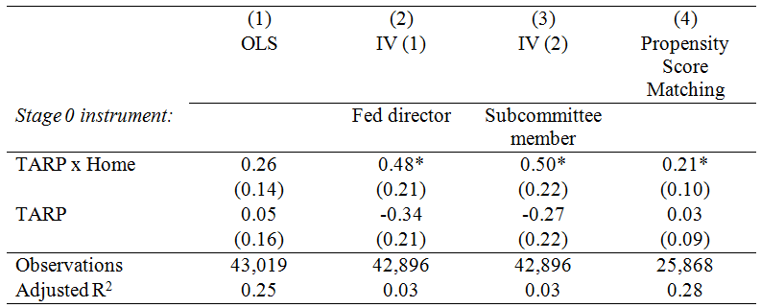
Small business lending (CRA data)

Slide 53
Small Businesses: Summary
TARP effect positive, big, significant
TARP recipients lend 70% or more
Consistent with Li (2013) positive effect of TARP on credit supply
More important: TARP x Home remains positive, economically and statistically significant with IV

Slide 54
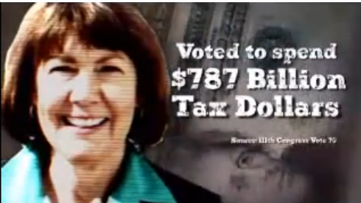
More on “Home District” Effect
Nature of mortgage lending by TARP recipients influenced by political considerations
Now try to supplement this, strengthen interpretation
TARP supporters should have:
Stronger “pressure point” on recipients
Also, higher incentive to use it
Mian et al. (2010): TARP vote determined by (i) campaign contributions by the financial industry and (ii) ideology.
TARP stigma: bailout of “Wall Street”, not “Main Street”.
Real effect on electoral outcomes
Cater to constituent interests to offset this “TARP stigma”.
Especially if they get re-elected in 2008
No reverse causality problem (timing)
Also, if in a close district (close 2008 race with tight margin)

Slide 55
Add Terms to Default Specification
We ask if “Home District” effect stronger if:
Home representative voted for Emergency Economic Stabilization Act (EESA) that created TARP?
“Yes” vote signals ability/willingness to intervene with Treasury/bank regulators to help bank needing TARP OR apply pressure on bank
So add “Yes” (1) / “No” (0) dummy to TARP x Home
Triple interaction, so IV impractical; use OLS
Result: positive effect, strengthens effect
TARP supporters got 26% more mortgage loans
Negative TARP x Yes effect means lower lending elsewhere

Slide 56
Add Different Term to Default Specification
We also ask if “Home District” effect stronger if:
Home representative voted for EESA AND won?
Elections for 111th congress took place Nov 4th, month after EESA vote
Winners have more ability to intervene, apply pressure on bank
So add “Win” (1) / “No” (0) dummy to TARP x Home
Result: positive effect, strengthens effect
TARP supporters that won got more mortgage loans

Slide 57
Add Yet Another Term to Default Specification
We finally ask if “Home District” effect stronger if:
Representative race more politically contested.
Add interaction of TARP x Home with “Margin” (margin by which bank I’s representative elected in 2008; difference in percentage votes with opponent)
Close competitors have more willingness to intervene, apply pressure
Result: negative effect, strengthens effect
More marginal candidates got more mortgage loans

Slide 58
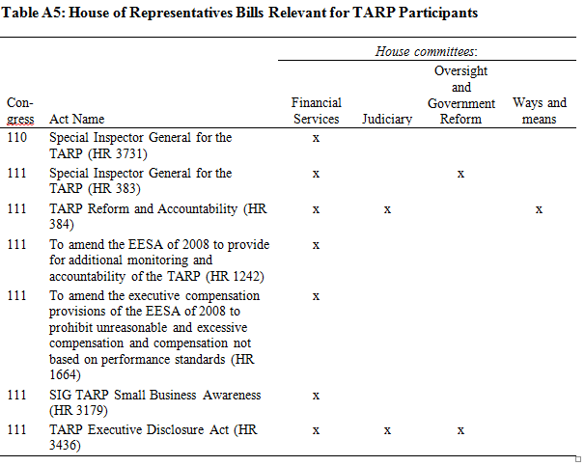
Political channels

Slide 59
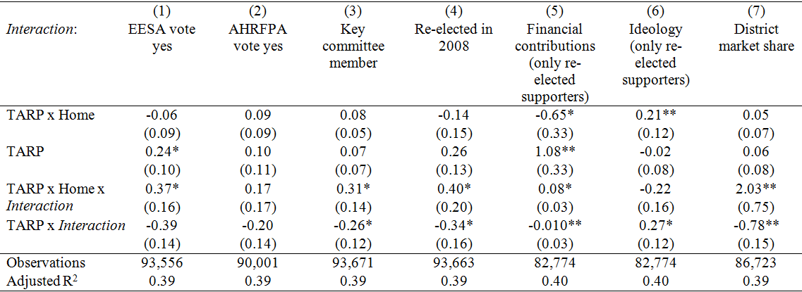
Political channels

Slide 60
Political channels

Slide 61
Political channels

Slide 62
Political channels

Slide 63
Political Effects: Summary
Supplemental evidence, not definitive
Still, all consistent with political channel:
Steers post-TARP mortgage growth to areas within district borders of bank’s congressional representative
Stronger for:
Representatives that supported TARP, and
Were re-elected,
Narrowly.

Slide 64
What did we learn?
Home-district effect: “bailed out” banks rebalance lending towards their home-representative’s district
Takeaway: political considerations influence US bank lending decisions
Despite no formal interference possibilities
More so if benefits are reciprocal
Complements recent US evidence:
Akey et al. (2016): consumer lending and powerful congress reps
Agarwal et al. (2016): foreclosures and powerful congress reps.
Ours: willingness and ability to help depends on a combination of factors.

Slide 65
What did we learn? TARP
TARP has increased lending riskiness, not volume (Black and Hazelwood, 2013; Li, 2013; Duchin and Sosyura, 2014)
Why were politicians so keen for their banks to participate?
Our findings: some constituents benefited more than others.

Slide 66
What did we learn? Policy
Lessons for resolution/regulatory regimes
Bailouts can create/exacerbate fragmented credit allocation.
Especially if bank activities extend across political borders.
And even in a politically/economically highly integrated area
Tragedy of the commons: even a benevolent politician will care about market failures in its own constituency only
Resolution authority in federal unions.
US: state vs. federal interests key for historically fragmented regulatory and branching system (White, 1982).
Deemed resolved by removal of barriers to intra- and interstate banking (1994 Riegle-Neal Act).
Tensions can resurface in the case of federal programs.
Support EU-wide bank resolution scheme, but cautionary note on the possibility of national distortions.
Heated debate: are “bailouts” about Wall Street or Main Street?
Perhaps both
But some Main Streets may be “more equal than others”.

