Slide 1
“The Macroeconomic Consequences of Tariffs”
Davide Furceri (IMF) Swarnali A. Hannan (IMF),
Jonathan D. Ostry (IMF) and Andrew K. Rose (Berkeley)
19th Jacques Polack Annual Research Conference
Washington DC, November 1-2, 2018
The views expressed in this paper are those of the authors and do no necessarily represent the views of the IMF, its Executive Board, or IMF Management.

Slide 2
Motivation
  Agreement among economists that international trade should be free…
      “Deadweight loss” associated with tariffs
  Even in the presence of market imperfections, tariffs are not the optimal solution
…and that tariffs should not be used as a macroeconomic policy
      Broad imposition of tariffs may lead to offsetting change in the exchange rate (Dornbush 1974; Edwards 1989) with little effect on the trade balance
      Superior alternatives such as monetary and fiscal policy
  Indeed, protectionism has not been much used in practice as a macroeconomic policy…until now…
2

Slide 3
Contribution and research questions
  Contribution
  Re-examine the macroeconomic consequences of tariffs
      Predisposition against protectionism is based on evidence that is either a) theoretical, b) micro, or,
      c) aggregate and dated
  Research questions
What are the macroeconomic consequences of tariffs?
      We look at the effect of tariffs on key variables of interest: output , productivity, unemployment, inequality, the real exchange rate, and the trade balance
      We examine three distinct features of the actual policy context: tariffs are increasing, in advanced economies, in a period of economic expansion
3

Slide 4
Approach
  We adopt a transparent and conservative approach:
      Large (unbalanced ) panel data covering 151 countries from 1996 to 2014
      Using Jorda’s (2005) LPM, to account for non-linearity without imposing much dynamic restrictions
      We try to be conservative: limit the response to the medium term; cost of tariff as a lower bound of the costs of protectionism; domestic focus; possible second round effects due to retaliation
      We complement the analysis with industry-level data to address some empirical limitation and shed lights on some of the channels through which tariffs affect output and productivity
4

Slide 5
Data
Macroeconomic variables
Data for annual GDP, labor productivity (defined as the ratio of GDP to employment), the unemployment rate, real effective exchange rates (period average, deflated by CPI) and the trade balance (period average, deflated by GDP) are taken from IMF WEO and World Bank WDI
Data on the Gini coefficient from the Standardized World Income Inequality Database (SWIID)
Tariff data
Our tariff series, T, is based on trade tariff rate data at the product level. The main sources are the World Integrated Trade Solution (WITS) and World Development Indicators (WDI); other data sources include: the World Trade Organization (WTO); the General Agreement on Tariffs and Trade (GATT); and the Brussels Customs Union database (BTN)
We aggregate product-level tariff data by calculating weighted averages, with weights given by the export share of each product, measured as fractions of value
5

Slide 6
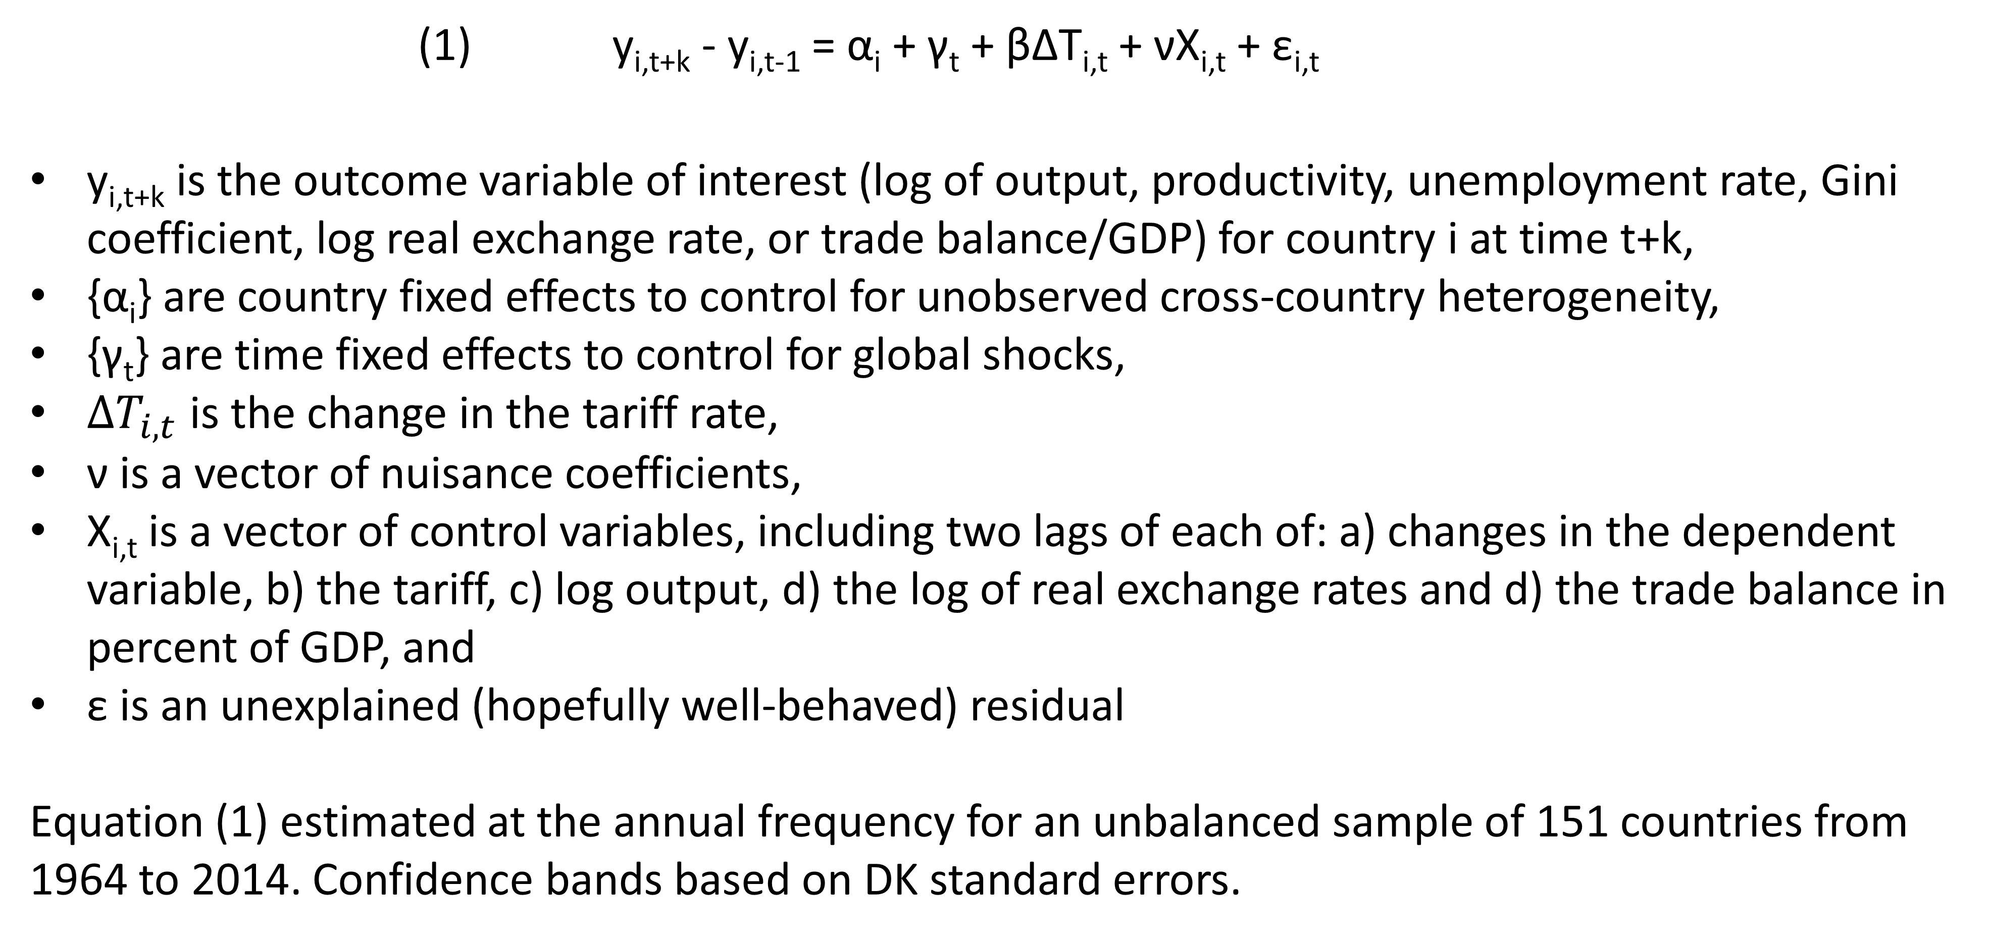
Methodology
    (1) y_{i,t+k} - y_{i,t-1} = α_{i} + γ_{t} + βΔT_{i,t} + νX_{i,t} + ε_{i,t}
y_{i,t+k} is the outcome variable of interest (log of output, productivity, unemployment rate, Gini coefficient, log real exchange rate, or trade balance/GDP) for country i at time t+k,
{α_{i}} are country fixed effects to control for unobserved cross-country heterogeneity,
{γ_{t}} are time fixed effects to control for global shocks,
$∆T_{i,t}$ is the change in the tariff rate,
ν is a vector of nuisance coefficients,
X_{i,t} is a vector of control variables, including two lags of each of: a) changes in the dependent variable, b) the tariff, c) log output, d) the log of real exchange rates and d) the trade balance in percent of GDP, and
ε is an unexplained (hopefully well-behaved) residual
Equation (1) estimated at the annual frequency for an unbalanced sample of 151 countries from 1964 to 2014. Confidence bands based on DK standard errors.
6

Slide 7
Industry-level analysis
(1’) y_{j,i,t+k} - y_{j,i,t-1} = α_{ij} + γ_{it} + ρ_{jt} + β^{I}ΔT_{j,i,t}^{I} + β^{O}ΔT_{j,i,t}^{O} + νX_{j,i,t} + ε_{j,i,t}
T_{j,i,t}^{O} is output tariff in each sector j, that is, the 2-digit level corresponding tariff rate.
T_{j,i,t}^{I} is input tariffs, computed as weighted average of output tariffs in all sectors, with weights reflecting the share of imported inputs from each of these sectors used in the production of sector j’s total input
Equation (1’) is estimated at the annual frequency for an unbalanced panel with 16 sectors for 39 countries over the period 1991-2014. Confidence bands based on DK standard errors.
The effect on aggregate value added of a tariff increase in sector j can be expressed (in the absence of output spillovers across sectors) as the sum of the effect of the tariff increase on the value added of sector j (output tariff effect) and its effect on the value added of all remaining sectors (effect through the input channel)
7

Slide 8
Tariff increases lead to declines in output and productivity
Output (%)
Productivity (%)
Note: The solid lines indicate the response of output (productivity) to one-standard deviation (about 3.6 percentage points) increase in the tariff rate; dotted lines correspond to 90 percent confidence bands. The x-axis denotes time. t=0 is the year of the reform. Estimates based on equation (1).
8

Slide 9
And increases in unemployment and inequality
Unemployment (ppt)
Inequality (ppt)
Note: The solid lines indicate the response of unemployment (inequality) to one-standard deviation (about 3.6 percentage points) increase in the tariff rate; dotted lines correspond to 90 percent confidence bands. The x-axis denotes time. t=0 is the year of the reform. Estimates based on equation (1).
9

Slide 10
RER appreciates leading to not much effect on trade balance
RER (%)
Trade balance (ppt of GDP)
Note: The solid lines indicate the response of RER (trade balance) to one-standard deviation (about 3.6 percentage points) increase in the tariff rate; dotted lines correspond to 90 percent confidence bands. The x-axis denotes time. t=0 is the year of the reform. Estimates based on equation (1).
10

Slide 11
Larger effects for tariff increases…
Output (%)—tariff increases
Productivity (%)—tariff increases
Output (%)—tariff decreases
Productivity (%)—tariff decreases
Note: The solid lines indicate the response of output (productivity) to one-standard deviation (about 3.6 percentage points) change in the tariff rate; dotted lines correspond to 90 percent confidence bands. The dashed red lines denote the baseline effect. Estimates based on:
y_{i,t+k} - y_{i,t-1} = α_{i} + γ_{t} + β^{P} DP_{i,t}ΔT_{i,t} + β^{N} (1-DP_{i,t})ΔT_{i,t} + νX_{i,t} + ε_{i,t}; where DP_{i,t} is a binary variable which is equal to unity when the change in tariff is positive, zero otherwise.
11

Slide 12
…in advanced economies…
Output (%)—AEs
Productivity (%)—AEs
Output (%)—EMDEs
Productivity (%)—EMDEs
Note: The solid lines indicate the response of output (productivity) to one-standard deviation (about 3.6 percentage points) change in the tariff rate; dotted lines correspond to 90 percent confidence bands. The dashed red lines denote the baseline effect. Estimates based on:
y_{i,t+k} - y_{i,t-1} = α_{i} + γ_{t} + β^{P} DA_{i,t}ΔT_{i,t} + β^{N} (1-DA_{i,t})ΔT_{i,t} + νX_{i,t} + ε_{i,t}; where DA_{i,t} is a binary variable which is equal to unity for advanced economies, zero otherwise.
12

Slide 13
…and in expansions
Output (%)—Expansions
Productivity (%)—Expansions
Output (%)—Recessions
Productivity (%)—Recessions
Note: The solid lines indicate the response of output (productivity) to one-standard deviation (about 3.6 percentage points) change in the tariff rate; dotted lines correspond to 90 percent confidence bands. The dashed red lines denote the baseline effect. Estimates based on:
y_{i,t+k} - y_{i,t-1} = αi + γt + β^{L}F(z_{i,t})ΔT_{i,t} + β^{H}(1- F(z_{i,t})ΔT_{i,t} + φZ_{i,t} + ε_{i,t}; where F(.) is a smooth transition function of economic conditions.
13

Slide 14
Robustness checks
Changing our key regressor (percent changes instead of absolute changes)
Concerns about endogeneity
VAR analysis (tariff ordered last)
Controlling for contemporaneous effect of RER and trade balance
Controlling for future economic growth (that is, growth forecast)
IV: weighted average of changes in tariff in major (top 5) trading partners
Concerns about sample
Drop series with gaps and less than 20 consecutive years
Drop high inflation episodes, small countries, outliers, high tariff episodes
Sample after 1979, excluding Americas, Asia and SSA
14

Slide 15
Robustness checks—endogeneity
Output (%)—VAR
Productivity (%)—VAR
Output (%)—IV
Productivity (%)—IV
15
Note: The solid lines indicate the response of output (productivity) to one-standard deviation (about 3.6 percentage points) increase in the tariff rate. The dashed red lines denote the baseline effect. Dotted lines correspond to 90 percent confidence bands of the baseline estimate.

Slide 16
Industry-level analysis
Output (%)—Input tariff
Productivity (%)—Input tariff
Output (%)—Output tariff
Productivity (%)—Output tariff
16
Note: The solid lines indicate the response of output (productivity) to one-standard deviation increase in input and output tariffs; dotted lines correspond to 90 percent confidence bands. Estimates based on equation (1’).

Slide 17
Summary and caveats
  Aversion of economics profession to the deadweight losses caused by protectionism seems motivated
  Tariffs lead to declines in output and productivity, increases in unemployment and inequality
  Effects larger for tariff increases, for AEs and in expansions
Limitations
      Hard to isolate causal effects, despite robustness checks mitigate this concern
      Results may underestimate the effect in case of retaliation
17

Slide 18
“The Macroeconomic Consequences of Tariffs”
Davide Furceri (IMF) Swarnali A. Hannan (IMF),
Jonathan D. Ostry (IMF) and Andrew K. Rose (Berkeley)
19th Jacques Polack Annual Research Conference
Washington DC, November 1-2, 2018
The views expressed in this paper are those of the authors and do no necessarily represent the views of the IMF, its Executive Board, or IMF Management.

