Slide 1
Agent Orange: Trump, Soft Power, and Exports
Andrew K Rose
Berkeley-Haas, ABFER, CEPR and NBER

Slide 2
Today’s Agenda
What Effect is Trump Himself Having on American Exports?
New Research linking “Soft Power” to Trade
New Research on Macroeconomic Tariff Effects
What Do Economists Think of Protectionism and Why?

Slide 3
Soft Power and Trade
Does Trump’s Leadership Style affect trade in and of itself?
Hard power is the ability to coerce
Grows out of country’s military and economic might
“Soft Power” (Nye) arises from attractiveness of country’s culture, political ideals and policies
“… the ability to attract, [since] attraction often leads to acquiescence … soft power uses a different type of currency (not force, not money) to engender cooperation – an attraction to shared values ...”
Does Trump’s effect on US soft power affect trade?

Slide 4
How is Soft Power Measured?
Gallup asks (≈1000) participants in (>150) countries:
“Do you approve or disapprove of the job performance of the leadership of China/Germany/Russia/UK/USA”
A standard measure of soft power
Alternatives exist (deliver similar results)
BBC/GlobeScan asks people in (>40) countries about (17) other countries:
“Please tell me if you think each of the following are having a mainly positive or negative influence in the world?”
Pew Research asks people in (>60) countries about (27) other countries:
“Please tell me if you have a very favorable, somewhat favorable, somewhat unfavorable or very unfavorable opinion of _____?”

Slide 5
Informally: Trump has Harmed US Soft Power

Slide 6
Still, a Range of Views Across Countries

Slide 7
Histograms of Gallup Net Approval

Slide 8
Heterogeneity Critical
Cross-country variation allows panel estimation
Time-Series variation allows within estimation (fixed effects)
Note that Trump about as popular as Bush
So data within standard range of variation

Slide 9
Importers of US Goods Preferred Obama

Slide 10
Contrast China and Russia: Lined up on 45⁰

Slide 11
Bush vs. Trump; roughly comparable

Slide 12
But Does Soft Power Actually Affect Exports?
Need to control for other export determinants via “Gravity Model”
One country (e.g., US) trades more with countries which are:
Larger in economic mass (GDP)
Closer
Geographically: distance, common land border
Culturally: share language, colonial heritage
Politically: regional trade agreement
Gravity: a (rare) example of an economic model that works well in both theory and practice
Fits well; large and similar (across study) effects of income, distance
Heritage of Tinbergen (and Newton)

Slide 13
Estimating Equation
Least Squares with Dummy Variables (Head-Mayer LSDV):
ln(X_{ijt}) = γSOFTPOWER_{ijt} + β₁ln(D_{ij}) + β₂Lang_{ij} + β₃Cont_{ij} + β₄RTA_{ijt} + β₅Colony_{ij}
+ {λ_{it}} + {ψ_{jt}} + ε_{ijt}
One-way trade flows a function of measures of distance (geography, language, policy, history)
Fixed effects (exporter/importer x time) do most of the work, cover all monadic constant/time-varying determinants
55 Exporter-Year/1426 Importer-Year FE

Slide 14
Data
Bilateral DoTS data from IMF
2006-17, for 5 exporters, 157 importers, 6,331 observations, LS estimation
CIA World Factbook for country-specific variables
(All available online at my website)

Slide 15
Soft Power Has a Big Effect!
Log(Approval) | .66** (.12)
Log(Disapproval) |  | -.35** (.10)
Net Fraction Approval |  |  | .91** (.20)
Log Distance | -.77** (.09) | -.89** (.09) | -.83** (.09)
Common Language | .39* (.17) | .38* (.18) | .35* (.18)
Common Border | .76** (.29) | .82** (.30) | .79** (.30)
Regional Trade Agreement | .52** (.19) | .60** (.20) | .54** (.19)
Colonial Relationship | .81** (.20) | .88** (.20) | .83** (.02)
Observations | 6,331 | 6,331 | 6,331
R² | .87 | .87 | .87

Slide 16
Result is Robust
Different Measures of Soft Power
Different cuts of the data, variants of the functional form, …
Different estimators;
Instrumental variables
Dyadic (pair-specific) fixed effects
PPML to account for zeros in regressand, heterogeneity ...

Slide 17
Robustness: Different Measures of Soft Power
 | Good | Bad | Net | Observations
Lag of Approval, Gallup | .70** (.12) | -.38** (.10) | 1.02** (.20) | 5,812
Current+1st+2nd Lags, (χ² (1)), Gallup | .78** (27.8) | -.41** (11.5) | 1.08** (20.8) | 4,166
Log (Positive Influence), BBC | .48** (.13) | -.30** (.10) | .77** (.22) | 3,369
Log (Favorable Opinion),Pew | .55** (.17) | -.31* (.12) | .62** (.22) | 1,946

Slide 18
Sensitivity Analysis
 | Ln Approval | Ln Disapp | Net Approv |  | Ln Approval | Ln Disapp | Net Approv
Drop gravity covariates | 1.45** (.14) | -.78** (.13) | 2.15** (.23) | Drop Industrial Exporters | 1.53** (.31) | -.86** (.30) | 2.54** (.69)
Sub Exp, Imp, Time FE | .41** (.07) | -.23** (.06) | .64** (.14) | Drop Industrial Importers | .93** (.15) | -.44** (.11) | 1.31** (.25)
Add Dyadic FE | .03 (.05) | -.06 (.04 | .20* (.08) | Drop >|2.5σ| residuals | .62** (.10) | -.32** (.09) | .79** (.17)
Drop 2006-09 | .76** (.14) | -.43** (.12) | 1.01** (.22) | Conventional standard errors | .66** (.05) | -.35** (.04) | .91** (.08)
Drop 2014-17 | .66** (.12) | -.33** (.10) | .99** (.21) | IV (BBC inf; 975 obs) | .39** (.12) | -.28* (.12) | .57** (.20)
2009 | .58** (.15) | -.26* (.11) | .90** (.26) | IV (Pew favo; 835 obs) | .53** (.13) | -.20 (.14) | .55** (.21)
2014 | .53** (.18) | -.39* (.15) | .71* (.28) | IV (others’ appr, <20% export) | .59** (.06) | .03 (.05) | .41** (.09)
Drop United States | .73** (.14) | -.43** (.12) | 1.04** (.24) | IV (others’ appr, <10% export) | .24** (.08) | .07 (.07) | .15 (.12)

Slide 19
PPML, with Dyadic FE added
 | Ln Approval | Ln Disapp | Net Approv |  | Ln Approval | Ln Disapp | Net Approv
Default | .052* (.022) | -.024 (.022) | .101** (.038) | Drop 2006 | .048* (.022) | -.033 (.022) | .109** (.037)
Approval Level (not log), Gallup | .0020** (.0007) | -.0019** (.0007) | n/a | Drop 2017 | .058** (.022) | -.029 (.022) | .116** (.039)
Log (Influence), BBC | .064** (.018) | -.010 (.014) | .077** (.029) | Only industrial Exporters | .070* (.029) | -.058* (.023) | .069* (.034)
Log (Opinion),Pew | .101** (.034) | .002 (.027) | .070 (.050) | No industrial Importers | .072* (.030) | -.015 (.030) | .153** (.053)
Lag of Approval, Gallup | .065** (.020) | -.033 (.022) | .131** (.036) | Drop >|2.5σ| residuals | .034 (.022) | -.018 (.021) | .093** (.036)
Current+1st+2nd Lags, (χ² (1)), Gallup | .104** (8.7) | -.083* (4.0) | .248** (15.6)

Slide 20
How Big is the Trump Effect on Exports?
A 1 percentage point improvement in leadership approval raises exports by ≈.1%
Average net approval by foreigners of the American leadership fell from +16.6% in 2016 (Obama’s final year in office) to -7.4% in 2017 (the first year of the Trump presidency)
Swing of 24 percentage points in average net approval lowers American exports by (.24*.91*$1.45tn≈) .22% or $3.3 billion
Probably more because both Canada and Mexico (largest US importers) had >50% declines in net American leadership approval
Long run effects bigger than short run effects

Slide 21
Today’s Agenda
What Effect is Trump Himself Having on American Exports?
New Research linking “Soft Power” to Trade
New Research on Macroeconomic Tariff Effects
What Do Economists Think of Protectionism and Why?

Slide 22
Joint work with Furceri, Hannan and Ostry
Key Question:
What are the macro effects of tariffs?
Output
Productivity
Unemployment
Inequality
Real exchange rate
Trade balance

Slide 23
Gap in Literature
Much work on protectionism theoretical
Most empirical work microeconomic
Sensible, given heterogeneity in protectionism, identification requiremen
But even reduced form empirical work at macro level: missing!

Slide 24
Stress on Sensitivity Analysis
Are Results Symmetric?
Tariffs rising/falling
Advanced economies/others
Good times/recessions
Conservative strategy: only medium term; ignore NTBs; domestic focus; ignore retaliation
All complemented with industry-level data

Slide 25
Methodology
Plain Vanilla: Jorda’s (2005) LPM, to account for non-linearity without imposing dynamic restrictions
Large (unbalanced ) panel data covering 151 countries from 1996 to 2014

Slide 26
Key Findings
Tariff increases lead to:
Economically and statistically significant declines in output and productivity
Increases in inequality and unemployment
Exchange rate appreciation, and little effect on trade balance
The effects of tariffs are larger:
When tariffs go up
In advanced economies
During economic expansions

Slide 27
Macro Data
Annual GDP, labor productivity (defined as the ratio of GDP to employment), unemployment rate, real effective exchange rates (period average, deflated by CPI) and trade balance (period average, deflated by GDP): IMF WEO and World Bank WDI
Gini coefficient from the Standardized World Income Inequality Database (SWIID)

Slide 28
Tariff Data
Based on trade tariff rate data at the product level. The main sources are the World Integrated Trade Solution (WITS) and World Development Indicators (WDI); other data sources include: the World Trade Organization (WTO); the General Agreement on Tariffs and Trade (GATT); and the Brussels Customs Union database (BTN)
We aggregate product-level tariff data by calculating weighted averages, with weights given by the export share of each product, measured as fractions of value

Slide 29
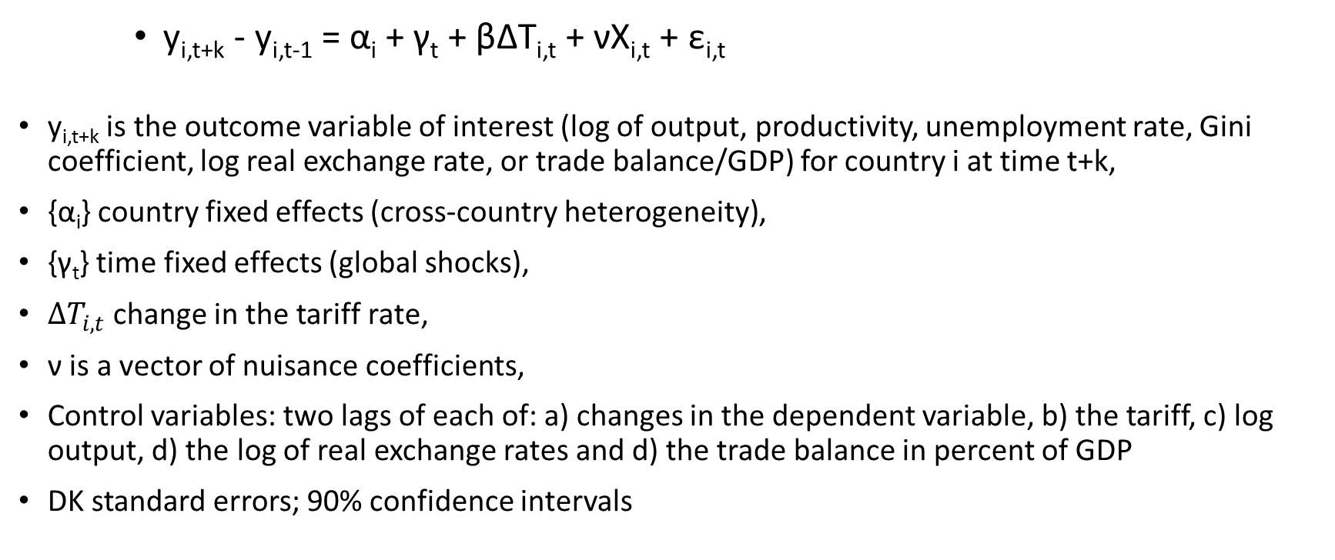
LPM (Jorda) Methodology
y_{i,t+k} - y_{i,t-1} = α_{i} + γ_{t} + βΔT_{i,t} + νX_{i,t} + ε_{i,t}
y_{i,t+k} is the outcome variable of interest (log of output, productivity, unemployment rate, Gini coefficient, log real exchange rate, or trade balance/GDP) for country i at time t+k,
{α_{i}} country fixed effects (cross-country heterogeneity),
{γ_{t}} time fixed effects (global shocks),
$∆T_{i,t}$ change in the tariff rate,
ν is a vector of nuisance coefficients,
Control variables: two lags of each of: a) changes in the dependent variable, b) the tariff, c) log output, d) the log of real exchange rates and d) the trade balance in percent of GDP
DK standard errors; 90% confidence intervals

Slide 30
Tariff rises lead to declines in output and productivity
Output (%)
Productivity (%)
Note: The solid lines indicate the response of output (productivity) to one-standard deviation (about 3.6 percentage points) increase in the tariff rate; dotted lines correspond to 90 percent confidence bands. The x-axis denotes time. t=0 is the year of the reform. Estimates based on equation (1).
30

Slide 31
Increases in unemployment and inequality
Unemployment (ppt)
Inequality (ppt)
31

Slide 32
RER appreciates; little effect on trade balance
RER (%)
Trade balance (ppt of GDP)
32

Slide 33
Larger effects for tariff increases…
Output (%)—tariff increases
Productivity (%)—tariff increases
Output (%)—tariff decreases
Productivity (%)—tariff decreases
33

Slide 34
…in advanced economies…
Output (%)—AEs
Productivity (%)—AEs
Output (%)—EMDEs
Productivity (%)—EMDEs
34

Slide 35
…and in expansions
Output (%)—Expansions
Productivity (%)—Expansions
Output (%)—Recessions
Productivity (%)—Recessions
35

Slide 36
Robustness checks—endogeneity
Output (%)—VAR
Productivity (%)—VAR
Output (%)—IV
Productivity (%)—IV
36

Slide 37
Summary and caveats
Aversion of economics profession to the deadweight losses caused by protectionism seems well-founded
Tariffs lead to declines in output and productivity, increases in unemployment and inequality
Effects larger for tariff increases, for advanced economies and in expansions
Caveats and Limitations
Reduced-form, purely empirical approach
Hard to isolate causal effects, though robustness checks mitigate this concern
Results may underestimate the effect in case of retaliation
37

Slide 38
Today’s Agenda
What Effect is Trump Himself Having on American Exports?
New Research linking “Soft Power” to Trade
New Research on Macroeconomic Tariff Effects
What Do Economists Think of Protectionism and Why?

Slide 39
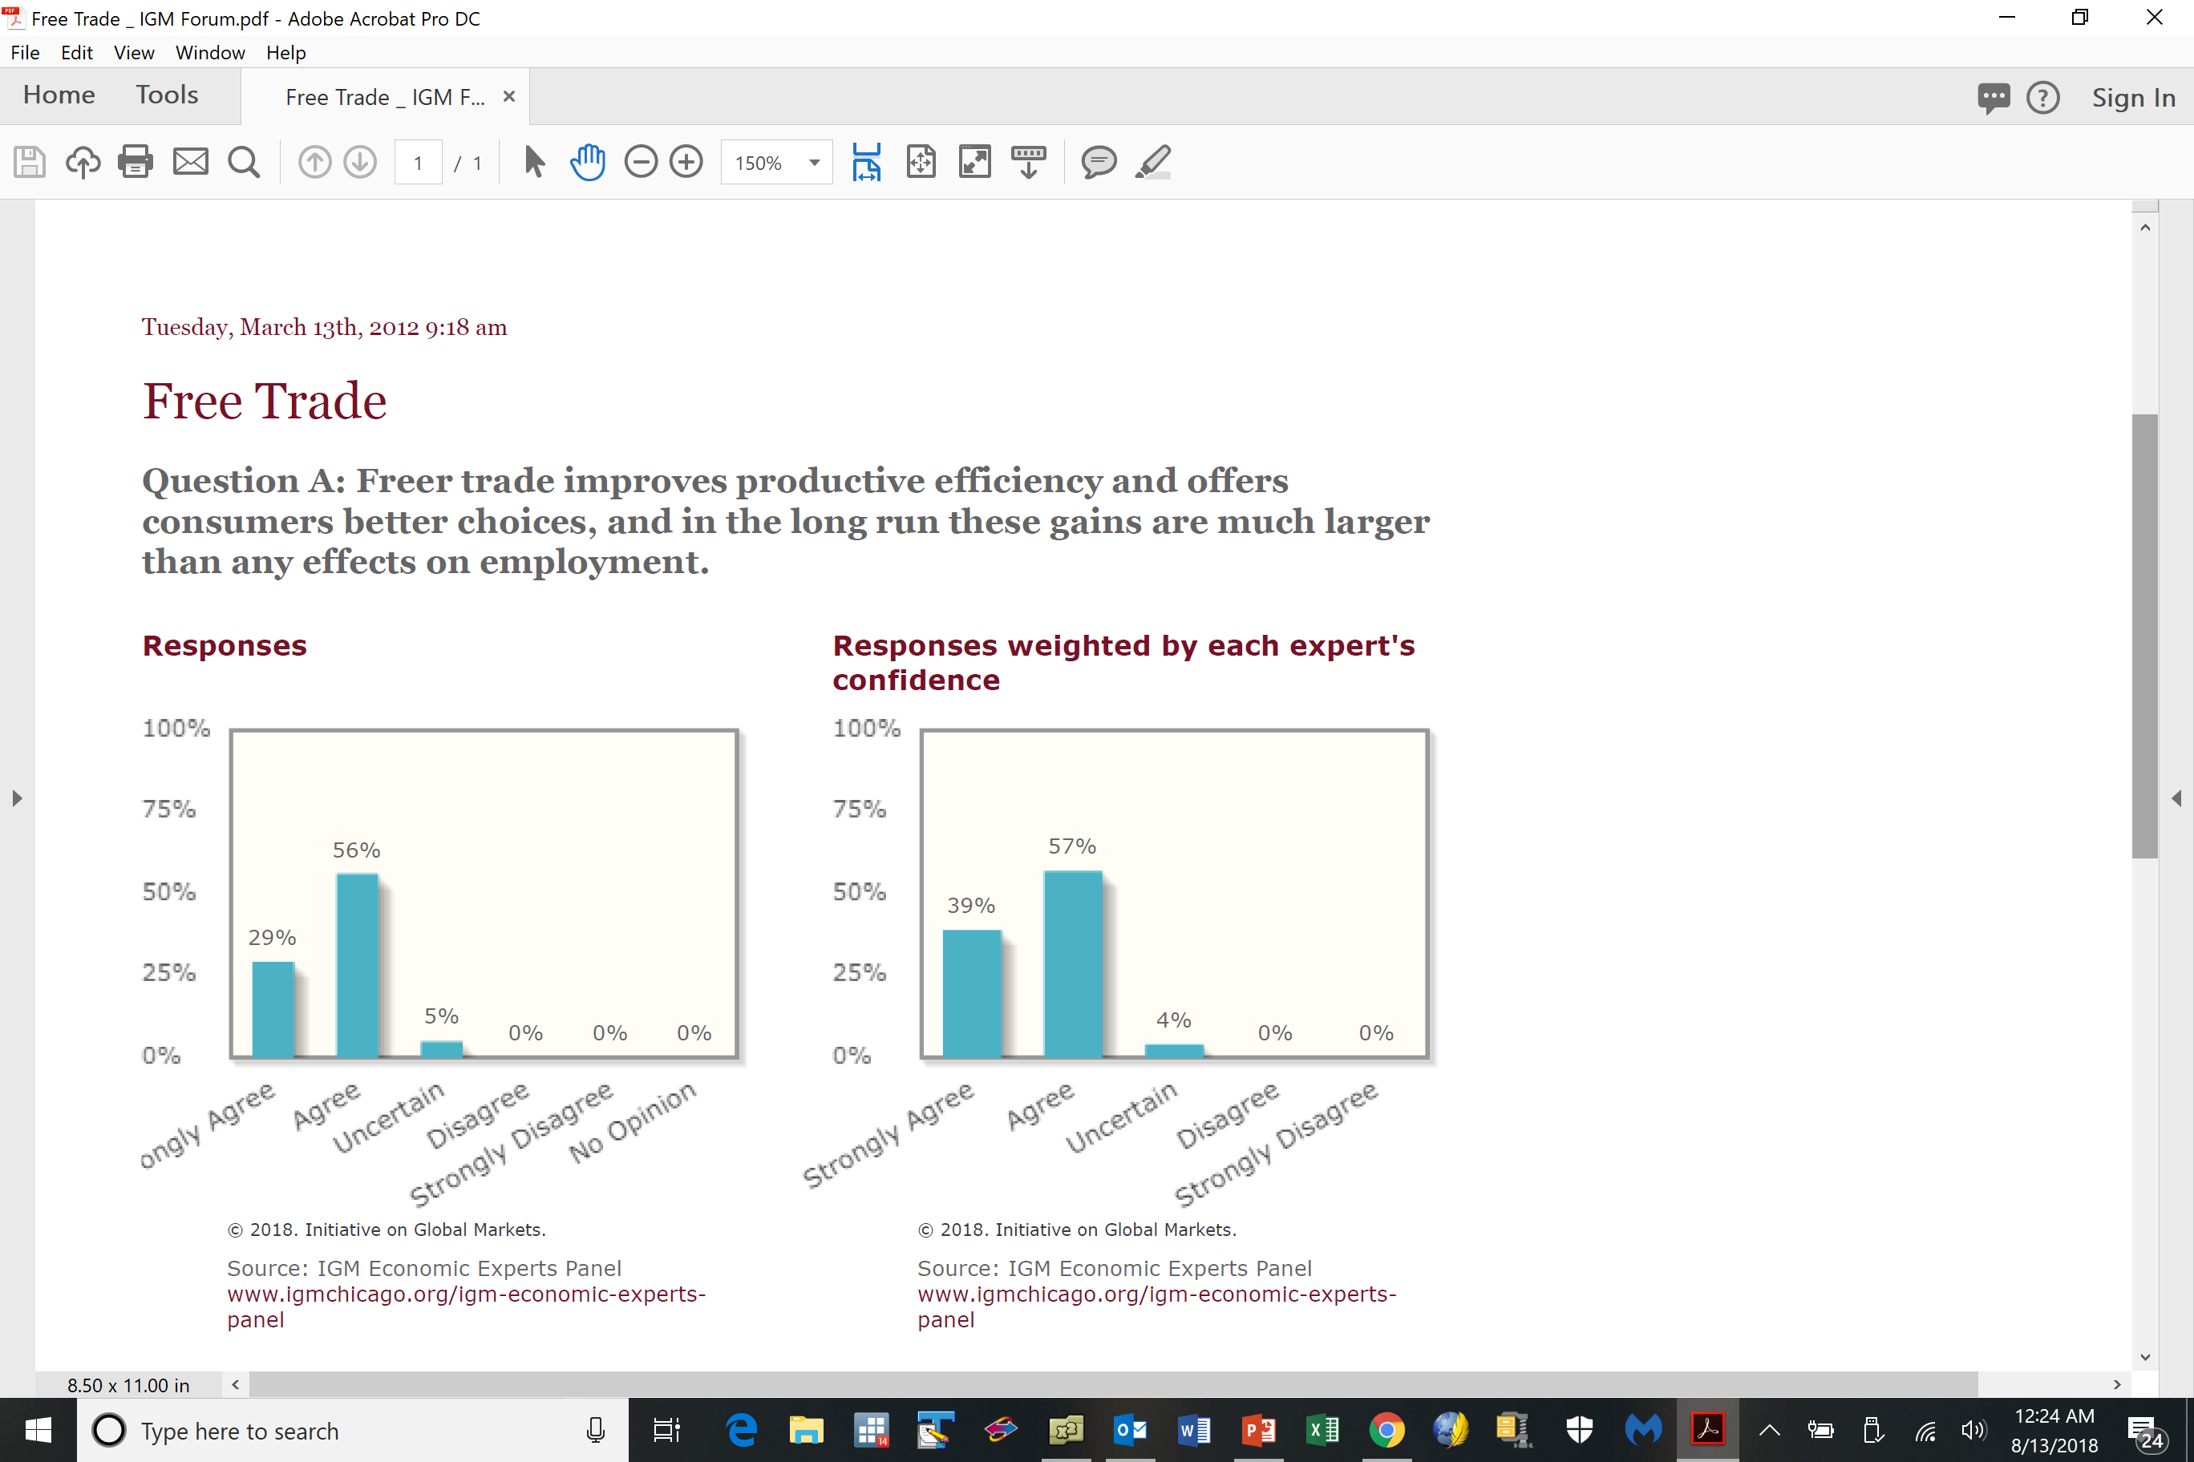
Free Trade Best: Essentially all Economists

Slide 40
Why do Essentially all Economists Agree?
(Noting how rare such agreement is)
If unrestricted markets are typically good, then protectionism is bad for the same reason
Absent a distortion/externality/market failure, one should let markets rule
Trade is a positive sum game, the way domestic transactions are
Who takes advantage of whom in a mutually agreed transaction (absent constraints, information asymmetries, etc.)?
Of course …
Free trade doesn’t help everyone in theory or practice; some factors of production can lose

Slide 41
There are sometimes market failures
But tariffs are almost never a targeted solution
One can find almost always find other policy tools with fewer side effects
Ex: if job losses painful, should assist transition across space/industry/occupation
Hence existence of social safety net; facilitates adjustment (counter to Trump policies)
Other trade barriers (quotas, NTBs, VERs) are worse than tariffs
Tariffs (as all taxes) create microeconomic distortions, inefficiency
Consumers lose (pay more) more than producers gain (higher prices)
“Harberger Triangles” are small … but add up over long periods of time
Trade is often “deflected” or “redirected”
What is a “German” car? BMWs produced in America?

Slide 42
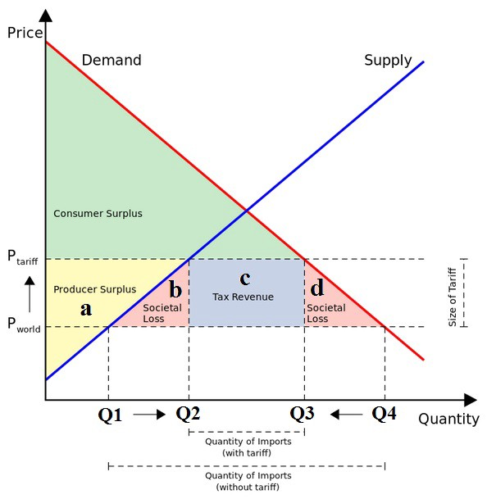
Traditional Analysis of Tariff: Micro (Harberger Triangles)

Slide 43
Economists and Free Trade, continued
Imports are often intermediate inputs, so raise costs
Especially true in Asia … and with commodities … like steel, aluminum
Tariffs redistribute “the wrong way”
From many consumers (some poor) to a few producers (usually rich)
Corrupt customs officials and smugglers benefit
Tariffs create wasteful vested interests, so hard to eliminate
Agriculture in rich countries
Tariffs invite retaliation
Especially with legacy of national humiliation – Chinese “Unequal Treaties” after Opium Wars
Tariffs have minor macroeconomic effects, especially with floating exchange rates (which tend to offset)
Without changing savings or investment, protectionism can’t change current account

Slide 44
Economists and Free Trade, more
No special concern about trade deficit
A country is not a company (Krugman); trade balance is not bottom line akin to business
Adam Smith: both sides gain even if trade is balanced
Trade deficit results from consumption > production, not “bad trade deals”
In any case, US is different:
US$ has three special roles as a currency of choice for: a) trade invoicing, b) official reserves, and c) debt issuance.
Issuing “safe assets” delivers “exorbitant privilege”

Slide 45
More on Capital Flows and Exchange Rates
American fiscal expansion pushing up US interest rates
Similarly, monetary tightening is also raising US rates
Both serve to attract capital inflows, appreciate US$
Appreciation of dollar, worsening of US current account seems likely
Will affect all countries in American sphere of financial influence – especially developing and emerging markets in Latin America, Caribbean, Asia-Pacific
Because of special role of US$ and resulting currency mismatch, US$ appreciation and access to US markets often leads to problems in developing countries (Turkey!)
Trump concern with current account deficit (≡ Savings – Investment) means that savings should rise not fall to lower current account deficit

Slide 46
Back to Economists and Free Trade
To avoid protectionism, need sustainable institutional commitment to liberal trade
Rules (on protectionism, dispute settlement, etc.) better than discretion
Uncertainty critical to encourage costly investment (but Trump likes uncertainty …)
Institutions are better than individuals
But the WTO, regional trade agreements (like NAFTA), and the rules-based trade institutions are being undermined by Team Trump
Belief that US can win more concessions unilaterally
Little supporting evidence thus far

Slide 47
Special Trumpian Points
Focusing on trade in goods, ignoring services is just dumb
What’s special about something you can drop on your foot?
Thinking of a G&S surplus as “good” is just dumb
Especially to potential defaulters … like Trump …
Think of a trade balance after a typical currency crisis … or Japan … or my trade balance with my son … or my son’s with UChicago …
Focus on bilateral trade balance is just dumb
Think of my trade balance with my barber
One can understand protectionism during bad times like the early 1980s (even if don’t agree). But protectionism during good times is especially perplexing
Liking strong US$ and trade surplus is contradictory and dumb

Slide 48
Trump Induces Trade Policy Uncertainty
Who gains?

Slide 49
But Trump really REALLY cares about Trade
Reducing US bilateral trade deficits is the one national “issue” Trump has consistently cared about
“Other countries are taking advantage of us”
“The United States has trade deficits with many, many countries, and we cannot allow that to continue”
“Trade wars are good and easy to win”
US is being “ripped off so badly” and “losing billions”

Slide 50
The Big Mystery
Why has my president found such a large audience?
Why no political cost from raising taxes?
Why protect inputs, focus on bilateral deficits, …?
Why has the profession failed?

Slide 51
Summary
Trump has had a large negative effect on global and American trade
Wrong-minded fixation on a) bilateral b) deficits in c) goods
Ignores economic and political benefits of trade, costs of protectionism, causes of aggregate deficit
Inducing retaliation and dollar appreciation
Undermining rules-based international order in trade (and security)
Ironically, reducing American soft-power lowers US exports
Fundamental Problem: protectionism seems to be a “solution” in search of a problem
Incoherence stems from inability to answer: What is the American objective?
Worse to come likely!

