Slide 1
Why Have Negative Nominal Interest Rates Had Such a Small Effect on Bank Performance? Cross Country Evidence
Jose A. Lopez, Andrew K. Rose, and Mark M. Spiegel*
Bank for International Settlements
July 6, 2018
*Comments are my own and do not necessarily reflect the views of the Federal Reserve Board of Governors or the FRBSF

Slide 2
Low interest rates concern for banks
Following financial crisis, rates reduced towards “zero lower bound” (ZLB)
Potential obstacle to bank profitability
Nominal deposit rates could not be reduced below zero without eroding banks’ customer base.
Low interest rates reduce bank profitability [Jobst and Lin (2016)].
Concern confirmed empirically
Borio, et al (2017) bank profitability reduced at low rates of interest
Borio and Gambacorta (2017) bank lending less responsive to policy rates around ZLB, weakening transmission mechanism

Slide 3
Even worse at negative rates
Adjustments in deposit rates likely to hit a hard stop at the zero bound.
Banks generally unwilling to charge negative nominal interest rates on deposits, especially for smaller customers
Eggertson, et al (2017): Negative rates disrupt monetary transmission
Evidence from aggregate data from five countries and the euro area as well as bank-level data from Sweden.
Rostagno, et al (2016): movements into negative rates may induce lending by increasing cost of hoarding cash

Slide 4
Many individual currency studies of negtive rates
Bank-level studies
Most conclude that responses at bank level mitigated adverse effect of negative rates on bank profitability and lending
Increasing non-interest income (such as increased fees)
Adjust funding allocations to rely less on deposits
Adjustments depend on both bank business model and size, as both influence reliance on deposit funding
However, move to negative rates likely reflects fundamentals
Leaves it difficult to identify changes in bank profitability solely from negative rates.

Slide 5
Relevant literature
Studies under low positive rates
Borio, et al (2017), Borio and Gambacorta (2017), Delis and Kouretas (2011), Bikker and Vervliet (2017)
Economies under negative nominal interest rates
Bech and Malkhozov (2016):
4 CBs in Europe since 2014
Negative rates similar to low positive rates
Turk (2016): Danish and Swedish bank margins roughly stable across the zero threshold

Slide 6
Micro data negative rate studies for individual currencies
Heider, et al (2017): 46 eurozone banks 2013-2015
Negative rates in euro area induced deposit-dependent banks to cut lending, and reallocate loans towards more risky firms.
Nucera, et al (2017): 111 eurozone banks
Negative rates induced smaller banks to increase riskiness
Basten and Mariathasan (2018): 68 Swiss banks
Banks with higher excess reserves raised fees and interest income to compensate for negative liability margins
Demiralp, et al (2017): 205 euro area banks
HD banks extend more loans under negative rates than LD

Slide 7
Multi-currency panel allows for global shocks
Different economies move to negative rates at different times
Include fixed time effects to control for global conditions
Global shocks particularly relevant over sample period [Rey (2015)]
Some countries in sample never experience negative rates
Can be viewed as a difference-in-difference study
Compare banks in economies that experienced negative rates, before and after policy rates turned negative
Local conditions also likely affect both bank profitability and monetary policy
Respond by instrumenting proxies for local conditions

Slide 8
First study pooling European and Japanese banks under negative rates
Annual income statements for 5,113 banks from 2010-2016
14 different currencies, one of which is the 19 country euro
Countries “go negative” at different times for different reasons
Example: Movements into negative rates different in floating and pegged exchange rate countries
Latter respond more to pressures that might undermine the peg.
Sample also includes large number of banks
Allows analysis of banks most exposed to negative interest rates
Split data into sub-samples by: a) bank size, and b) reliance on deposits.

Slide 9
Results: Bank profitability unaffected by negative nominal interest rates
No substantive effect on net income from negative rates.
ssssNotable because sample includes relatively large share of small and high-deposit banks
Both expected to be more exposed to negative rate losses
Do find statistically significant losses in net interest income
Statistically significant losses both on lending income and “other” interest income
Mitigated by reductions in interest expenses, but not sufficiently
Notably, banks do not substantially reduce deposit expenses
Heterogeneity: Large banks do achieve reduction in deposit expenses, small banks don’t

Slide 10
Losses on net interest income made up on non-interest income
Significant gains in net non-interest income
Increases in fees
Increases in other non-interest income (capital gains, gains on securities, insurance)
Differences by bank type
Large banks also reduce other interest expenses more than their smaller counterparts.
Low-deposit (LD) banks do better under negative interest rates than high-deposit (HD) counterparts
LD banks actually suffer bigger reductions in net interest income, but also achieve larger increases in net non-interest income

Slide 11
Data
Fitch Global Banking database
Balance sheet and income statement variables for individual banks, 2010-2016
28 European countries and Japan
Variety of monetary regimes, including monetary unions, exchange rate peggers, and inflation targeters
Data begins 2 years before negative nominal interest rates
Includes all negative nominal interest rate countries through 2016

Slide 12
Difference from the existing literature
Variety of countries with different monetary regimes
Enter negative rates at different points in time, if at all.
Five economies experienced negative nominal policy interest rates: Denmark, EMU, Japan, Sweden, and Switzerland
Denmark first into negative rates July 2012
Swiss interest rates most negative (on sight deposit rates at -0.75%)
Similar countries that did not go negative
Bulgaria, Czech Republic, Hungary, and the UK
Allows time fixed effects to account for global conditions
More generally, difference-in-differences strategy, since not all experienced negative rates, and none for the entire sample.
The second difference from the literature is that, with over 5,100 banks and more than 30,00 observations, our data set is relatively large. The database allows us to examine closely the effects of negative rates on banks that differ along several dimensions, such as size and deposit-reliance. We identify a bank as large if its assets exceed $10 billion during the sample; about an eighth of our banks are large. Similarly, we define a bank as high-deposit if its deposits exceeded 75% of total funding at some point in the sample, as is true of four-fifths of our sample.
Our data set has a few complications. One is that banks report information using different (sometimes multiple) accounting methods. While we used bank-level fixed effects throughout, we are interested in using as consistent a sample as possible. Towards that end, when we have duplicate time series of banks reported in different accounting methods, we drop the less-popularly-used method for the bank’s country. We also drop banks that use accounting systems unconventional for their own country. Finally, we generally choose unconsolidated observations, only reporting consolidated observations if unconsolidated are unavailable. Our annual observations are typically reported in the fourth quarter, though our Japanese banks report them in the first quarter. Since our data set also has suspicious outliers, we typically truncate variables at the first and ninety-ninth percentiles, dropping the outliers (a few exceptions to this rule are tabulated below).
Descriptive statistics for our data set are tabulated in Appendix Table A1. At the right of the table, we present mean values for bank income (measured as a percentage of total assets), along with standard deviations. These are presented for nine different monetary regimes, in rows. We compare bank profitability under negative and low positive nominal interest rates, defining the latter as a policy rate that is within the [0, 1%) range (hereafter we refer to “positive” rather than “low positive” rates, for the sake of brevity). Of the five economies that experienced negative nominal interest rates, net income was, on average, higher under positive rates for the EMU, Japan, and Sweden. However, the differences between positive and negative rates were small, and both Danish and Swiss banks did slightly better with negative rates. This impression is corroborated by Figure 1, which scatters bank profitability against the policy rate. The fitted regression line has essentially no slope, suggesting little effect of interest rates on bank profitability.

Slide 13
Data set is large
Over 5,100 banks and more than 30,00 observations
Allows examination of effects of negative rates on banks that differ by size and deposit-reliance
Identify large as assets exceed $10 billion (1/8 of sample)
Define HD as deposits exceeded 75% of funding (4/5 of sample)
Complications
Multiple accounting methods
Generally choose unconsolidated observations
Japanese banks report in first quarter
Truncate outliers at 1% and 99%

Slide 14
Losses on net interest income made up on non-interest income
Significant gains in net non-interest income
Increases in fees
Increases in other non-interest income (capital gains, gains on securities, insurance)
Differences by bank type
Large banks also reduce other interest expenses more than their smaller counterparts.
Low-deposit (LD) banks do better under negative interest rates than high-deposit (HD) counterparts
LD banks actually suffer bigger reductions in net interest income, but also achieve larger increases in net non-interest income

Slide 15
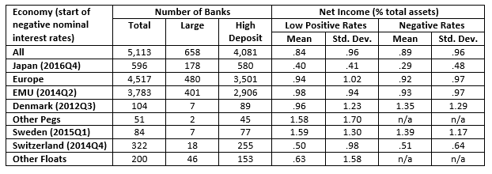
Little overall difference in profitability across ZLB
Descriptive Statistics

Slide 16
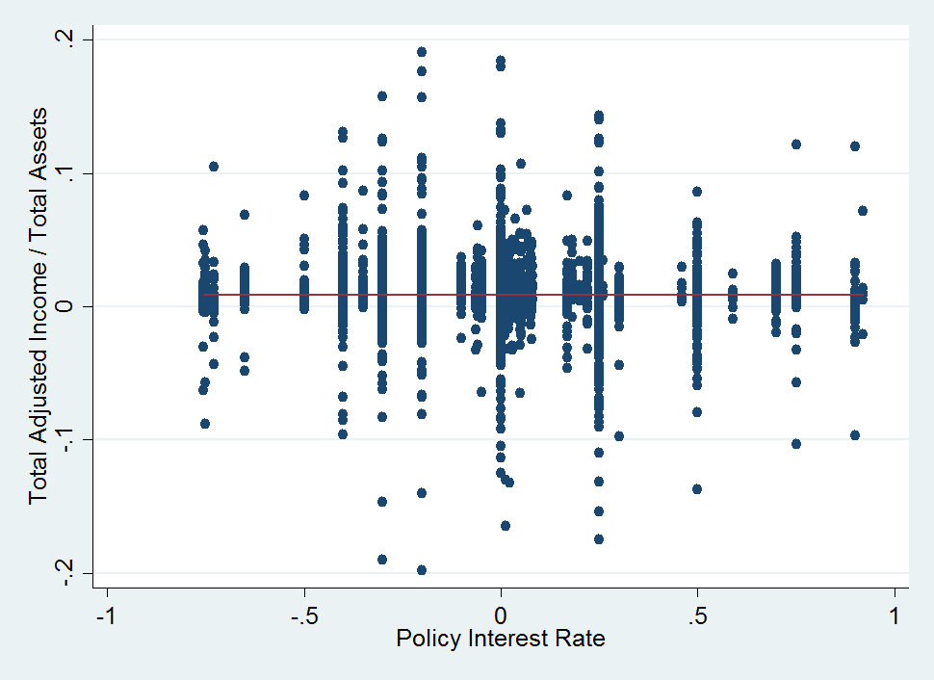
No apparent differences in raw data
Figure 1: Bank profitability under positive and negative policy rates

Slide 17
Base specification
Conventional least-squares panel specification:
Y_{ijt} = βNEGI_{jt} + {δ_{i}} + {θ_{t}} + ε_{ijt} (1)
where:
Y_{ijt} is dependent variable for bank i in economy j for year t
NEGI_{jt} is 1 if country j had a negative nominal policy interest rate during year t, and 0 otherwise (nominal rates>1 are dropped)
{δ} and {θ} are comprehensive sets of bank- and time-specific fixed effects
ε represents a residual, assumed to be well-behaved

Slide 18
Base specification (2)
Coefficient of interest is β
Average effect of negative nominal interest rates
Use robust standard errors, clustered by bank.
Consider number of measures of bank performance
Calculated as ratios of total assets
Drop outliers, observations outside (1,99) percentiles
Confirm results insensitive to the use of earning assets instead of total
Exclude values of net income (to total assets) greater than 20% in absolute value

Slide 19
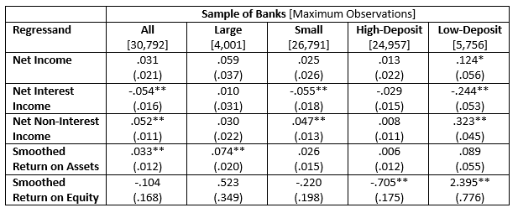
Base specification results
Negative Nominal Interest Rates and Bank Profitability

Slide 20
Base results indicate small negative rate impact
Economically small – but positive – and statistically insignificant effect on bank net income, compared with low positive rates
Masks large movements in income components
Net interest income falls significantly by around 5.4 bp
Almost precisely offset by gains in net non-interest income of 5.2 bp.
Offsetting results suggest banks are reluctant to charge their depositors negative rates
Results in losses from interest income
Compensate for losses with gains from non-interest income

Slide 21
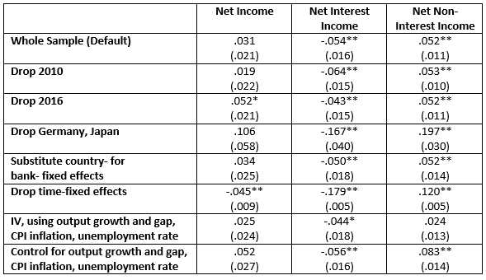
Results robust to variety of perturbations
Sensitivity Analysis

Slide 22
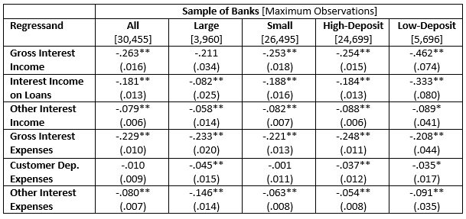
Decomposition of net interest income
Negative Nominal Interest Rates and Bank Interest Income and Expenses

Slide 23
Interest expense cuts less than revenue losses
Both gross interest income and expense show economically significant and statistically significant declines
Decline in expenses is smaller
Decline in gross interest income largest for loan income
Other interest income decline also significant
Customer deposits insignificant
Matches conventional wisdom
Banks suffer interest losses but can’t pass fully on to depositors
Hence, bank net interest income declines

Slide 24
Differences across banks
Large banks seem more nimble than smaller banks
Suffer smaller and insignificant declines in gross interest income
Also cut expenses further, avoiding losses on net income
LD banks suffer significantly greater losses in gross interest income, especially income from loans
To offset losses, LD and HD banks lower interest expenses
However, LD banks lower “other interest expenses” more
More reliant on other, market-based funding sources
Differences in deposit expenses much smaller

Slide 25
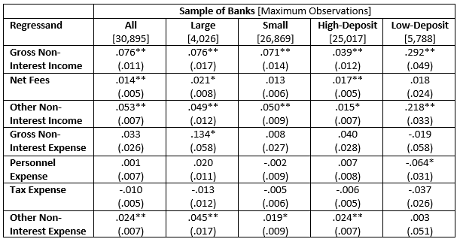
Decomposition of non-interest income
Negative Nominal Interest Rates and Bank Non-Interest Income and Expenses

Slide 26
Interest expense cuts less than revenue losses
Increase in net non-interest income stems from an increase in gross income, rather than a decline in expenses
Two sources increasing gross income, both significant:
Increase in net fees
Improvements in other types of non-interest income, such as capital gains and gains on securities and insurance
But change in most non-interest expenses insignificant
Exception is “other non-interest expenses,” including capital gains on securities and interest expenses, which increase

Slide 27
Differences across banks
Few substantive differences between large and small banks
Relatively large discrepancies across HD and LD banks
Modest differences in point estimates for non-interest expenses
Increase in gross non-interest income for LD banks about 10 times size of that enjoyed by HD banks
Most from increases in non-fee income, which may reflect gains on securities
May be associated with unanticipated movements into negative rates
Benign impact of negative rates might in part reflect immediate capital gains on bond holdings for LD banks
However, remaining under negative rates may not be painless
Medium-tern impacts of negative rates may differ

Slide 28
Differences across monetary regimes
Data includes three different types of monetary regimes
Large number members of EMU, (3 Baltic countries joined)
Largest negative rate monetary regime
Floating exchange rates
Japan, Sweden and Switzerland (but not Czech Republic, Hungary or the UK) experienced negative nominal interest rates.
Fixed exchange rates
Bulgaria and Denmark (Estonia, Latvia and Lithuania prior to EMU entry)
Only Denmark experienced negative interest rates.
Analysis implicitly exploits this panel variation
Next, reexamine results by monetary regime

Slide 29
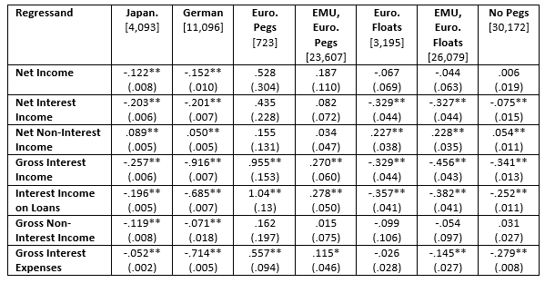
Results for different monetary regimes
Table 4: Negative Nominal Interest Rates Effects Across Economies

Slide 30
Results indicate importance of panel approch
Results for Japan and Germany erroneously negative
Unable to control for time fixed effects; interpret with caution
Demonstrates advantage of cross-country panel
Literature often uses banks from single monetary regime
Other samples more credible
Countries with exchange rates pegged to the Euro
European countries that maintained flexible exchange rates
Flexers plus Eurozone
All economies with flexible exchange rates

Slide 31
Much heterogeneity across monetary regime panels
None of the five panel estimates indicate significant effect of negative nominal interest rates on bank profitability
Stark contrast with national results indicating significant decline in bank profits in both Japan and Germany
Decomposition of sub-panels consistent with full sample
Observed significant effect on net interest income always negative
Significant coefficients for net non-interest income positive
Result that negative rates only have a small overall effect appears driven by floating exchange rate economies

Slide 32
Conclusion (1)
Examine banks under negative nominal interest rates
First study under negative rates for different monetary regimes
Panel allows conditioning for global shocks, and dis-aggregating by both size and dependence on deposit-funding
Find little overall impact on bank profitability, compared with low positive rates
Components of income respond significantly
Decline in net interest income
Largely offset by increases in non-interest income
Results driven by countries with floating exchange rates, and small or LD banks
Overall, our results suggest that banks fare relatively well under negative nominal interest rates, compared to low positive rates. The considerable heterogeneity we find makes us cautious to conclude that the financial channel of the monetary transmission mechanism remains unchanged as policy rates cross zero. That is especially true since the positive returns in “other non-interest income” enjoyed by banks under negative rates may well be unsustainable if they are driven by the capital gains stemming from negative interest rate surprises.

Slide 33
Conclusion (2)
Overall, results suggest banks fare relatively well under negative nominal rates, compared to low positive
Considerable heterogeneity raises caution in concluding that monetary transmission mechanism unchanged
Particularly since positive returns in “other non-interest income” may be unsustainable over medium term
Capital gains from negative interest rate surprises unlikely to persist

Slide 34
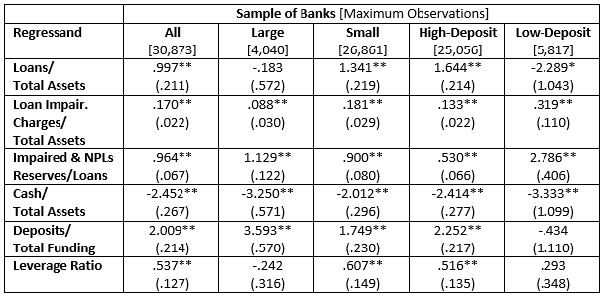
Results for activity
Appendix Table A3: Negative Nominal Interest Rates and Other Bank Activity

