Slide 1
Endogenous Optimum Currency Areas: Where Do We Stand?
Andrew K. Rose
Berkeley-Haas
ABFER, CEPR and NBER

Slide 2
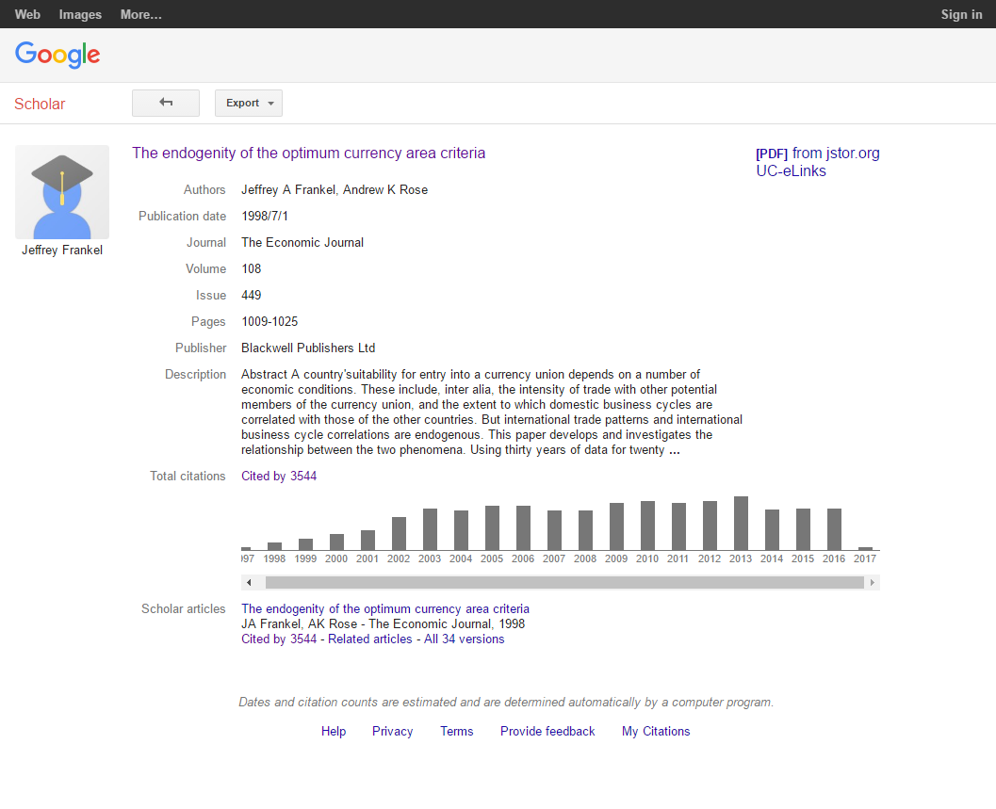
Disclaimer

Slide 3
Mundell’s Optimum Currency Area Criteria
Consider two economies with sticky prices and business cycles
Q: When should these economies share a common money?
A: When two criteria satisfied:
Criterion 1: Large benefits from one instead of two currencies (large trade)
AND
Criterion 2: Low opportunity cost of relinquishing monetary sovereignty
Criterion 2 likely to be satisfied when:
Business cycles are synchronized (common monetary policy appropriate), or
Labor markets sufficiently flexible, or
Risk-sharing sufficiently high (e.g., cross-area fiscal redistribution system)

Slide 4
Setting the Endogeneity Stage (Frankel-Rose)
Consider two economies with business cycles
For some reason, a trade barrier falls
Makes Criterion 1 more likely to be satisfied (trade rises ... how much?)
Usually policy-driven, such as trade/non-trade/monetary barriers
Q: Are the business cycles of the two economies likely to become more or less synchronized (Criterion 2 less/more likely)?
Less if countries specialize more because of deeper trade integration(inter-industry trade), and sector-specific shocks are important
More with fewer idiosyncratic shocks (e.g., from national monetary policies), because common (rather than sector-specific) shocks grow, or because intra-industry trade dominates inter-industry trade (little specialization)

Slide 5
How to Tackle the Issue Empirically?
Two-step common procedure to test direction of effect empirically:
Create measure of Business Cycle Synchronization (BCS)
Detrend output/unemployment for area i … to create business cycle deviation
Repeat for area j
Create measure of coherence between business cycles for i and j (BCS)
Link BCS to integration between i and j
Usually regress BCS on bilateral trade between i and j, appropriately normalized

Slide 6
Theoretical Ambiguity, Empirical Clarity
In practice, Frankel-Rose found strong empirical results
Positive: more trade leads to more synchronized business cycles
IV results often larger than OLS
Robust: many authors, especially Baxter and Kouparitsas
But exceptions exist (more below)
Also issues of size of effect
Kose-Yi puzzle … more below

Slide 7
Quick Notes
Trade only one possible measure of integration
Many barriers to integration exist
Decline possible because of policy or technology
Financial integration easy to measure, likely important, big recent changes
Fits well into OCA framework (risk-sharing can be private)
Labor market integration of special political interest recently
Why only link trade/financial integration to BCS?
Are other OCA criteria endogenous?
Labor markets? Price rigidities? Insurance mechanisms?

Slide 8
Cautionary Note 1
Potential feedback from BCS to trade implies simultaneity problem
Plausible because monetary regimes (fixed exchange rates/CU …) can easily affect both trade and BCS directly, often by design
So instrumental variables seem generally appropriate

Slide 9
Cautionary Note 2
Many steps involved in empirical procedure
Some examples
Which raw series to consider for business cycles? (GDP? Unemployment?)
How to convert raw series to business cycles? (BK/CF/HP-detrending/growth rates?)
How to cohere business cycles across countries? (Correlation coefficient?)
Measure integration through outputs (e.g., trade/asset flows) or inputs (barriers)?
Which measure of integration/trade to link to BCS? (Bilateral trade? Normalization?)
Which instrumental variables?
What tradeoff in time/space data span? (Large cross-section or time-series?)
Affords researchers considerable discretion/measurement error
A general cause for concern

Slide 10
Cautionary Note 3
Follow-up to point 7 above:
Some BCS-Trade Linkages associated with change in structure of economy
Specialization/Movement of resources across sectoral boundaries
But Not All
Switch from idiosyncratic national monetary shocks to common international monetary shocks
Hence unclear what is appropriate frequency for empirics
In practice need to examine changes over time of BCS across countries
I.e., time-series changes of cross-sectional phenomena
An unusual, unfamiliar space

Slide 11
Tangent: A Unified Framework
Imbs (RES 2004) provides a unifying statistical framework
BCS driven by: a) trade integration; b) specialization; c) financial integration
But also:
Specialization driven by a) trade integration; b) financial integration
Trade integration driven by specialization
Financial integration ... ?
Estimates simultaneous system via 3SLS
But means researcher must take views on many structures
Considerable data/estimation requirements
3SLS means mistakes anywhere spill over
Hence satisfying to purists, but unpopular

Slide 12
Quantifying the Trade – BCS Effect Empirically
In 2008, I conducted a meta-analysis of 20 studies linking trade to BCS
Estimates of β from standard estimating equation:
BCS_{ijt} = α + β*ln(trade_{ijt}) + controls + ε_{ijt}

Slide 13
Literature (as of 2008)
 |  | Beta | SE |  |  | Beta | SE
Baxter and Kouparitsas | 2005 | 0.13 | 0.03 | Gruben, Koo and Mills | 2002 | 0.06 | 0.02
Bower and Guillenmineau | 2006 | 0.02 | 0.01 | Imbs | 2003 | 0.03 | 0.02
Calder | 2007 | 0.01 | 0.00 | Imbs | 2004 | 0.07 | 0.02
Calderon, Chong and Stein | 2007 | 0.02 | 0.00 | Inklaar, Jong-a-Pin and de Haan | 2005 | 0.12 | 0.04
Choe | 2001 | 0.03 | 0.01 | Kose and Yi | 2005 | 0.09 | 0.02
Clark and van Wincoop | 2001 | 0.09 | 0.03 | Kose, Prasad and Terrones | 2003 | 0.01 | 0.00
Crosby | 2003 | 0.05 | 0.06 | Kumakura | 2006 | 0.06 | 0.04
Fidrmuc | 2004 | 0.02 | 0.04 | Kumakura | 2007 | 0.06 | 0.01
Fiess | 2007 | 0.12 | 0.06 | Otto, Voss and Willard | 2001 | 0.05 | 0.09
Frankel and Rose | 1998 | 0.09 | 0.02 | Shin and Wang | 2004 | 0.08 | 0.08

Slide 14
Meta-Analysis of Trade Impact on BCS
Estimation Technique | Pooled Estimate of γ | Lower Bound of 95% | Upper Bound of 95%
Fixed | .020 | .016 | .023
Random | .043 | .031 | .054

Slide 15
Finding 1
Increased trade seems to increase business cycle synchronization
Not a universal consensus, but pretty strong
If anything, the size of the linkage may be too large …

Slide 16
Effect Size: the “Trade-Comovement Puzzle”
Kose-Yi (AER 2001, JIE 2006) the positive effect of trade on BCS is too large to be consistent with standard international RBC model (first developed by Backus, Kehoe and Kydland)
Theoretical exercises with calibration, productivity shocks
2- and 3-country versions
Consider different levels of: a) financial integration; b) transport costs
Findings:
Too little trade in theory (compared to data)
Too little responsiveness of BCS to trade in theory (again, compared to data)

Slide 17
Kose-Yi has Spawned Literature to Consider Potential Resolutions
Puzzle lends itself to further research
Explanations include
Production fragmentation , trade in intermediate inputs (Ng, JIE 2010, Di Giovanni and Levchenko AEJM 2010, Johnson 2013)
Firm behavior (foreign affiliates, multinationals, … Burstein, Kurz and Tesar JME 2008, Kleinert et al AEJM 2015)
Fluctuations in extensive margin of trade (Liao and Santacreu JIE 2015)
My view: many possibilities, little consensus as yet
Unclear if this matters for OCA endogeneity
Unusual: challenge to EOCA result is size but not sign

Slide 18
Finding 2
Little strong evidence of any other strong linkages to BCS
Baxter-Kouparitsas (2005) did Leamer-style EBA analysis:
“… findings are negative, in the sense that we found many variables not to
be robust. Specifically, total trade measures are fragile, as are the measures of the
similarity of total and bilateral trade. Factor endowment variables, including
measures of education, capital, and arable land, were all found to be fragile. All
gravity variables except for distance were found to be fragile.”
Ditto De Haan, Inklaar and Jong-A-Pin (2008)

Slide 19
Possible Exception: Financial Integration and BCS
Considerable analysis
Likely motivation: of rising capital mobility
Policy-induced or mostly technological?
Or ease of measurement?
Economically important
Private risk-sharing a substitute for public (fiscal) risk-sharing

Slide 20
Risk-sharing should enhance production specialization, lower BCS
Financial integration plausibly leads to lower BCS
Empirically valid: Kalemli-Ozcan, Sorensen, Yosha (JIE 2001)
Kalemli-Ozcan, Sorensen and Yosha (AER 2003)
True within regions of US, Japan, UK, Canada …
Less specialization across countries than regions because risk-sharing is (much) larger within countries than between countries
Clever, compelling comparison of international and intranational phenomena
Kalemli-Ozcan, Papaioannou and Peydro (JF 2013)
Strong negative effect of banking integration on BCS

Slide 21
But ... No Consensus Exists
Imbs (RES 2004)
Question marks because imperfect information/herding/contagion: more financial integration could raise BCS (financial crises often regional)
In practice, most specialization not a result of country endowments, or integration (real or financial)
Rather, stage of development (GDP p/c) drives specialization
Also: Dees and Zorell (2011)
No effect of financial linkages on BCS

Slide 22
Who Wins the Horse-Race?
Integration often deepening in both real/trade and financial markets
Literature creates two presumptions:
More financial integration probably implies decline in BCS
Empirically uncertain
More real integration implies rise in BCS
Strong empirically
On net?
Relatively little work directly comparing size of effects
ECB study (Dees and Zorell 2012): real effects tend to dominate
Ripe for further study

Slide 23
Tangential Wistful Note
High expectations for enhanced private risk-sharing early in EMU
Ex: abstract of Kalemli-Ozcan, Sorensen and Yosha (2004):
“We find that risk sharing in the European Union (EU) has been increasing over the past decade due to increased cross-ownership of assets across countries. Industrial specialization has also been increasing over the last decade, and we conjecture that risk sharing plays an important causal effect by allowing countries to specialize without being subject to higher income risk even though the variability of output may increase. … We further find that the asymmetry of GDP fluctuations in the EU has declined steeply over the last two decades. This may be due to economic policies becoming more similar as countries were adjusting fiscal policy in order to meet the Maastricht criteria… We expect to see a further rise in risk sharing between EU countries, accompanied by more specialization. The resulting increase in GDP asymmetry should be minor, however, and will have small welfare costs, because increased risk sharing should lower income (GNP) asymmetry.”

Slide 24
Which Leads to the Key Case: EMU
Has OCA endogeneity changed BCS inside EMU?
Special focus should be on core/periphery divergence
Has BCS endogeneity had same (lack of) effect everywhere?
Given our current knowledge, requires two possible steps:
Effects of EMU on integration (real/financial/labor …)
Effects of integration on BCS

Slide 25
EMU: Considerable Confusion
De Haan, Inklaar and Jong-A-Pin (JES 2008) survey concluded:
“We conclude that business cycles in the euro area have gone through periods of both convergence and divergence … Higher trade intensity is found to lead to more synchronization, but the point estimates vary widely. The evidence for other factors affecting business cycle synchronization is very mixed.”
Considerable work post-dating de Haan et al confirms mixed EMU picture
BCS rising/high: Aguiar-Conraria and Soares (2011); Artis and Zhang (2008); Gachter and Ridel (2014); Goncalves, Rodrigues and Soares (2009)
BCS falling/low: Caporale, De Santis and Girardi (2015); Christodoulopoulou (2014)
Unclear: Crespo-Cuaresma and Fernandez-Amador (2013); Lehwald (2012)
Literature cries out for EMU-focused meta-analysis/synthesis!
Methodology for meta-analysis has improved considerably in last decade

Slide 26
Outside EMU
Little work on determinants of BCS/OCA endogeneity
But many (multilateral) currency unions exist:
Eastern Caribbean
Central Africa
Western Africa
Southern Africa …
And many more proposed (rarely seriously)

Slide 27
Bilateral Currency Unions/Dollarization
Almost no work at all
Ex: Bulgaria vs Romania
Ex: Ecuador vs Peru
Mechanisms should be similar, perhaps cleaner
Unanswered Question: How do bilateral currency unions (between large/small) differ from multilateral currency unions?
Few serious multilateral CUs until EMU
EMU too recent to study ... until recently ...

Slide 28
Related Literature: Statistical Characterization of Business Cycle Movements
Tends to be high-tech, low-ec
Focus is on characterizing business cycles
Tends to ignore determinants of BCS
Ignore international linkages (focus on global/multilateral influences like oil prices, terms of trade, …)
Kose, Otrok and Whiteman (JIE 2008)
Crucini, Kose, and Otrok (RED 2011)
Kose, Otrok and Prasad (IER 2012)
Global/regional/country-specific variation
Different periods of time
Different aggregates (output, consumption, …)

Slide 29
The Litany: Complaints on the Endogenous Optimum Currency Area Literature
Where do we stand?

Slide 30
Criticism 1
The literature is now boring
Lends itself to derivative empirics
New data (more countries! Years! Measures of financial integration!)
New techniques (wavelets, spectral coherence, …)
So a citation-generator
But little in the way of novel data collection
Unlike much empirical work in economics

Slide 31
Criticism 2
(Literature not boring enough)
Does the BCS endogeneity literature care about … endogeneity?
In our original EJ paper, Frankel and I found that IV doubled the magnitude of the effect of trade on BCS
Used gravity IVs: (log) distance, adjacency, common language
Ironically, this point has been forgotten
BCS seems clearly endogenous with respect to trade, but trade itself might be endogenous in the relevant sense
More plausibly, both trade and BCS might be driven by other forces
Accordingly, most estimates were IV until around 2005
Yet most of recent literature ignores potential feedback
If intra-national and international data give same results, this may not be important (Imbs) but many authors find opposite

Slide 32
Criticism 3
The literature is narrow
Other OCA criteria not really addressed
Difficulty with quantifying labor-mobility? Price-stickiness? Or reforms?
Some work (e.g., Bongardt and Torres 2016; Dyson 2000; Hancke and Rhodes 2016), but without rigorous theory or empirics
Promising early start by Duval and Elmeskov (2006), but little follow-up
Finding: use OECD data on labor/product market policies through 2003, find that high unemployment, crises, healthy budgets and small country size spur reform
Hints that EMU slows reform, but based on little data
How long does it take interest groups to emerge in this context?
More generally, quantifying endogenous policy response to monetary union seems worthwhile – little evidence, but also little work

Slide 33
Criticism 4
Too much focus on EMU without any consensus/encompassing framework emerging
Little work on currency unions outside EMU
Alesina and Barro’s work an important but dated exception, dealing with possible OCAs

Slide 34
Criticism 5
(Scylla and Charybdis)
Everyone agrees: trade-BCS is inappropriately sized
Too Large in Theory
Kose-Yi critique and many follow-ups
Too Small in Practice
Meta-studies: point estimates of trade-BCS effect ≈ .02; EMU-trade effect ≈ .1
So increase in correlation coefficient is (.02*10) = .20
Economically big (BCS sample average is .22) change, but still leaves BCS low

Slide 35
Criticism 6
A literature of great … academic … interest
EMU the obvious test case
Lurking in the Background: Currency unions in theory and practice
OCA criteria: well-established, well understood in theory
Somewhat quantified empirically
But demanding (if mis-applied) five “convergence criteria” necessary for EMU entry remain orthogonal to OCA criteria!

