Slide 1
Population, Policy, and Prospects for Chinese Growth
Andrew K. Rose
Berkeley-Haas
with considerable presentation help from
Shang-Jin Wei, ADB

Slide 2
Outline
Recent changes in the population control policy and their impact on the Chinese economy
From “one-child policy” to “two-child policy”
China’s growth slowdown and impact on other economies

Slide 3
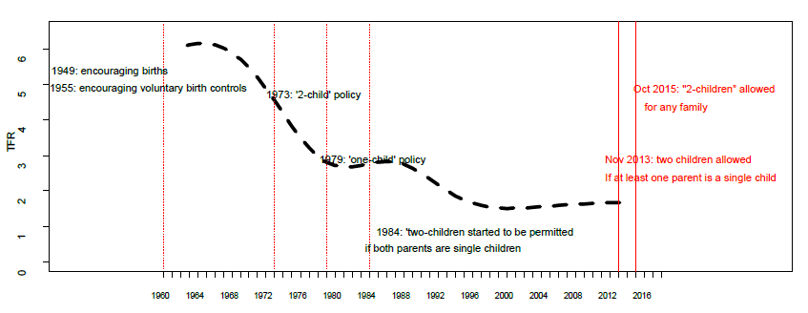
Evolution of the Chinese Population Control Policy and Total Fertility Rate

Slide 4
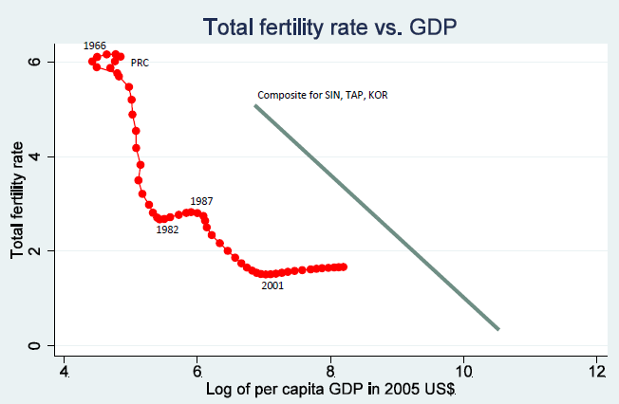

Slide 5
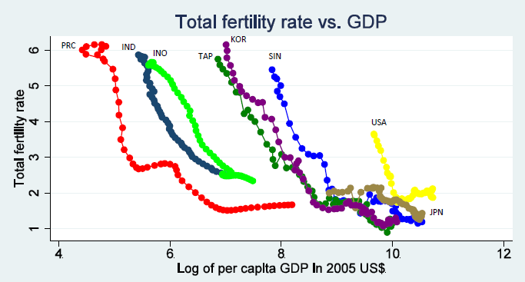

Slide 6
Why do We Care? Growth!
Standard theories link output growth to
(a) the growth of the working age cohort
(b) the dependence ratio

Slide 7
Growth rate of working age population: China vs. USA
China

Slide 8
Chinese working age population peaked in 2011
2014
2011

Slide 9
Inverse of the Dependence Ratio: Share of 15-59 Cohort in Total Population
2009
PRC
India
USA

Slide 10
Bad News for Chinese Growth!
GDP growth rates, savings rate, and current account/GDP peaked around 2011
Life-cycle theory links the working age cohort pattern to these variables

Slide 11
Something More Sexy
The sex ratio pattern plays an important but mostly unrecognized role
Key researcher: Shang-Jin Wei (Berkeley student, now on leave from Columbia GSB at ADB)

Slide 12
Sex Ratio (age 0-14)
PRC
India
US

Slide 13
The competitive saving motive: people save partly due to a desire to improve their status in the dating/marriage market
Can hold in any society
But a rise in the sex ratio both greatly exacerbates its relative importance as a determinant of the savings rate and make it possible to estimate it empirically
The effect can go through the parent cohort
Finding: about ½ of the rise in the household savings from 1990-2009 may be linked to a rise in the sex ratio

Slide 14
Many Implications!
Higher savings and thus higher current account surplus results from a rise in the sex ratio
Relationship between competition on human capital vs physical capital accumulation
Can also have major effects on housing prices
Important for other countries (India …)

Slide 15
High sex ratio region
High sex ratio region
Low sex ratio regions
Low sex ratio region

Slide 18
Impact on Economic Growth
Much evidence that sex imbalances adversely affect crime
But some potential benefits
Entrepreneurship induced by sex imbalance
New domestic private firms – important growth engine – more likely to emerge in regions with sex imbalances
Parents with sons more likely to be entrepreneurs with local sex imbalances
More dangerous/unpleasant work (e.g., mining) by households with sons in regions with sex imbalances
No effect on labor supply of households with daughters
Regional GDP grows faster in provinces with higher sex imbalances
Net Result: possibly extra 2 ppts/year (!)

Slide 19
Effects of Recent Changes in Population Policy
From “one-child policy” to “two-child policy”
Elasticity of child-bearing parents
The short run response is mild: about 20%
Medium term: could rise to 40-60%
On working cohort:
No effect in the next 15 years; then improving
On dependence ratio
Worsening in the next 15-20 years; then improving
On the sex ratio for the pre-marital cohort
Improving

Slide 20
Effects, continued
On household savings and current account
Decline/improving
Will see discussion on the “success of the rebalancing policies of the government” even though it could be an unintended consequence of the changes in the population control policy
On GDP growth
The sex ratio effect: further moderation of the growth rate
The working age cohort effect:
No effect to small further moderation in the next 15 years
Improvement after 15 years

Slide 21
The China Slowdown Question

Slide 22
Motivation: China Growth Downgrades
Notes:
Motivation: Disappointments and downward revisions of forecasts for China’s growth. ADB forecast for this year was 7.4% as of September last year, and over the course of one year projections have been revised down 0.6pp.
Downward revisions not unique to ADB forecasts; see similar downgrade in Consensus Forecasts and IMF forecasts, from above 7 percent [7.1 percent to be exact] in Sept/Oct 2014 to current 6.8 percent.
[For 2016 ADB forecasts 6.7 percent, down from 7 percent in March; Consensus forecast for 2016 is 6.5 percent, down from 6.8 percent in March.]

Slide 23
What exactly do we mean by a PRC slowdown?
Soft vs. hard landing scenarios
How big is the impact on different regions and countries?
Two approaches:
“Standard analysis” - Global Projection Model simulations,
Taking into account GVCs - using inter-country I-O tables

Slide 24
Soft vs. Hard landing scenarios
“Soft landing” scenario
A reduction in GDP growth by 25 basis points /year
Corresponding deceleration in investment
Current baseline - we’ve seen it in the last two years
Relatively “orderly”
“Hard landing scenario”
Sharper and more persistent growth deceleration
~2pp per year for two years)
Accompanied by a spike in global risk aversion
About one-third of a “Lehman” in VIX
Notes:
What might China’s soft and hard landing scenarios look like?
China remains a heavily-managed economy, where the state attempts to—and is often successful at—determining the economy’s rate of expansion.
Authorities target rapid but sustainable growth. The target growth rate has been on a downward trend, driven by long-term factors including shifting demographics, rising labor costs, and the structural shift of the economy from investment to consumption. Authorities had previously been targeting growth of above 7 percent, and more recently aimed for growth of about 7 percent. The recent meetings on China’s 13th Five-Year Plan indicate a further adjustment down to about 6½ percent in the coming years.
It should also be kept in mind that the authorities consistently succeeded in not just meeting their growth target but beating it—so an official target of 7 percent often meant an unofficial target of above 7 percent.
The sustainable rate of potential growth is unobservable, and authorities have to make adjustments based on developments. Especially for an economy like China’s undergoing structural change, it is difficult to identify how much of slowing growth is structural vs. cyclical.
Over the past two years (2014-15), the authorities have managed to stay close to their target growth rate, but it has come at a cost—growth was driven by an unsustainable mix of credit and investment, with much of the financing coming from the unregulated shadow banking sector. There are also worries about increased environmental pressures.
In weighing the achievement of higher growth against the reining in of vulnerabilities, authorities began putting relatively more emphasis on the latter, which was evident in policy actions to rein in credit growth particularly in the shadow banking sector.
One possible way to model this is to assume that authorities’ expectations of potential growth being above 7 percent were overoptimistic, and these expectations gradually adjusted as new data were observed. The updating of these expectations led to a shift in policy, akin to a demand shock. So the shock can be modeled as a negative demand shock of about the size of the shift in their view of potential growth, of about half a percentage point.

Slide 25
Guestimates from Global Projection Model
7 regions (US, Euro area, Japan, China, Emerging Asia ex-China, Latin America, and Remaining Countries); 85% of world GDP
(Aims to strike a balance between DSGE and VAR/time series models)
Developed mostly at the IMF
Can identify shocks, (some) transmission channels, policy responses; gives comprehensive picture, as it contains trade, financial, and commodity price channels
Caveats: (a) no GVCs, and (b) few individual countries
Notes:
GPM: multi-country model developed mostly at IMF, used for forecasting and policy analysis
Seven regions: US, euro area, Japan, China, Latin America, Emerging Asia, and remaining countries (UK, AUS, RUS, ZAF, others). Countries account for 85 percent of global GDP
Modeling approach strikes balance between DSGE modeling (theoretically sound at cost of empirical accuracy) and VARs/time series models (empirically accurate but at cost of theoretical consistency). Just a few key variables are modeled: output, inflation, interest rates, and exchange rates (unemployment also included for G3).
Each region is described by a few behavioral equations familiar/interpretable to most policymakers: an output gap equation, Philips curve, Taylor rule, UIP with risk premia, and Okun’s law. Also incorporates financial-real linkages (bank lending tightness or BLT indicators) for G3 economies [which can substitute for global financial shocks since they are highly correlated across the G3 and affect all regions], and Balassa-Samuelson trend real appreciation in emerging market economies.
China is modeled slightly differently from other regions. It has reserve-requirement ratio as additional policy variable, and exchange rate regime is different—a weighted average of floating and fixing, with the latter getting 2/3 weight.
GPM is “gap model” that uses deviations from equilibrium values (potential output, NAIRU, equilibrium real interest rate and equilibrium real exchange rate). Equilibrium values are unobserved, and are specified as stochastic processes, with lead-lag and stochastic shocks to levels and/or growth rates.
Estimated/calibrated using Bayesian estimation, to ensure that simulation properties are sensible and consistent with priors and data. Allows for estimation even with short samples.
Model also includes world commodity prices (oil, food, and metals), which are a function of the world output gap, and which affect inflation and output.
Advantages of model-based approach to spillovers: can identify/construct shocks to variable of interest; comprehensive global picture; can trace effects through various channels (and in GPM, all main channels present—trade, financial, commodity prices).
But cannot tease out effects on individual countries, and does not capture production linkages very well.

Slide 26
“Soft Landing” Substantial effects on Japan and Emerging Asia, little effect on US and Europe…
Notes:
The GPM simulations of the effects of a soft landing in China suggest that the effects on Asia are non-trivial. While Japan and emerging Asia benefit from lower commodity prices (oil prices are 7-10% lower than they otherwise would have been), these are more than offset by the negative impact through trade. The effect on Japan is larger because the adverse shock to demand combined with lower commodity prices reduce inflation, and the zero lower bound then implies a rise in real interest rates, compounding the external shock.
The effects on the US and Europe, in contrast, are negligible. The trade effects are much smaller, and are offset by the boost from lower commodity prices. [NB: GPM may not adequately capture the growing reliance of shale oil production in the US; lower oil prices may curtail investment in that sector. Nonetheless it remains true that the US economy as a whole is a net beneficiary from lower oil prices.]
[The way we implement the soft landing in GPM is to examine a counterfactual scenario where growth remains above 7 percent, specifically at the rates forecast in the September 2014 ADO Update. Growth is 0.6pp higher in 2015 and 2016, due to greater demand (credit and investment would have been higher than is currently the case). Since we want to talk about the effects of China’s slowdown, we present the results flipped (multiplied by -1).]

Slide 27
Magnitudes of Growth Decelerations During Disorderly Slowdowns (Growth in the 1st 2 years after the event relative to growth in previous 5 years, % points)
What does a “hard landing” in China look like?
Suppose past disorderly slowdowns
elsewhere are a guide…
 | Real GDP | Government consumption | Investment | Private consumption | Imports | Exports
Credit boom-bust | -3.4 | -1.0 | -11.7 | -2.8 | -7.9 | -3.1
Banking crisis | -2.0 | -1.0 | -8.0 | -2.0 | -6.3 | -1.5
Investment slowdown | -2.7 | -2.1 | -23.3 | -2.1 | -14.5 | -3.7
Housing downturn | -2.1 | -0.2 | -7.8 | -2.2 | -6.4 | -3.0
Growth slowdown | -5.0 | -1.7 | -14.3 | -4.3 | -9.7 | -6.2
Notes:
A hard landing scenario where there is a disorderly unwinding of imbalances in China’s economy is a low-probability, medium term tail risk. Potential imbalances can arise from one or more of the following: (i) an unsustainable credit boom that turns into a bust; (ii) an asset market bubble (in real estate or equities) that corrects; (iii) a sharp and sustained drop in investment; (iv) a full-blown financial crisis, triggered by deterioration in the balance sheets of conventional or shadow banks.
Expectations of how much growth might slow under a hard landing vary widely. Based on the tendency of most countries’ growth rates to revert to the mean, Pritchett and Summers (2014) suggest that growth in China could slow to about 4 percent (5 percent if one allows for asymmetric persistence in periods of high and low growth). Haltmaier (2013), Hoffman and Polk (2014) and Albert et al. (2015) describe scenarios where growth slows to about 5 percent. On the low end, Nabar and N’Diaye (2013), Gauvin and Rebillard (2015), and Pettis (2013) describe hard landing scenarios where growth slows to 3-4 percent per year.
Based on the experience of countries that have gone through investment slowdowns, credit boom-busts, housing downturns, and financial crises, the typical decline in growth during such disorderly slowdowns is about 2-3 percentage points. In the hard landing simulation we assume that growth in China is lower by 2 percentage points over a two year period.
[These downturns typically involve both supply and demand elements. The financial sector may become impaired following a financial crisis, for example, and this results in a supply shock (higher cost of capital for producers) but also reduces demand (greater difficulty getting credit for consumption and investment). More generally, on the supply side capital growth may slow during these episodes, or some capital may become obsolete, and there be some skills obsolescence as well if people become employed for protracted periods. On the demand side, On the demand side, lower wage growth reduces consumption growth, and diminished economic prospects can lead to lower investment growth. So to operationalize the hard landing scenario in the model, it makes sense to have a negative shock to demand alongside a reduction a similarly-sized reduction in potential growth. Both of these would be about 2 percentage points. However, negative supply shocks in GPM have a perverse effect—they benefit other countries by increasing demand for imports, since domestic supply is lower. Hence we leave out the supply effect and just model the negative shock to demand.]

Slide 28
One “Hard Landing” scenario
An initial reduction in real GDP growth by 200 basis/year over 5 years
… followed by a tightening of the global financial condition (about 1/3 of the Lehman shock)

Slide 29
Recent Market Turmoil in China led to VIX spiking above 40 for first time since Euro Crisis
China market turmoil
Notes:
Given China’s size and global importance, one could also expect that a hard landing would generate a global financial shock which results in a tightening of global financial conditions. We already saw a preview of this in August, when a stock market swoon and concerns about China’s growth prospects led to the VIX spiking above 40 for the first time since the euro area crisis.
In the hard landing simulation we assume the global financial tightening is about a third of what we saw during the Lehman crisis.
In addition to a rise in global financial volatility and risk aversion, one could also imagine China’s country risk premium going up in response to a hard landing, leading to a depreciation of the yuan.

Slide 30
“Hard Landing” would affect All Regions Negatively
Notes:
In a hard landing scenario where China’s growth falls by about 2 percentage points relative to the current [soft landing] baseline, there are non-trivial effects on all regions of the world. Trade effects are correspondingly bigger, as are commodity prices effects (oil prices fall by 10-25% relative to the baseline), and these two tend once again to cancel each other out for the US and (partially for) Europe. But the additional negative shock that comes from the tightening of global financial conditions results in an overall negative impact—growth is lower by about 0.4pp in the US, and 0.65pp in the euro area.
The effects on Asia are once again large—Japan’s growth would be lower by about 1¼pp, and emerging Asia’s by about 1½pp. Latin America and the remaining-country block would take a hit both from lower trade and lower commodity prices. On the whole, global growth would be lower by just over 1pp, with four-fifths of the effect coming from trade effects and one-fifth coming from the financial shock. [Commodity prices are primarily redistributive, boosting commodity importers while pulling down commodity exporters, but the net effect on global growth is slightly positive as many commodity exporters can use existing buffers to soften the impact.]

Slide 31
If RMB depreciates, China’s slowdown muted, other countries hit harder
Notes:
Finally, what happens if, in the hard landing scenario, the yuan depreciates substantially [by about 10% in real effective terms], due either to a risk premium shock and/or to a decision by the authorities to let the currency weaken to offset the domestic shock?
This of course would be primary redistributive. China’s slowdown is substantially softened, with the depreciation providing an offset of more than 1pp to the adverse shock [the overall slowdown in China is about 1pp, compared to 2¼pp when the yuan does not depreciate]. But other regions’ currencies appreciate (the US, euro area, and Japan), exacerbating the negative spillovers from China’s hard landing.

Slide 32
China Impact: Taking into Account Regional and Global Value Chains
Notes:
While the model-based approach allows us to look at multiple channels and endogenous policy responses, trade and production linkages are not fully captured in GPM.

Slide 33
Assessing spillovers via world input-output tables
Can trace effects on individual countries/sectors
Explicitly accounts for trade and production linkages
Need to specify how much various domestic demand components slow in China
Limitations: uses production linkages as of 2011; static model (no adjustment of production in response to the shock); no price/ToT effects; no policy response

Slide 34
Most of China’s recent slowdown has come from a slowing of investment…
Notes:
To use the Leontief inverse, we first need to determine the nature of the slowdown in China, specifically its composition in terms of final demand.
The red line in the LHS chart shows the steady decline in the contribution to GDP growth from investment. From the table on the RHS, when one examines the growth rates over the last 4 quarters of data (Q4 2014 to Q3 2015) and compares it to either the 2010-11 period, the 2012-13 period, or the preceding four quarters, one sees that most of the decline in domestic demand has come from a slowdown in investment.

Slide 35
… and if a disorderly slowdown should occur, it will also mostly come from slowing investment
Credit boom-busts (historical episodes)
Banking crises (historical episodes)
Notes:
Should a hard landing occur, historical experience shows that the bulk of the slowdown will also be accounted for by investment.
During the first two years of the bust phase of credit boom-busts (as identified by Mendoza and Terrones, 2012), investment growth slows by almost 12 percentage points relative to the five years prior; consumption growth slows by almost 3 percentage points.
The same pattern is evident in systemic banking crises (as identified by Laeven and Valencia, 2012), which typically see an 8 percentage point drop in investment growth and a 2pp drop in consumption growth.

Slide 36
… and if a disorderly slowdown should occur, it will also mostly come from slowing investment
Investment slowdowns (historical episodes)
Housing downturns (historical episodes)
Notes:
Investment slowdowns, defined as a sharp and sustained fall in investment as a share of GDP, by definition show a very large (-23pp) slowdown in investment growth [NB: episodes are defined as periods where five-year average investment/GDP is at least 5pp below the previous five-year average.]
Housing downturns show a similar pattern (-8pp in investment growth, -2pp in consumption growth).
The occurrence of more than one of these—say, a credit boom-bust that then results in a systemic financial crisis—leads to correspondingly bigger decelerations in GDP growth and in I and C growth.
[These historical episodes are based on a sample of all countries. Restricting it only to emerging and developing countries shows similar pictures, although the sample of housing downturns in EMDEs is much smaller due to lack of quarterly data on housing prices for most EMDEs. Further restrictions based on openness or resource-rich/poor also narrow the samples substantially.]

Slide 37
When we consider input-output linkages or GVC linkages, it becomes important to distinguish short-run and medium-run effects
In the short-run, because the production relations are hard to adjust, the negative effects tend to be big – perhaps comparable to the hard landing scenario in the GPM simulations
In the medium-term, however, production relations can adjust, and only the location of the final demand would matter. This often implies a smaller negative effect from a fall in the growth rate of China’s final demand

Slide 38
Even if China’s GDP were to fall by 4.5pp, the effects for other countries tend to be more muted in most cases
Notes:
For this exercise, we assume (based on historical precedents shown in the previous slides) that a hard landing in China would result in a 10pp ↓ in I, 2pp ↓ in C, and a 1pp ↓ in G.
Given China’s current composition of domestic demand (where investment is about 40 percent of GDP and final consumption expenditures including both HH and government C is about 60 percent of GDP), this would imply a fall in GDP growth of about 4½ percentage points.
We then trace the effects on other countries/sectors via the Leontief inverse. Among the 40 countries including in the world input-output tables, the spillovers through trade and production linkages are largest for countries in the region—Taiwan POC, Korea, Malaysiia, Australia, and Vietnam are the top five countries most affected by China’s slowdown.

Slide 39
The I-O approach allows us to identify sectoral contributions to GDP declines
5 most affected countries
Selected advanced economies
Notes:
The analysis can be more specific about which sectors in these economies are hard-hit by China’s slowdown. In the case of Taiwan POC, Korea, and Malaysia, the impact is primarily through the manufacturing sector. In Australia and Vietnam, in contrast, the impact is primarily through the mining/quarrying sector.

Slide 40
But … China still accounts for 35-40% of Global Growth

Slide 41
Contributions to Global Growth
Percentage contributions to global GDP growth
Asia continues to account for about 60% of global growth; still fastest-growing region

Slide 42
China Slowdown: Keeping Things in Perspective
“Soft Landing” still much more likely than “hard landing”
China will remain a main engine of growth for the world economy in the foreseeable future
Slowdown inevitable: Pritchett and Summers emphasize how unusual durability of Chinese growth; underemployed labor now gone, there are diminishing returns to capital, hard to boost service productivity, SOEs need reform, heavy debt …
With the changes in the population control/family planning policies, and with continued growth in per capital income, its effect after twenty years will only rise

