Slide 1
Some Consequences of Brexit
Andrew K. Rose
Berkeley-Haas and
ABFER, CEPR, NBER

Slide 2
The Unthinkable Happened
Serious Consequences along Many Dimensions
Focus here on:
Political
Economic

Slide 3
Brexit Result Essentially Unexpected
Polls Close throughout Campaign
But Betting Markets not!

Slide 4
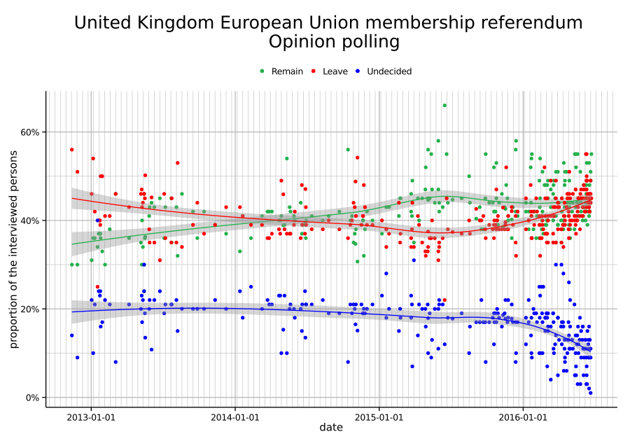
Polls Close Throughout

Slide 5
Not Betting Odds: June 23 (late) had Remain at 76.1%!

Slide 6
Consequence of Surprise/Wording
Since Brexit (mostly) a surprise, consequences not carefully considered ex ante
Also, alternative to “remain” unclear, so massive uncertainty upon Brexit
Referendum wording: “Should the United Kingdom remain a member of the European Union or leave the European Union?”

Slide 7
Political Background, 1
Ongoing Tory skepticism about EU (dating back to PM Thatcher)
Earlier too: EEC entry refused 1963, 1967
EEC 1973 entry (Heath), 1975 referendum (Wilson)
Thatcher wins rebate, 1985
Thatcher falls over Europe (and poll tax), 1990
ERM Crisis 1992
Rise of UKIP 2011-13
Jan 2013: PM Cameron promises referendum, conditional on re-election
May 2015: Tories re-elected in surprise

Slide 8
Political Background, 2
Winter 2016-17: UK “renegotiates” conditions of UK’s EU membership
Recognition that EU has multiple currencies; Eurozone cannot damage EU (can appeal EMU decisions); UK sets regulatory rules for financial services
Feb 2017: PM Cameron sets June 23 as referendum date
Sources of skepticism:
Long-standing, continuing UK nationalism
Ongoing Euro crisis, Grexit, high youth unemployment
European migration crisis
Some high-profile MPs campaign to leave
Michael Gove, Home Secretary; Boris Johnson, London mayor

Slide 9
British Political Consequences
PM steps down; replaced by Theresa May (remainer)
Labour troubles: Jeremy Corbyn weak, UK lacks effective opposition
Possible exit of (pro-EU) Scotland
Nicola Sturgeon demands 2nd Sottish Referendum (within 18m), March 2017
Big problems with Northern Ireland,
Open border with Ireland part of Good Friday accord
Also problems for EU
Post-Brexit Germans look too large; EU becomes more inward/socialist
Also problems for RoW (first signs of nationalism in 2016)
UK less useful for US outside EU

Slide 10
Political Consequences: Sovereignty
Supremacy of EU law violates sovereignty of parliament
But EU laws not imposed solely by Brussels bureaucracy!
EC proposes legislation
Adopted by Council of Ministers (includes British PM) and (elected) European parliament
Also: British parliament can withdraw from EU
All international obligations imply sovereignty loss (e.g., NATO)
But gain influence
As EU member, UK represented twice at international summits
But limited influence within EU

Slide 11
Rise of Nationalism
Benefits of Integration ignored
EU as quintessentially a peace-generating institution
First exit from EU: a dangerous precedent

Slide 12
Rise of Populism
Anti expertise
Destruction of existing institutions instead of reform
Propensity for revolt intrinsically dangerous
Interaction with user-chosen media
Referenda rather than representative democracy

Slide 13
Important Economic Consequences of Brexit
Trade
FDI (especially financial)
Migration
Regulation
Fiscal (EU budget)

Slide 14
Most Obvious Economic Consequence: British Trade
Critical Question: How Important is the EU to the UK?
And how important is the UK to the EU?

Slide 15
Statistical Overview of British Trade
The UK is a VERY open economy!
Export/GDP = 28%
#11 global exporter
Comparison: US 13%; Germany 46%
Import/GDP = 29%
#6 global importer
Current Account Deficit $124bn = 4% GDP (!), persistent

Slide 16
Brief Statistical Overview of British Trade
The EU matters for British trade!
Around 50% British imports from EU
Ditto British exports: half to EU
Only 10% EU exports go to UK: asymmetry
Manufactured; fuel; chemicals;
Supply chains with EU deep, growing: likely disrupted
Services are big, growing fast, and the future
Regulatory harmonization with EU likely more important than tariffs

Slide 17
UK Needs New Trade Deal with EU
Brexit means UK needs a new trade deal with EU (27)
Negotiations painstaking, politically fraught
Requires agreement with 27 other EU countries PLUS European parliament
EU likely to punish UK, deter exiters
Most trade barriers are NTBs, difficult to remove (because protected by special-interests.
Any FTA with EU likely to take long time
Article 50 allows for two years(!)
Can be extended with unanimity
Designed to give most power to EU, not exiter
UK had literally no relevant civil servants before Brexit!
“Free-trade agreements do not come free, do not cover all trade, takes ages to agree”
Started by liberals, finished by protectionists
Canadian FTA negotiations began in 2007 – and they’re Canadian!

Slide 18
UK also Needs Deal with Rest of the World
As EU member, UK has not been involved with trade negotiations for two generations; handled by EU
Brexit means UK needs a new trade deal with RoW
Much easier to undertake inside EU, using its apparatus
EU has 53 FTAs with third countries
Korea, Mexico ... and future ones with US, China, India
All those have to be handled too!
Probably must wait until EU/UK situation clarified
Even creating UK’s own tariff/quite subsidy rules must be approved by WTO
163 other WTO members
Slow moving: think of Doha

Slide 19
Why does This Matter? Open Economies are Richer Economies
LSE Estimates:
Static effects of Brexit: small
Optimistic (Norway): 1.3% drop in income
Realistic: 2.6%
Long run because of productivity effects: 6.3-9.5% of GDP
Other studies give similar estimates: typically negative, less than 5% GDP
Considerable uncertainty because unclear what Brexit entails

Slide 20
Things to Remember
UK has always been extraordinarily open to trade
Ever since industrial revolution, has championed free trade in goods, services and capital
Historical role of Royal Navy
Britain is already more open than most of the world
So it has fewer concessions to give
UK also historically open to foreign ideas and people

Slide 21
So Status Quo Superior to Any Exit
Can UK just “technically” exit but retain access to single market?
Access to single market comes with access to all of single market (labor), and paying dues (Norway, Switzerland), without voice in creating laws
Inconsistent with promises of Brexiters and PM May
Hence likely to exit unless fudge can be found
Trade outside single market painful and expensive
Ex: checking for rules of origin in exports
“Singapore alternative” free trade unilaterally
But some special interests lose (agriculture)
No bargaining chips to induce others to liberalize

Slide 22
Back to Earth
Consensus in Literature: FTAs aren’t that important, because many trade barriers already eliminated
“Harberger triangles” are small
Freer Trade improves welfare, but not that much
Trade linkages are difficult for a firm/country to establish
Created slowly, but usually wither slowly (absent some political shock)
Conclusion: likely a long period of stagnation/gradual closing

Slide 23
Options for Hard Exit
Imitate Norway: join EFTA and EEA
Pay for access to single market, requires labor mobility; hence unlikely
Imitate Switzerland (EFTA, not EEA)
Ditto
Imitate Turkey: FTA/customs union with EU
Standard WTO relationship
Doesn’t handle many tariffs (cars), NTBs, most services (financial!)
Special British relationship with EU
Seems most likely, but difficult to negotiate

Slide 24
FDI/Financial Services
Britain has been a popular destination for FDI because it serves as stable export platform for EU (Japan, Korea, China, US)
Notably in autos, aero-space ... especially financial services
City of London very important to British economy
>2m employees, 12% GDP and taxes, massive trade surplus
Rivals: Paris, Frankfurt, Dublin, Amsterdam ...
What will hard Brexit consist in?
Will UK lose “passporting rights” which allow UK banks/firms to trade across EU?
Again, can’t sensibly discuss effects without taking a stand here

Slide 25
Migration
UK an attractive destination for economic migrants
Free flow of people part of Single Market
But UK not part of Schengen (passport-free) zone
Hence avoided most of refugee crisis
Note: consensus that EU migrants are net fiscal contributors!
Long-standing Tory issue: Cameron vowed to reduce net migration below 100k p/a
Never succeeded; currently over 300k
But antipathy a major reason for Brexit vote
No easy solution
8 million foreigners living in UK (many non-EU)
2 million Brits in EU (more outside EU)

Slide 26
Regulation
Most EU regulations collapse (28) national standards into single EU
Reduces red tape, benefits business
But geared towards European, not British interests
OECD: UK already among least regulated countries in Europe

Slide 27
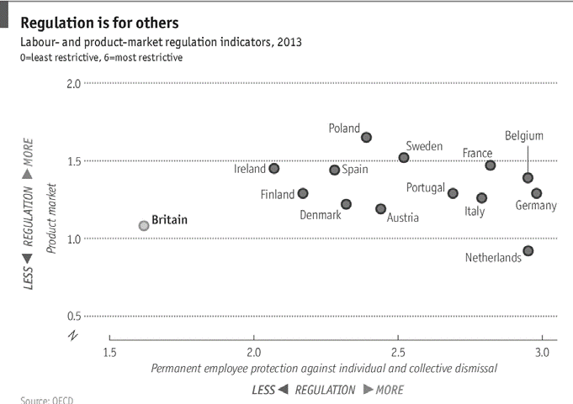
Light Hand of British Regulators

Slide 28
Narrow but Prominent Issue: Fiscal Payments
Lump-Sum Exit bill of ≈₤60 billion (!)
Forgoes ongoing payments ₤340 p/a per household
But net payments are only one-third of this
Estimated benefits: ₤3,000 p/a per household

Slide 29
All Adds up to ... Huge Uncertainty
Hard to resolve in two years!
Especially because:
Status of foreigners in UK
Status of British residents abroad
Incentives of current EU members to discourage further secession
Uncertainty deters investment a lot in practice
Hence support of most British industry for remaining

Slide 30
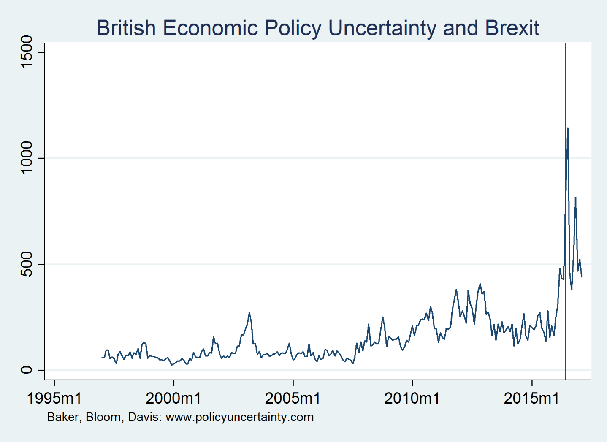
Economic Policy Uncertainty is Quantifiable

Slide 31
Going Forward
Theresa May has opted for a hard Brexit (Jan ’17)
Parliamentary issues mostly resolved: Brexit legislation has passed both Commons, Lords, March ‘17
So far, little sign of economic downturn
GDP growth moderate, unemployment stable
None at all in stock market

Slide 32
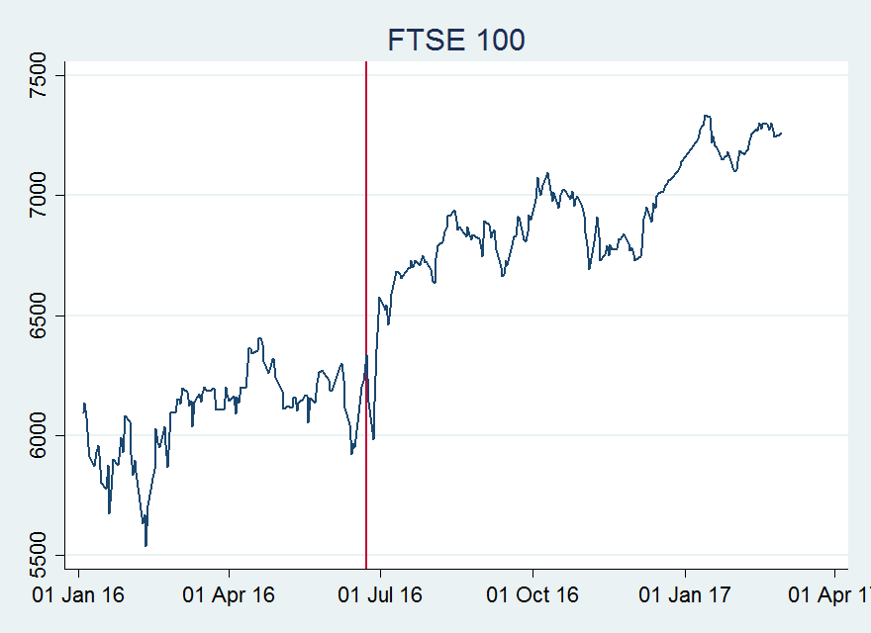
British Stock Market

Slide 33
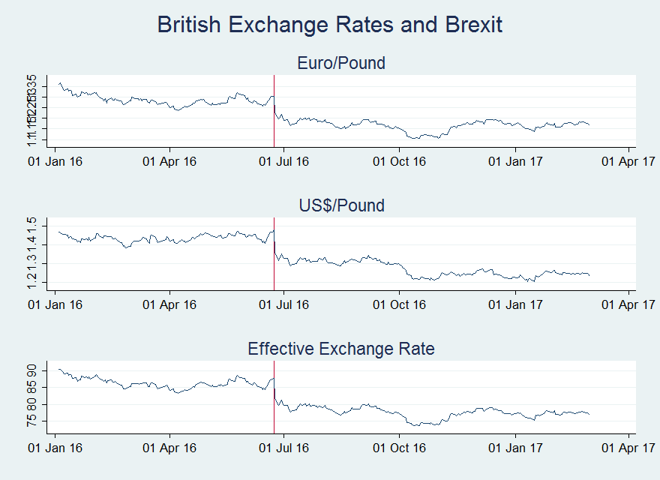
Exception: Sharp, Persistent Depreciation

Slide 34
Summary
Brexit inflicted a number of self-inflicted wounds:
End of political career of PM Cameron, wounding of Corbyn
Possible end of UK (Scotland, Ireland)
Illusory gains in sovereignty
Losses to international trade, FDI, pound, material standard of living
Possible demise of City of London
Little gain in regulatory freedom, fiscal freedom
Increase in uncertainty, especially about migration
Increase in populism, nationalism, tribalism

