Slide 1
Comments on “IMF Reform: The Unfinished Agenda” by De Gregorio, Eichengreen, Ito and Wyplosz
Andrew K. Rose
Berkeley-Haas, ABFER, CEPR and NBER

Slide 2
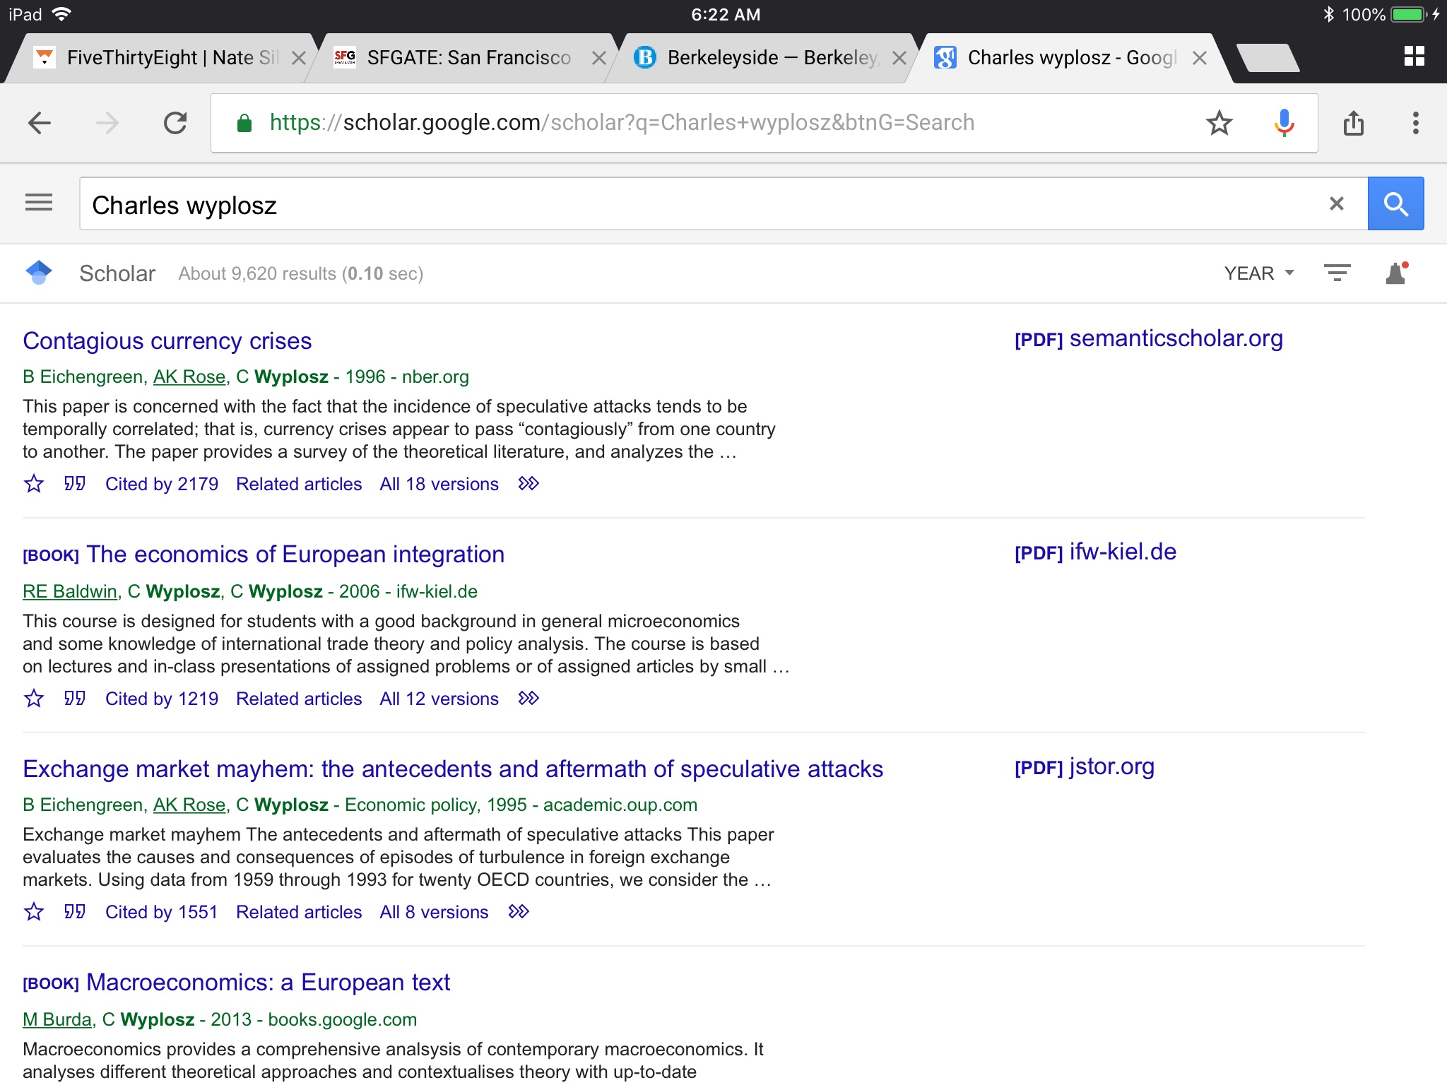
The Reveal

Slide 3
Critique #1: Berating the Fund
Some of the criticisms seem minor, even petty
Little/grudging acknowledgment of Fund’s considerable reforms
Increasing focus on financial flows
More attention paid to emerging markets and developing countries
Transparency (article IV, conferences, data, reports, papers, blogs)
Independent Evaluation Office
“Good Crisis”
Too easy for academics to take pot-shots, so they should be rare, big, and overwhelming

Slide 4
Critique #2: Where’s the Beef?
A Characterization of the Report:
Lots of accurate, fair-minded description
A little analysis
Few conclusions/recommendations
Easy to fix (early draft)

Slide 5
Most Proposals Seem Minor
Unfinished Agenda Is Short!
IMF should try to create formal framework for regional associations
Replace swaps with another pre-approved fast qualification system
After failure of a) CCL; b) SLF; c) RFI ... this one is different!
Make IMF independent and accountable
Choose the right voting schemes
Especially to guarantee French MD and American 1st DMD!

Slide 6
Critique #3: What’s the Case for Independence?
If independent, then accountable … but why independent?
Not like the case for independence of judiciary
Not like the case for central bank independence
What’s the fundamental divergence that makes independence necessary or appropriate?
Ex: What’s the nature of the dynamic inconsistency or special interest?
Ordinarily want governments to make intrinsically political decisions over fiscal affairs
Doesn’t logic extend to IMF?
IMF Is Mostly Fiscal

Slide 7
Critique #3: Independence case, cntd
“The status quo, under which management answers to the Fund’s principal shareholders, makes it hard for the management team to disregard the preferences of the countries with the largest quota and voting shares in the interest of the global good.”
But who defines “the global good” if not the principal shareholders and largest members of the Fund?
Is this a simple argument that quotas are mis-allocated, without saying how?
Special and unvalued role of US$ means that US quota may be too low
Is IMF Independence a Solution in search of a problem?

Slide 8
Summary
A good beginning to what can be a fine Geneva Report
Needs more focus, linkage to IMF
Without fawning, perhaps acknowledge IMF’s successes?
Make the Case for Independence!
Charles: don’t forget who’s behind you. We’ve got your back!

Slide 9
Minor Stuff
Text tends to meander
Much material tangential to IMF
Ex: excessive detail on capital flows, exchange rate regimes, regional monetary funds
Ex: way too much on voting schemes
Any meaningful reform should deal with pre-eminent role of IMF as reserve, invoicing currency, etc.
Academics know that all rules come with escape clauses
Could imagine these academics being angry when escape clause NOT used
Ex: systemic exemption, and Bear Stearns vs Lehman.

