Slide 1
Comments on Foreign Effects of Higher US Interest Rates by Iacoviello and Navarro
Andrew K. Rose
ABFER, CEPR, NBER and Berkeley-Haas

Slide 2
An Important and Under-Studied Question
So good motivation

Slide 3
Issues with Theory
None; the paper is wholly empirical!
So should judge paper by its two empirical parts

Slide 4
Issues with First Step (exogenous monetary policy shock)
None

Slide 5
Only 2 Problems with Second Step (linking foreign output to monetary policy shock)
Data
Methodology
Especially in Spillovers
Choice of Mechanisms
Methodology

Slide 6
Data Problems
50 Countries, 1965Q1-2014Q4
“Hmm”s …
Converting annual to quarterly data
Extrapolating data backwards
Footnote 10: “To avoid dropping observations relative to our benchmark analysis, we fill in the missing observations using backward extrapolation. For instance, we assume that the current account position of a country in 1965-1969 is equal to its 1970 value…”
Affects 26/50 countries!
Most missing data is early in sample, during fixed exchange rate regime (selection bias?)

Slide 7
Some Nationalistic Bitching
P13: “Canada, for instance, was closely pegged to the dollar until 2002, kept a managed floating regime between 2002 and 2010 …”

Slide 8
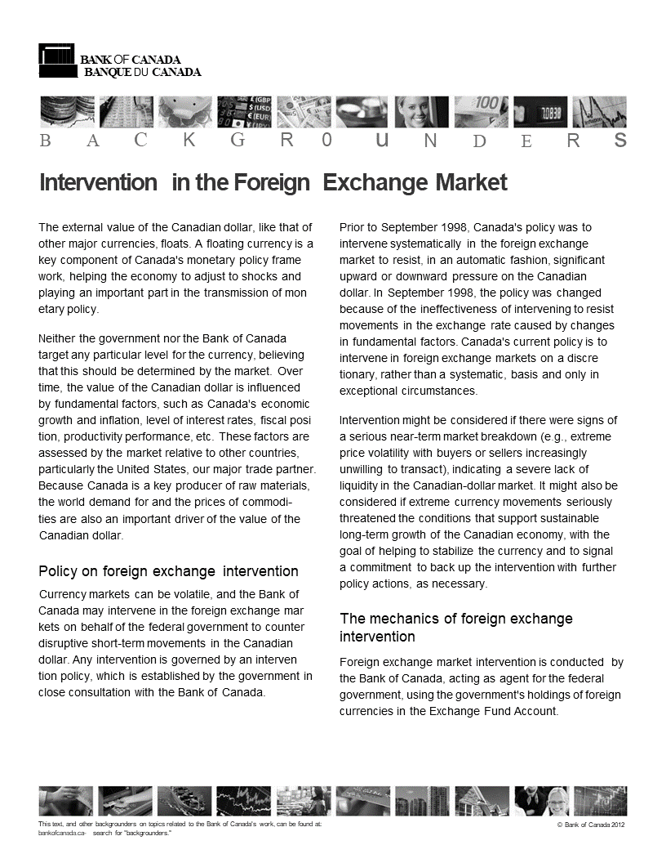

Slide 9
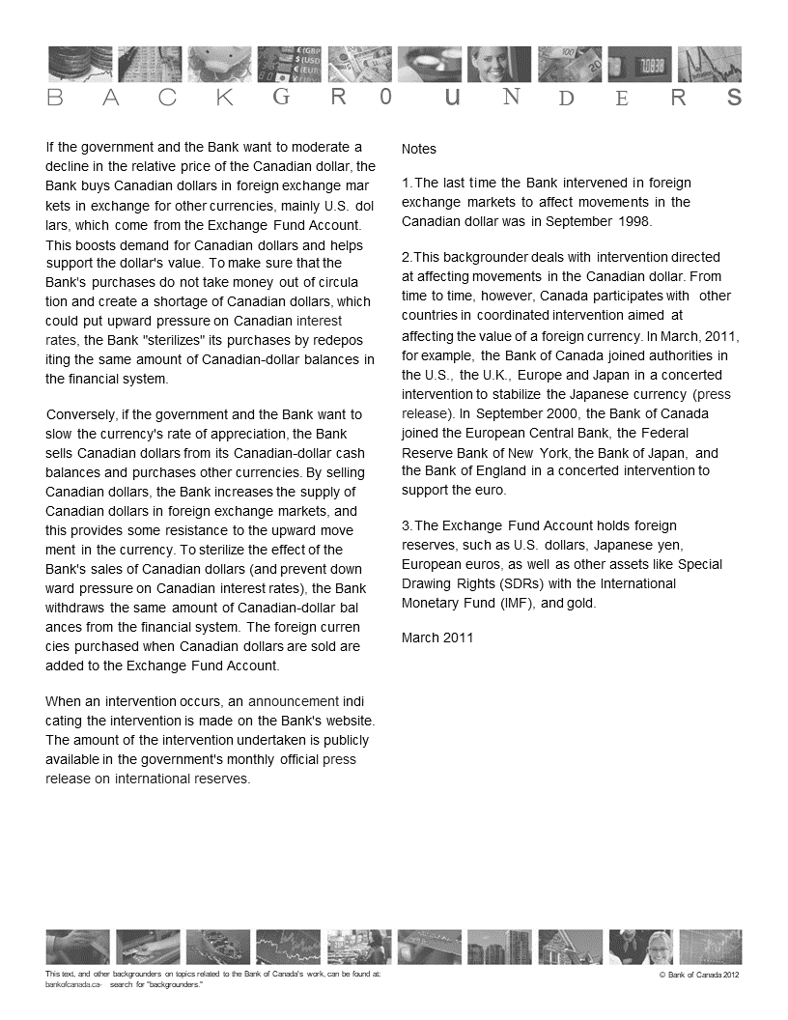

Slide 10
Footnote
“1. The last time the Bank intervened in foreign exchange markets to affect movements in the Canadian dollar was in September 1998.”
Written in March 2011!

Slide 11
Europe: Problematic for $-Bilateral Approach
50 Countries
Some countries moved from 2nd world to 3rd world to 1st world
China, Czech Republic, Hungary, Poland (China has made first step)
Seems odd to estimate time-invariant functions for these
More Serious: Europe per se
12 countries in EMU – a large open economy, mostly unaffected by America after 1971 (compared with Germany)
8 are affected by EMU/Germany more than America
Czech Rep, Denmark, Iceland, Norway, Poland, Sweden, Switzerland, UK
These 19 should be re-centered on Germany (and Germany dropped)
Reason for excessively large number of rich floating exchange rate observations (80%)

Slide 12
Mechanisms
Here:
Exchange Rate Regime against US$
Trade Openness vis-à-vis US
Index of “Financial Conditions” – Vulnerability Index
Itself a principal component of inflation, output gap, current account deficit
Don’t seem mostly financial
Why this list?

Slide 13
What About?
International Reserves (East Asians, Frankel)
External Debt (especially if denominated in FX, Calvo)
Capital Controls (most academics)
Credit Growth (Borio)
Government Debt (Germans)
Asset Price Bubbles (MacroPru types)

Slide 14
Methodology
Why use a PC of 3 variables (inflation …) rather than 9 separately?
Foreign GDP is a cause of US monetary shocks (eqn 1)
Legal?
Note: also caused by US monetary shock
Note: also part of transmission mechanism (in index of financial conditions)
May be hard to disentangle roles

Slide 15
Methodology: somewhat contrived
Ex 1: Interactions of section 5.1 consists of 5 (!) steps:
Standardization
Logistic transformation
Re-centering
Interacting
Recursively orthogonalizing
Ex 2: Index of financial conditions is principal component of 3-year moving averages of 3 fundamentals (inflation, …) truncated at 5%
Is this complexity really necessary?
Simpler is more plausible, perhaps less sensitive
Why not just add interactions directly or split sample?

Slide 16
Bottom Line
Their conclusions:
Using a panel (with cross-section AND time-series variation) is best
Large response of foreign output (≈US) to tighter American monetary policy
Lots of Heterogeneity in foreign responses
Advanced: Tighter trade and FX links (fixing) make for bigger response (classic SOE)
Emerging: Financial vulnerability makes for bigger response
All completely sensible, well-aligned with my priors
Large Number of Issues with Empirics
So … I believe their conclusions
Don’t believe their evidence
No Bayesian updating

Slide 17
Minor
Tabulate results of estimation of (1)
Why 68% confidence intervals?
Dynamic responses of Figure 4 seem way too slow compared to conventional wisdom of Debt and Tequila crises
Foreign effects look permanent … are they?
5.1 and 6.1 are hard to follow
Make figures readable in B&W

