Slide 1
Comments on Frankel’s “Systematic Managed Floating”
Andrew K. Rose
Berkeley-Haas, ABFER, CEPR and NBER

Slide 2
Much to Agree With!
Paper carefully written, full of good ideas and nuance
In fact, I agree with most everything that’s written
A few disagreements in the small
Below, I essentially add another layer “in the large”
Mostly interpretation of things beyond scope of paper
Some new empirical evidence
Same sample of countries, time

Slide 3
Apples to Apples: Regimes & Time
Are countries comparable over the span of time?
Reinhart-Rogoff exchange rate regime classification:
9 countries remain in same regime 1997-2015
But 17 experience at least 3 regimes over same time
Potential source of worry?

Slide 4
Apples to Apples: Financial Openness & Time
Are countries comparable in terms of capital controls over time?
Chinn-Ito classification 1997-2015:
11 countries increased financial openness significantly
5 decreased
Again, potential source of worry?
And countries differ at a point in time …

Slide 5
Apples to Apples: Financial Openness & Space

Slide 6
Just Whining?
My view: don’t do this sort of thing until you’re tenured and chaired at Harvard!
But there is a value for Harvard professors to do precisely this sort of thing to move profession forward!

Slide 7
Switching Gears

Slide 8
Good News: for Effective Exchange Rates, Nominal ≈ Real Volatility, as asserted

Slide 9
OK News: Nominal Effective and Bilateral Exchange Rate Volatility

Slide 10
What about Exchange Rates vs. Reserves?
Paper implies (without stating) a tradeoff exists; countries take a shock either via reserves or in the exchange rate. Does it?

Slide 11
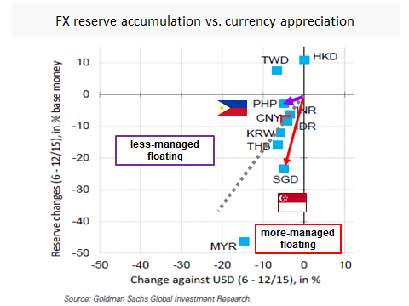
Figure 3 (from the paper, c/o Goldman Sachs)
“Once again, Singapore intervened in the foreign exchange market, while the Philippines took the negative shock more in the form of a depreciation of its currency.”
But:
Dollar depreciation similar for Philippines and Singapore
Reserve changes not

Slide 12
More Generally: Consider Volatility of Reserves and log Nominal Exchange Rate

Slide 13
Reserves over Monetary Base

Slide 14
How does the Exchange Rate Regime Show up in the Data?

Slide 15
Fixes, Floats, and Systematic Managed Floats

Slide 16
Tangent: the Ongoing Mystery of Reserve Volatility Clean Floats have volatile reserves!

Slide 17
Why are We Discussing This?
Unclear to me that there is “Systematic Managed Floating”
But even if there is, should we care?

Slide 18
Defining the Problem Down
Paper examines consequences of exchange rate regime for (responses to shocks of) real exchange rates: Too Easy!
Conventional wisdom since Mussa/Baxter-Stockman: the one thing that varies across exchange rate regimes is the volatility of both the nominal and real exchange rates
“The only systematic regime-specific pattern in the data is higher volatility of the real exchange rate in regimes of floating rates. By way of contrast, the volatility of, for example, output and consumption does not appear to vary systematically with the exchange rate regime.”
Frankel and Rose 1995

Slide 19
More Difficult: Show Regimes really matter
Hard to find manifestation of the exchange rate regime in something real (growth/volatility/inflation …)
In passing: a very low bar for a “major” monetary policy!
So even if there is a well-defined intermediate regime, it may have no substantial consequences for inflation, output, or anything we really care about.
Manifestation of the “Sargent critique“: linking any (macro) price to any price or any quantity to any quantity MAY work, but … mixing prices and quantities almost always fails

Slide 20
Exchange Rate Volatility and Real GDP Growth

Slide 21
Exchange Rate Volatility and Output Volatility

Slide 22
Exchange Rate Volatility and (CPI) Inflation

Slide 23
Exchange Rate Volatility and (GDP) Inflation

Slide 24
Story in a Slide: Case Study of Malaysia

Slide 25
Conclusion
Airplane seats and Exchange Rate Regimes
Preferences seem irrelevant given that consequences are low
Adding middle seats probably adds … but how much?
A Conversation Never Heard
Flaky: eccentric, unreliable, goofy, nutty, odd, wacky
Exchange Rate Regimes are Flaky
Simply don’t matter for inflation/output/growth/volatility
If they did, we would ALL know it
ER Regimes are not Communism vs Capitalism
ER Regimes are of academic interest

Slide 26
Small Gripes
Why ignore interest rates? Standard monetary policy is a completely plausible way to affect the exchange rate
Ignored here: ONLY reserves matter
VIX/Commodity prices seem poor instrumental variables; don’t satisfy either requirement for good IV:
Don’t satisfy exclusion restriction as shown!
Don’t seem to be strong IVs, again as shown.
OLS regressions of exchange rate on VIX/Commodity Prices:
Quantitatively Important in ANOVA sense, or just statistically significant?
Many free parameters in empirical work on India, Thailand, Turkey
Are standard errors Newey-West?

